Slide 1
Economic Simulations and Economic Development
by
Gyula Rábai

Slide 2
Plan
Intro
Computational Economics
Applied Example (DES with Solow-Swan)
Other Techniques:
  Continous Simulation
  Monte Carlo
  DSGE
Agentic Simulations
AI?

Slide 3
The Nature of Economics
Inputs
Model
Outputs
Labour
Solow-Swan
Total Production
Notes:
- Economics works via models
- What are models
- What is the Solow-Swan model
- Application

Slide 4

Big Data
“The organisational structure is currently being reviewed to respond to an increased focus on Data Science, Big Data and the growing importance of digital technologies”
- ONS
Notes:
2.7B youtube users, supply demand graphs
- As well as this
- amount data that is being created
- Limited usefulness (cat videos)
- New technologies needed to process this data into models

Slide 5
Uses for Computational Economics
Test Hypotheses
Find Patterns

Slide 6
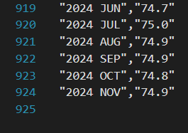
Computational Economics
?
Solow-Swan
Notes:
- What is computational economics
- Why we need it
- Example of why we need it
- How it works

Slide 7
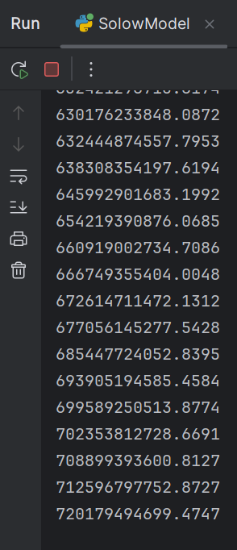
Computational Economics
Solow-Swan
?
Computer
Notes:
- What is computational economics
- Why we need it
- Example of why we need it
- How it works

Slide 8
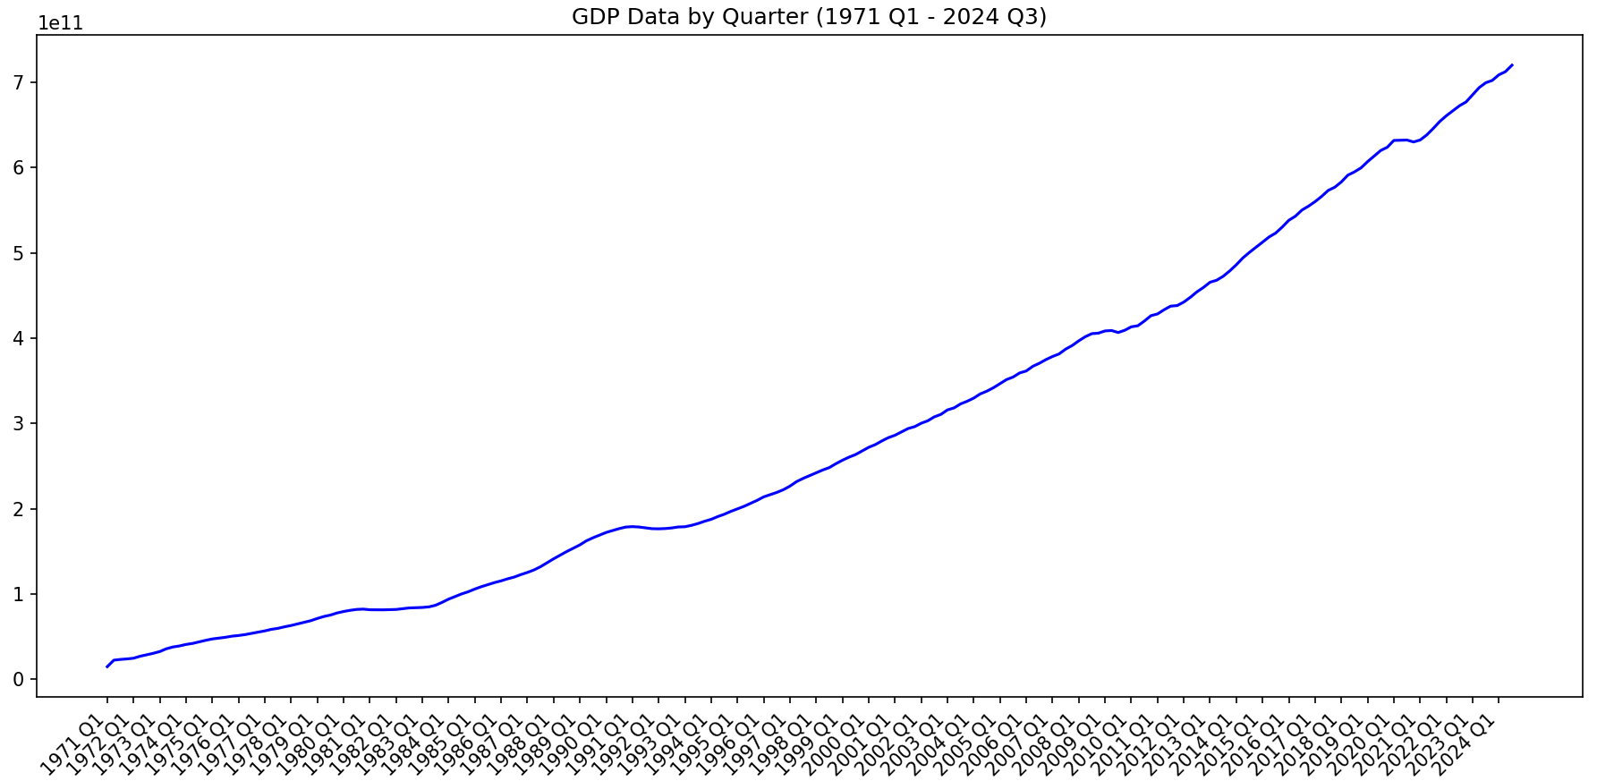
Computational Economics
Solow-Swan
Computer
Notes:
- What is computational economics
- Why we need it
- Example of why we need it
- How it works

Slide 9
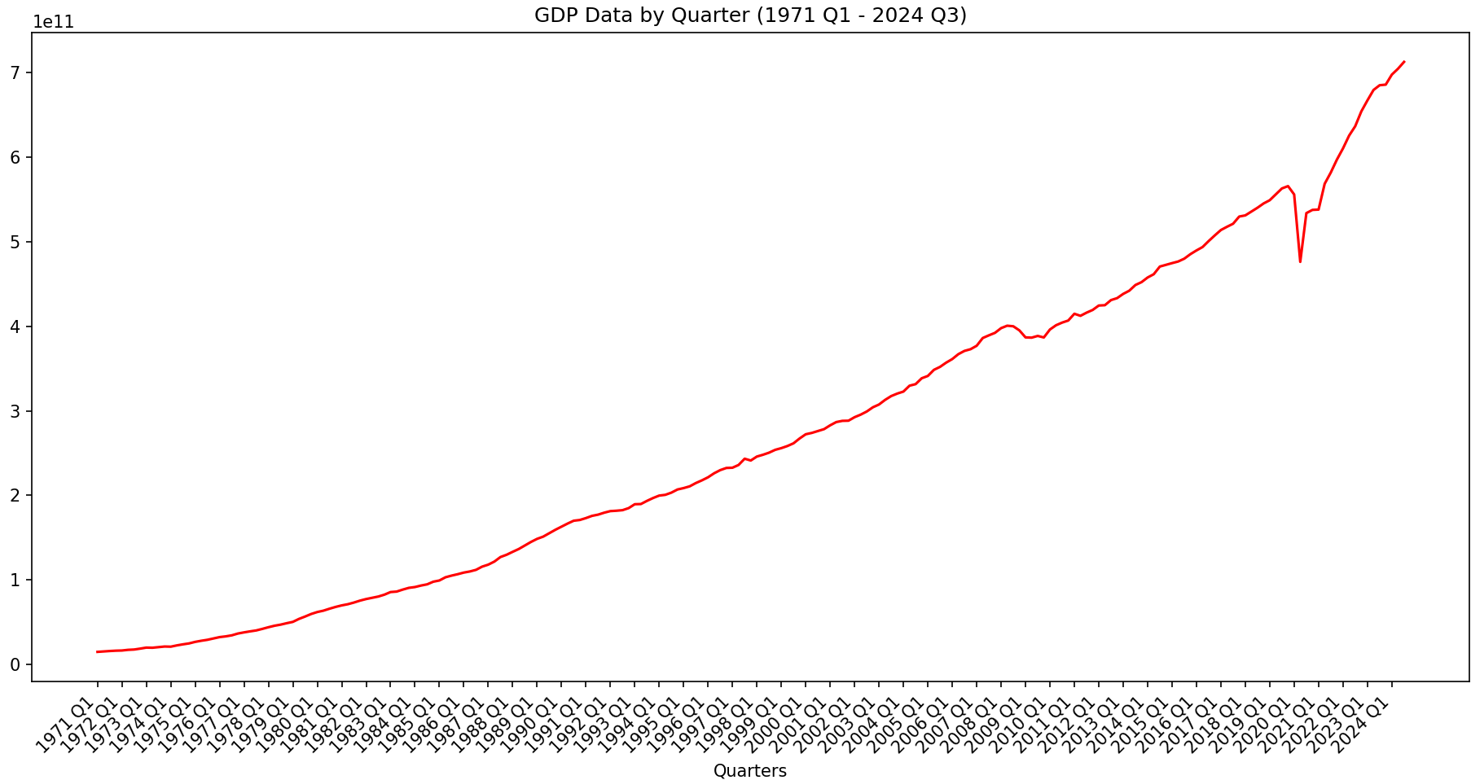
Computational Economics
Solow-Swan
Computer
Notes:
- What is computational economics
- Why we need it
- Example of why we need it
- How it works

Slide 10
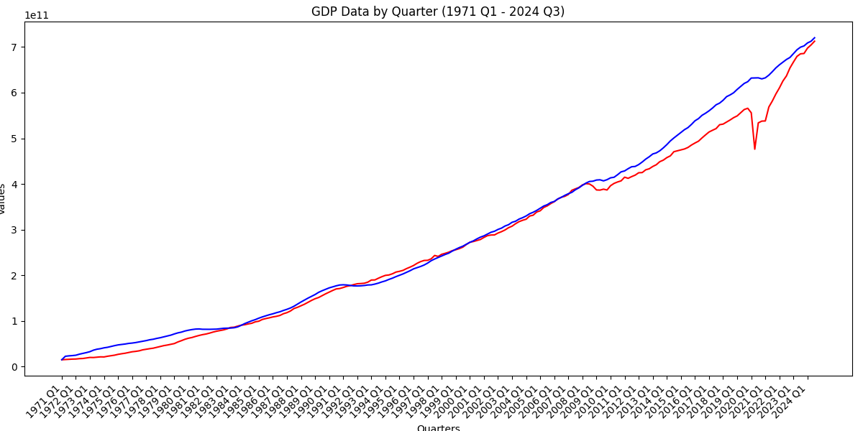
Computational Economics
Solow-Swan
Economic Implications
Evaluation of Accuracy
Notes:
- What is computational economics
- Why we need it
- Example of why we need it
- How it works

Slide 11
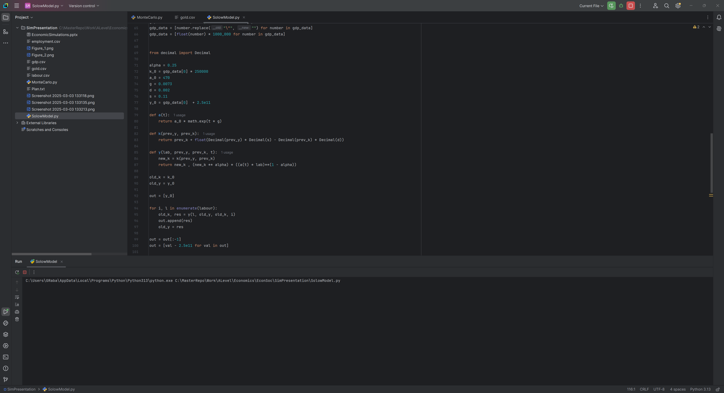
Discrete Event Simulation
Break time down into small units called time steps or ticks
Apply the equations to the data for each time step
Record the data obtained at each time step and put it on a graph

Slide 12
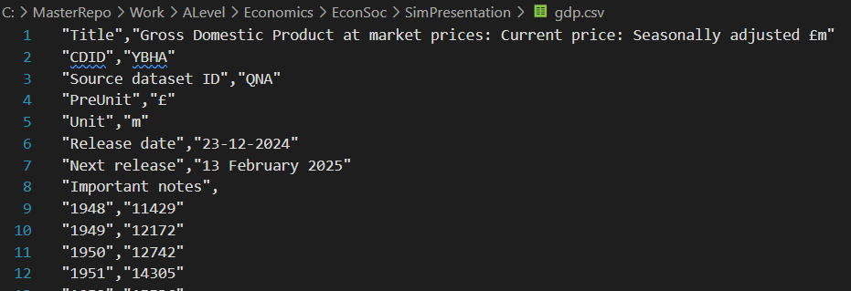
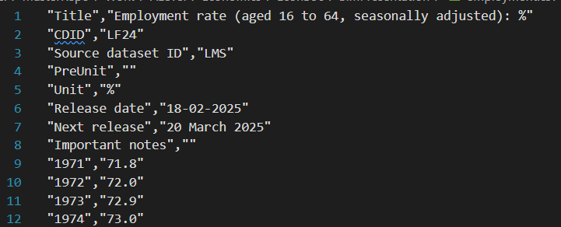
Discrete Event Simulation
Data Sets:
  ‘Employment rate (aged 16 to 64, seasonally adjusted): %’, .csv format, ONS
  ‘LFS: Population aged 16-64: All: Thousands’, .csv format, ONS
  ‘Gross Domestic Product at market prices: Current price: Seasonally adjusted £m’, .csv format, ONS

Slide 13
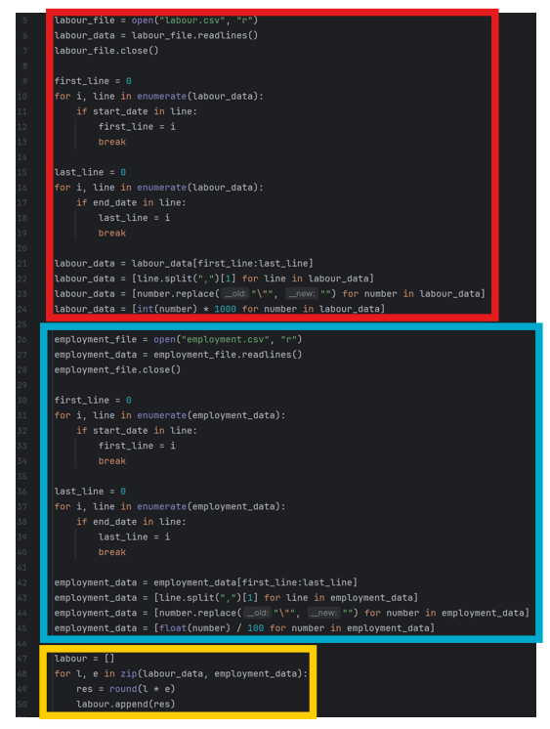
Discrete Event Simulation
Load Employment Rate
Computer
Load Labour Force
Get Total Number Employed

Slide 14
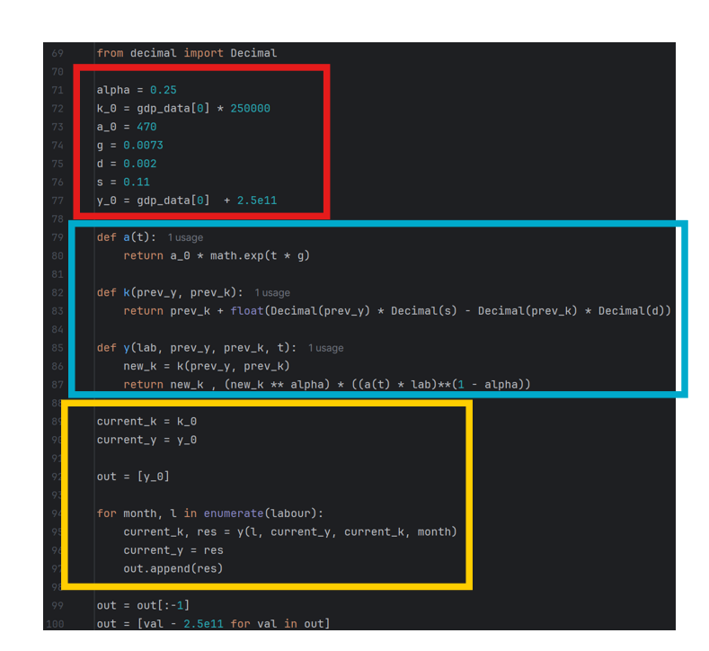



Discrete Event Simulation
Solow-Swan
Constants
Formulae in Python
Caclulate Output
Computer

Slide 15
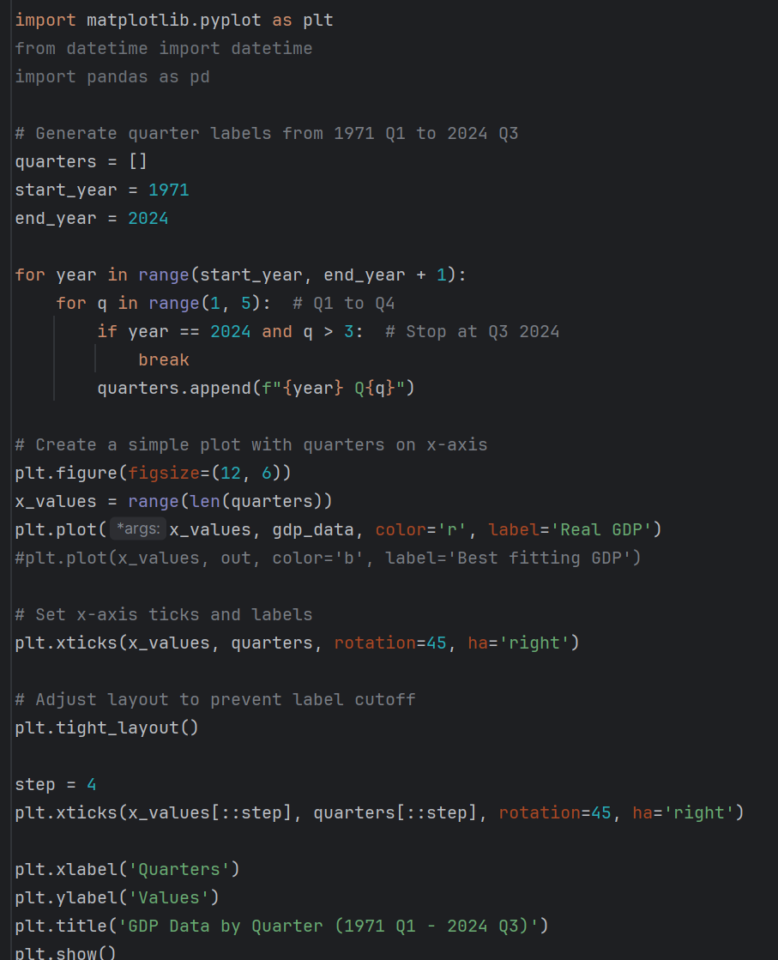
Discrete Event Simulation
Computer

Slide 16
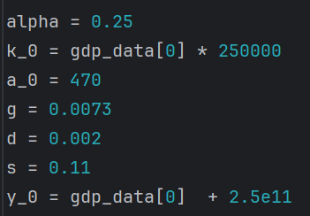
Discrete Event Simulation

Slide 17
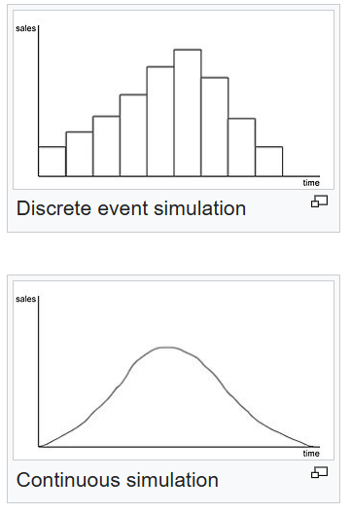
Continous Simulation

Slide 18

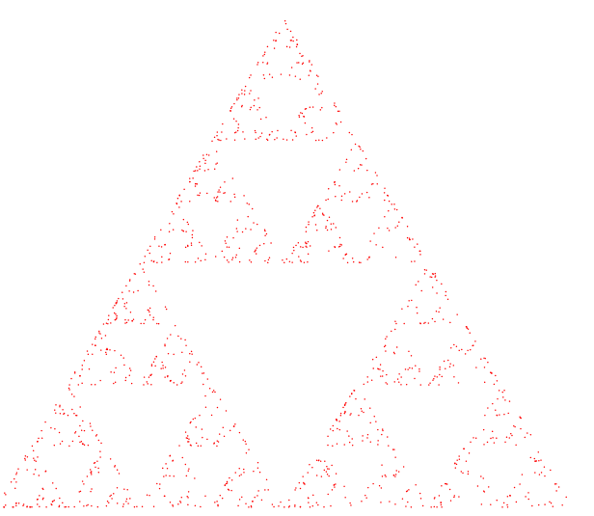
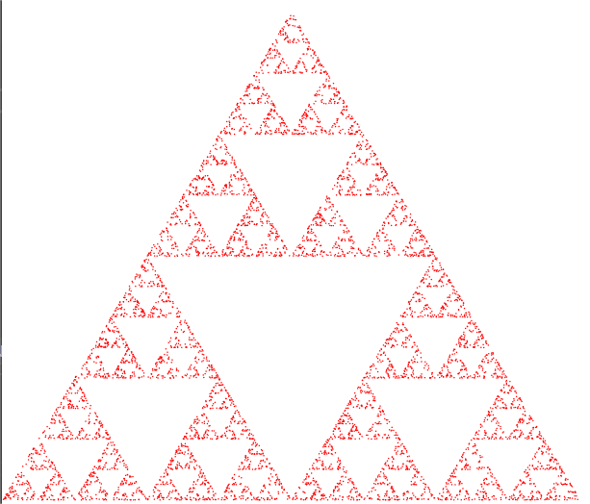
Monte Carlo

Slide 19
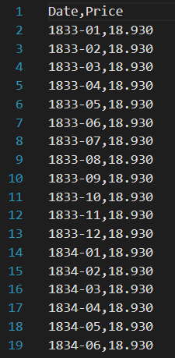
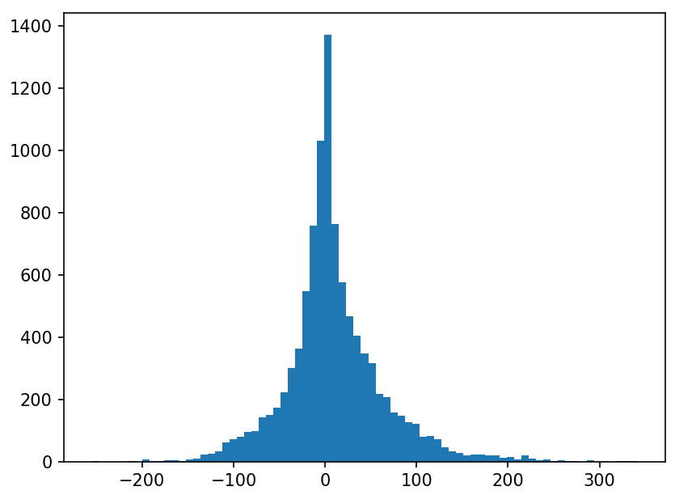
Monte Carlo: Value at Risk

Slide 20
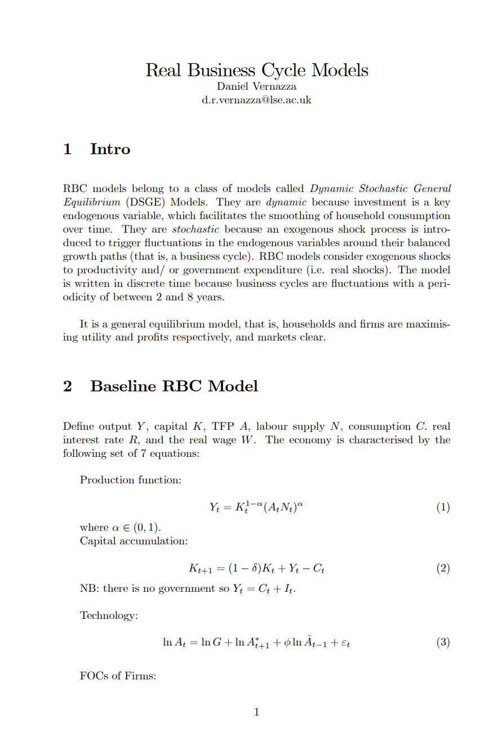
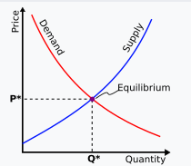
Dynamic Stochastic General Equilibrium

Slide 21

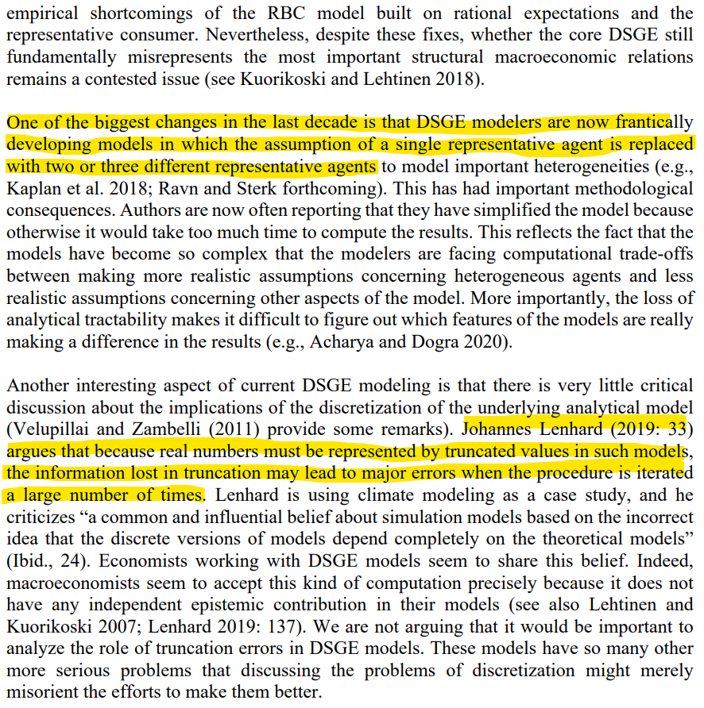
Agentic Simulations

Slide 22
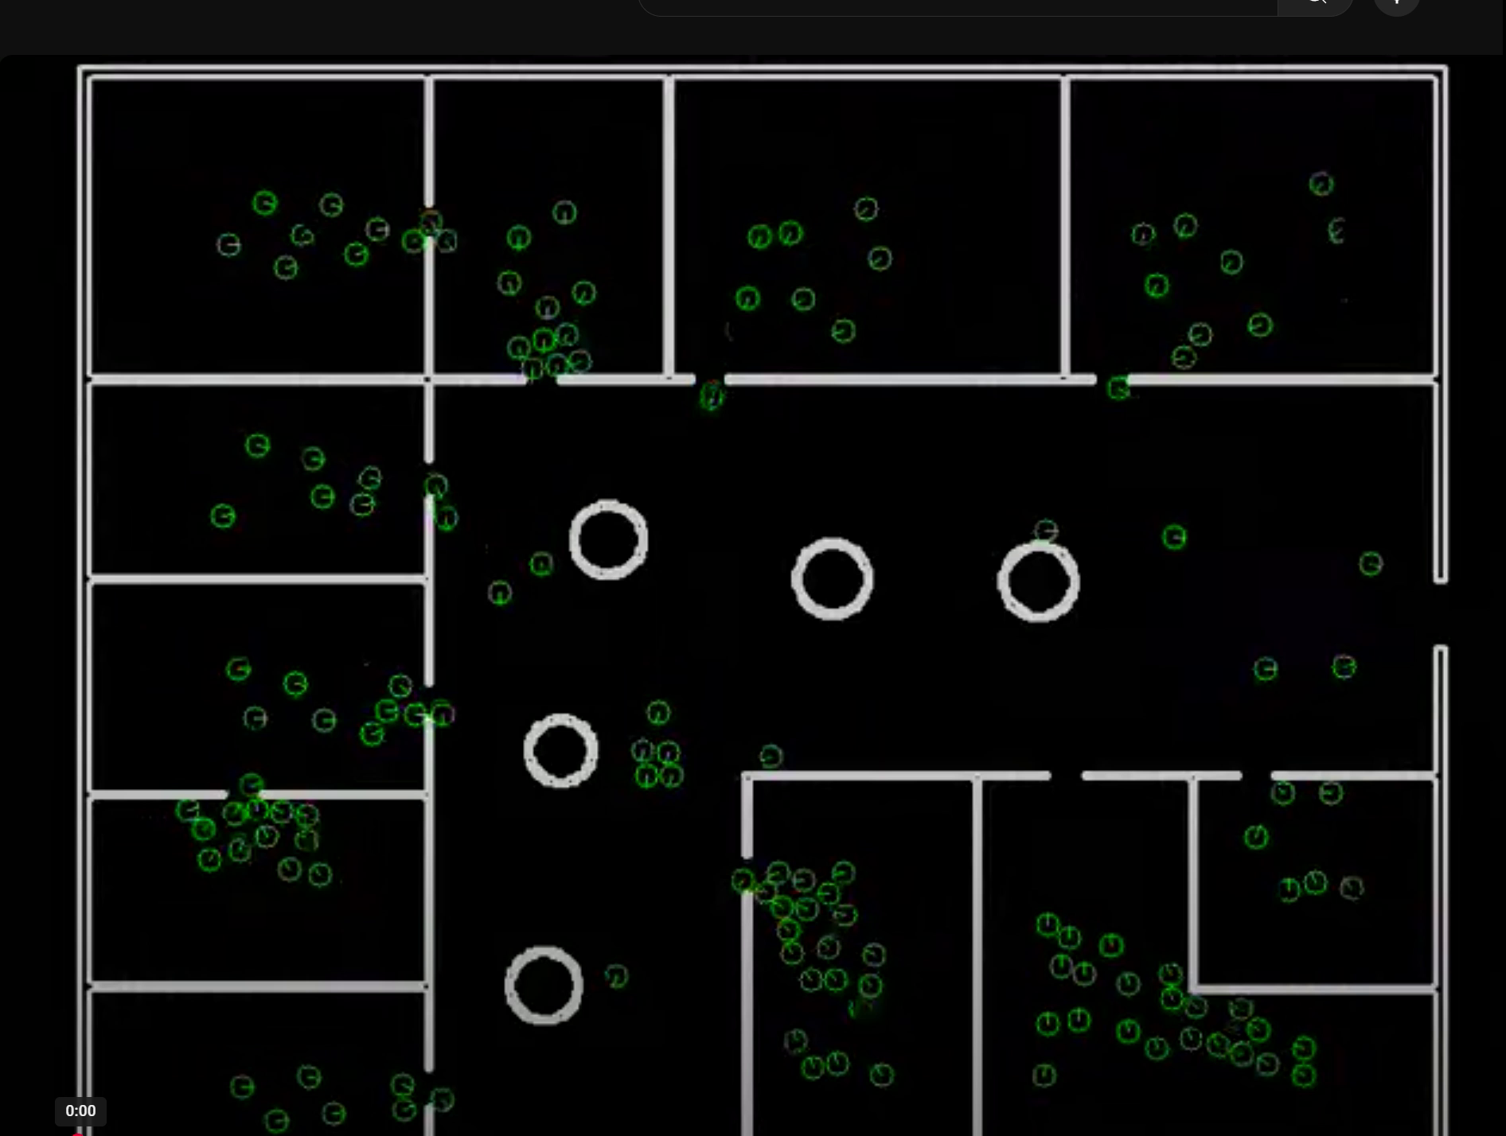
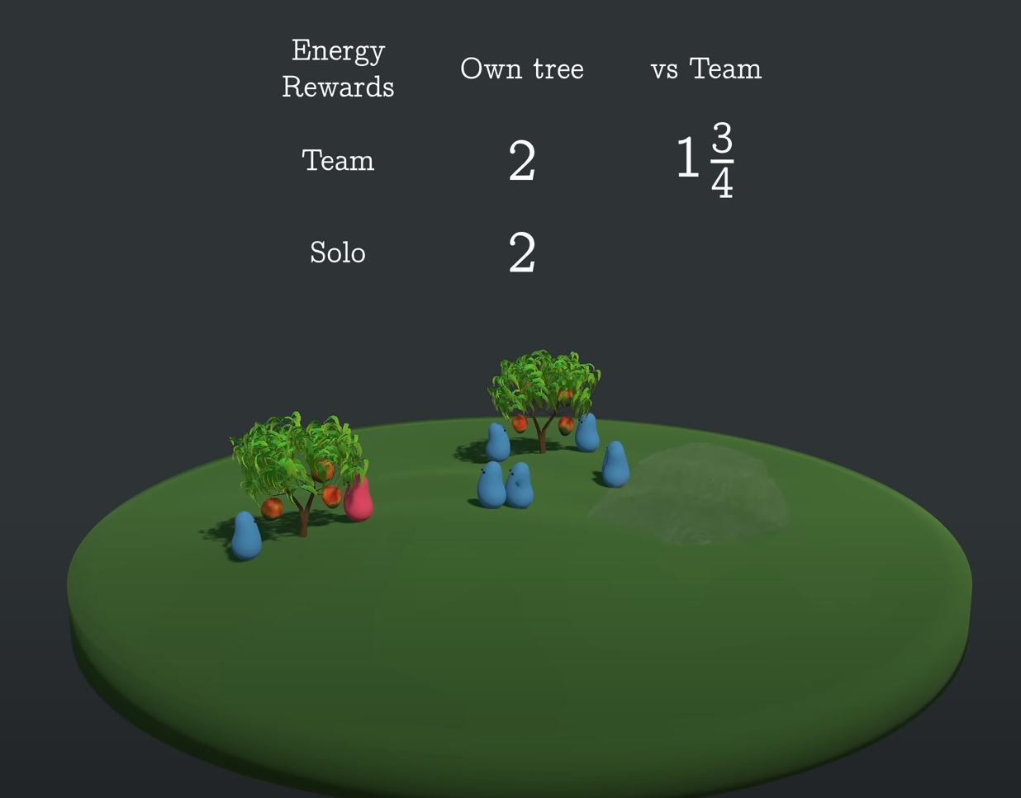
Agentic Simulations

Slide 23
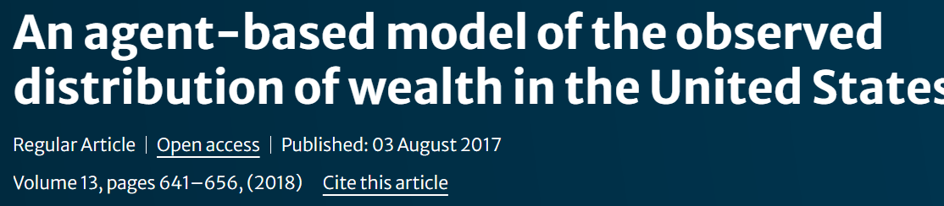
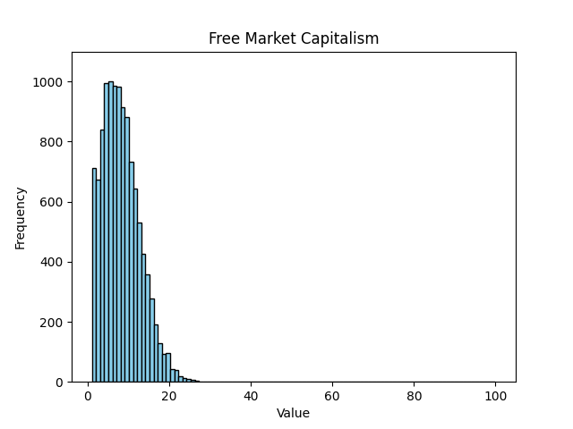
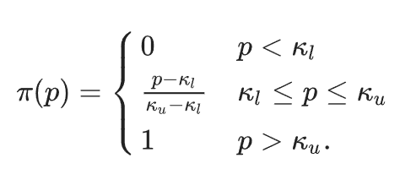
Example: Wealth Distribution

Slide 24
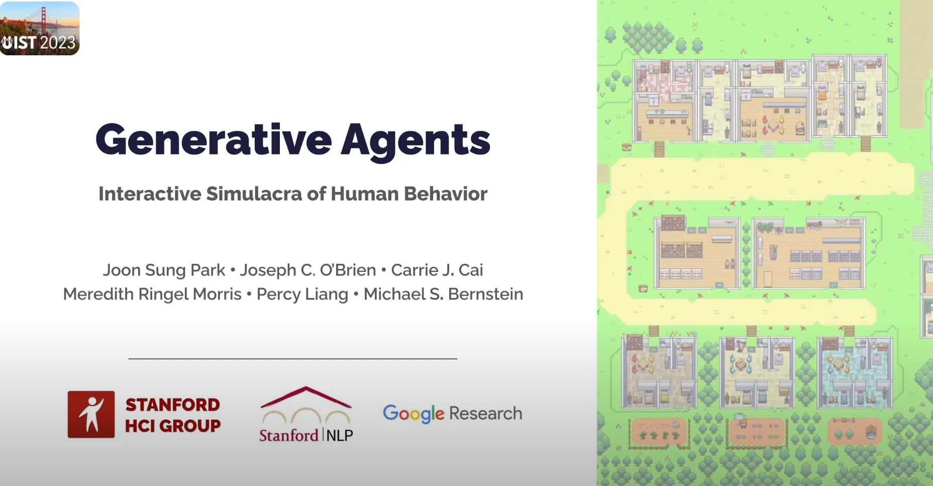
AI

