Slide 1
Abstract Multilinear Algebra
By Gyula Rábai

Slide 2
What is a Number?

Slide 3
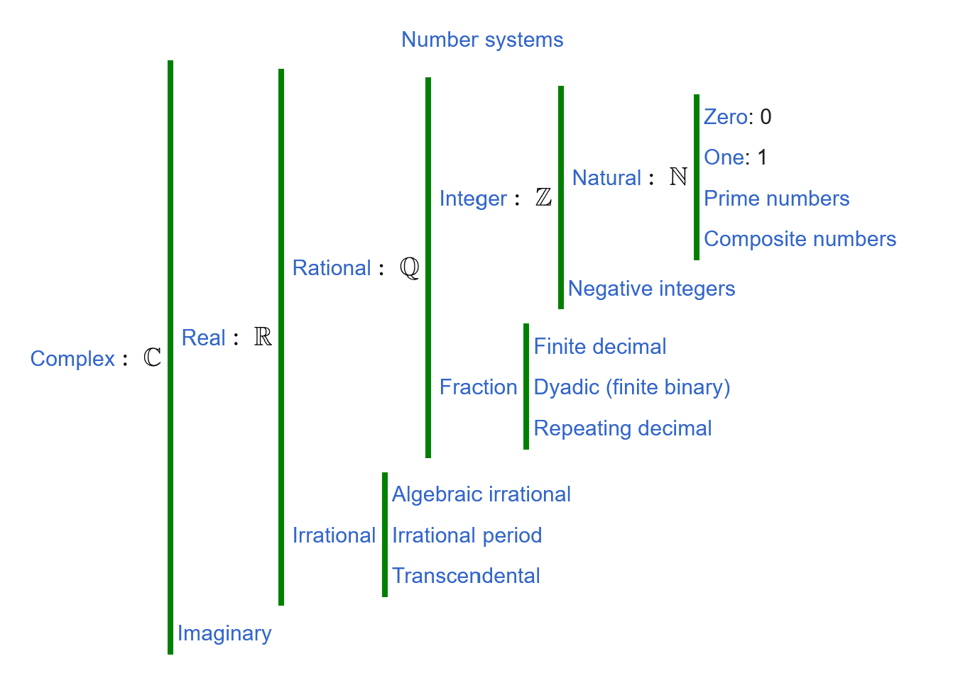
What is a Number?
An element of :

Slide 4
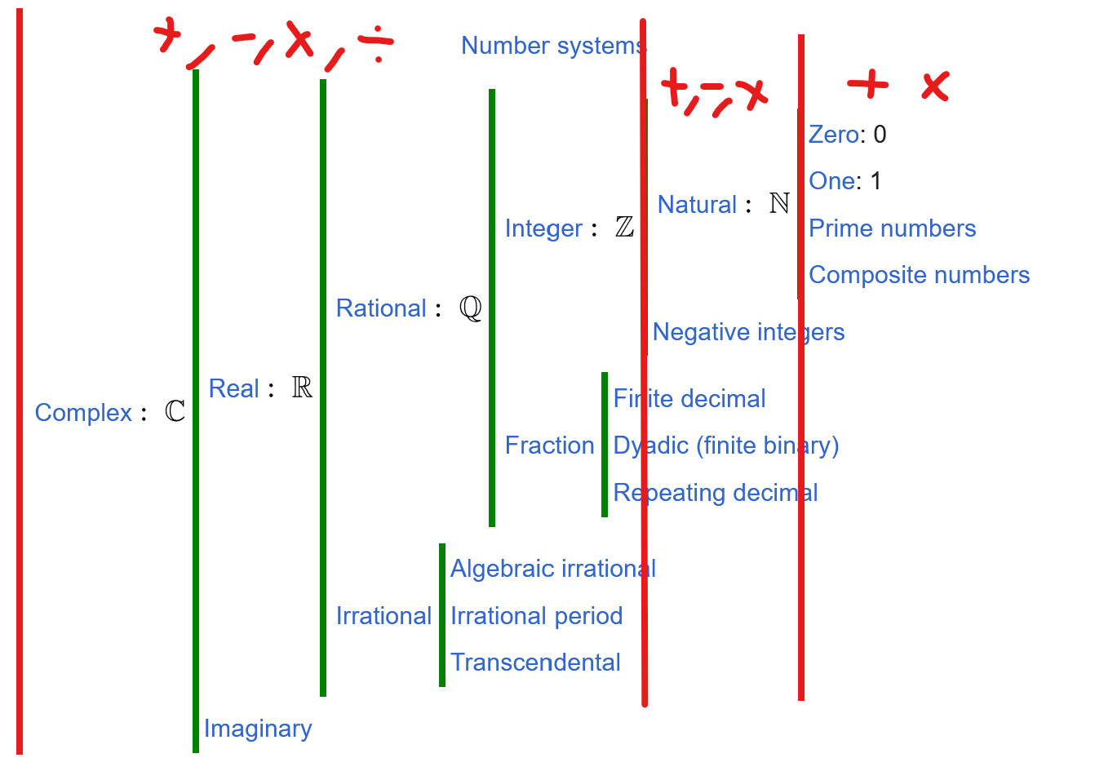
Algebraic Structure of Numbers
Field
Commutative Ring
Free Commutative Monoid

Slide 5
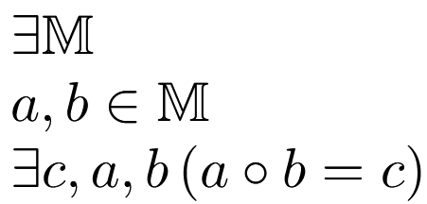
Set
There exists a set M
[Name]

Slide 6
Non-Empty Set = Set + Elements
There exists a set M
[Name]
where a and b are elements of M,
[Elements]

Slide 7
Partial Magma = Non-Empty Set + Binary Operation
There exists a set M
[Name]
where a and b are elements of M,
[Elements]
and there exists an operation on some a and b
[Bin-arity]

Slide 8
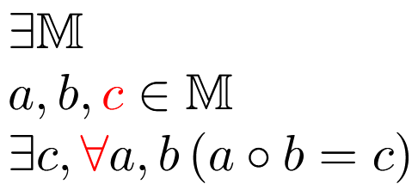
Magma = Partial Magma + Totality + Closure
There exists a set M
[Name]
where a and b and c are elements of M,
[Elements]
and there exists an operation on every a and b
that results in c
[Total Bin-arity]
[Closure]

Slide 9
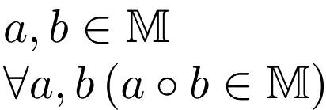
Magma = Partial Magma + Totality + Closure
There exists a set M with elements a and b
[Set]
The result of an operation on any a and b is in M
[Total Binary Closure]

Slide 10
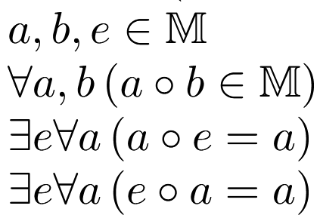
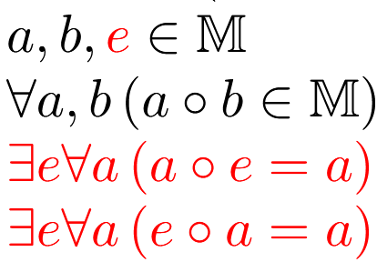
Unital Magma = Magma + Identity
There exists a set M with elements a and b
[Set]
The result of an operation on any a and b is in M
[Total Binary Closure]
There exists an identity element e such that e
compose any other element is itself.
[Identity]

Slide 11
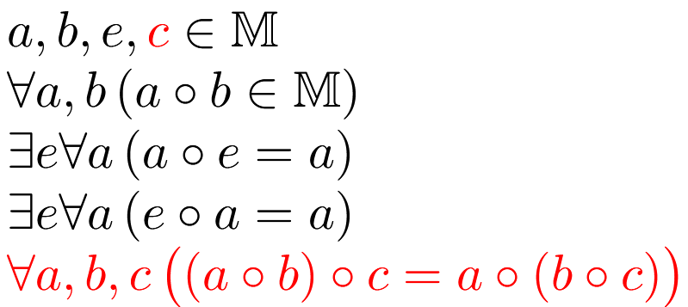
Monoid = Unital Magma + Associativity
[Set]
[Total Binary Closure]
[Identity]
[Associativity]

Slide 12

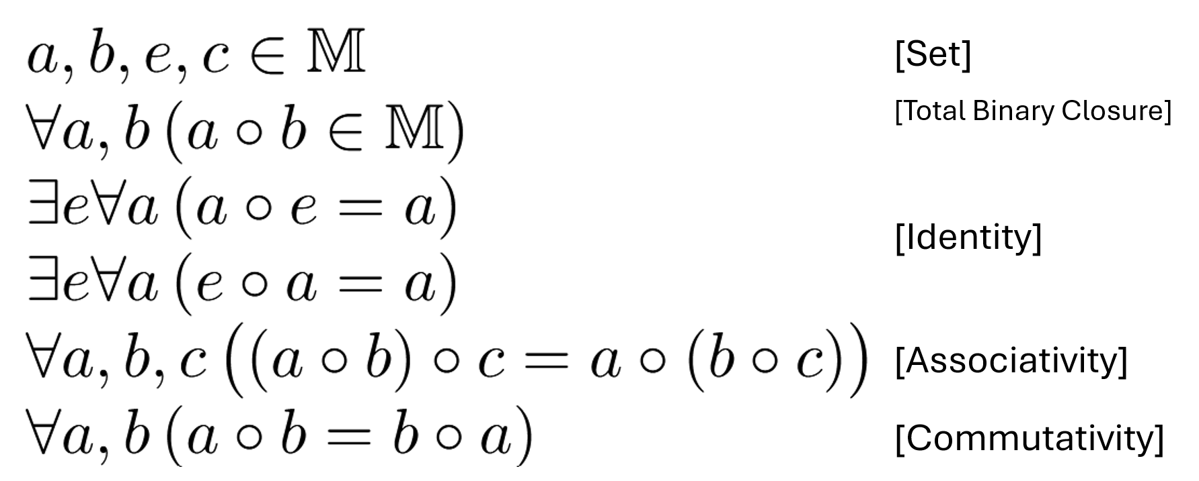
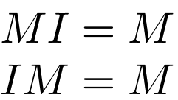

Monoid Example -

Slide 13
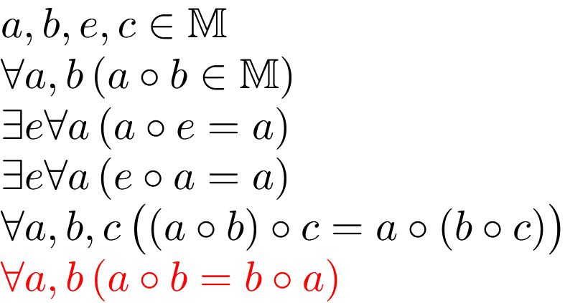
Commutative Monoid = Monoid + Commutativity
[Set]
[Total Binary Closure]
[Identity]
[Associativity]
[Commutativity]

Slide 14
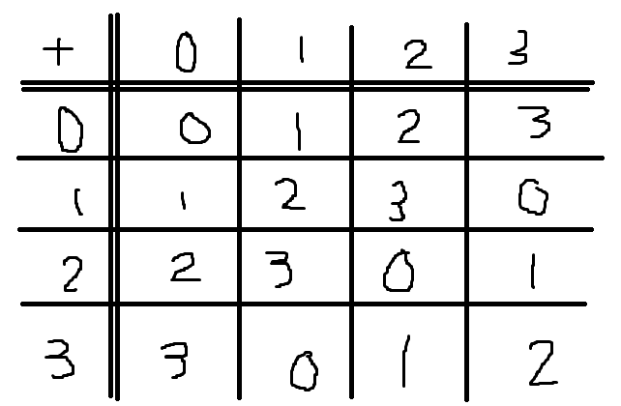
Commutative Monoid – Example N Mod 4

Slide 15
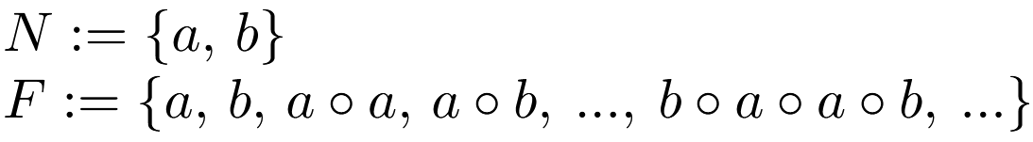
Free Monoid of a Commutative Monoid

Slide 16
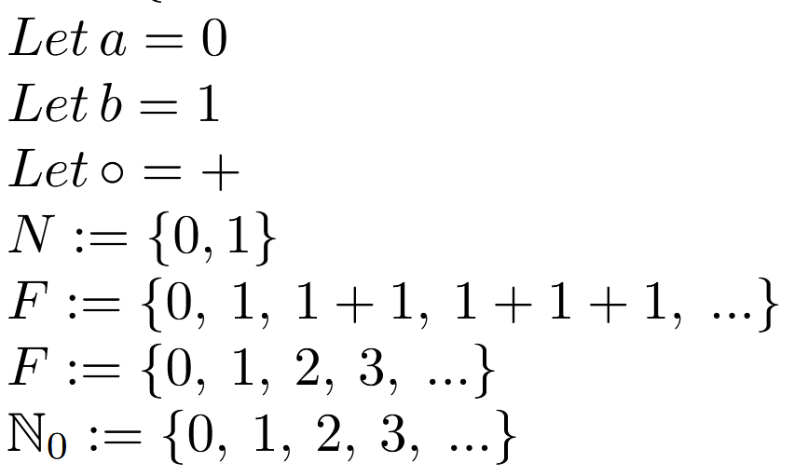
Natural Numbers = Free Commutative Monoid
Counting numbers without counting!!!

Slide 17
Where are we?

Slide 18


Slide 19
Commutative Monoid

Slide 20
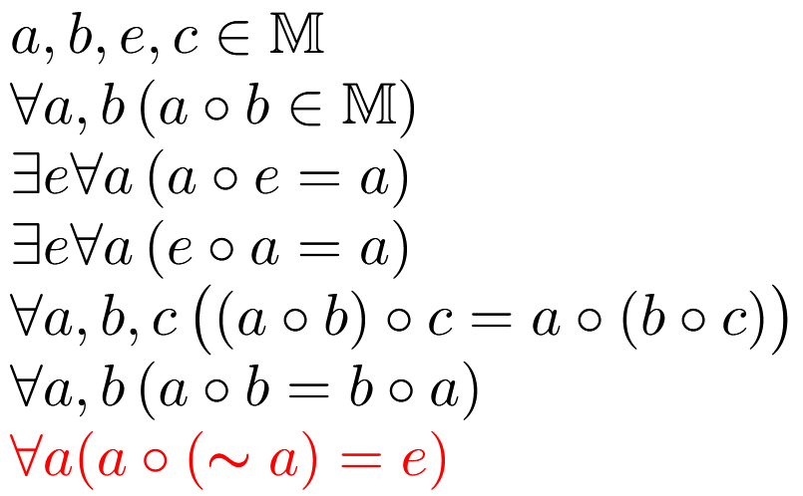
Commutative Group = Commutative Monoid + Inversibility
[Inversibility]

Slide 21

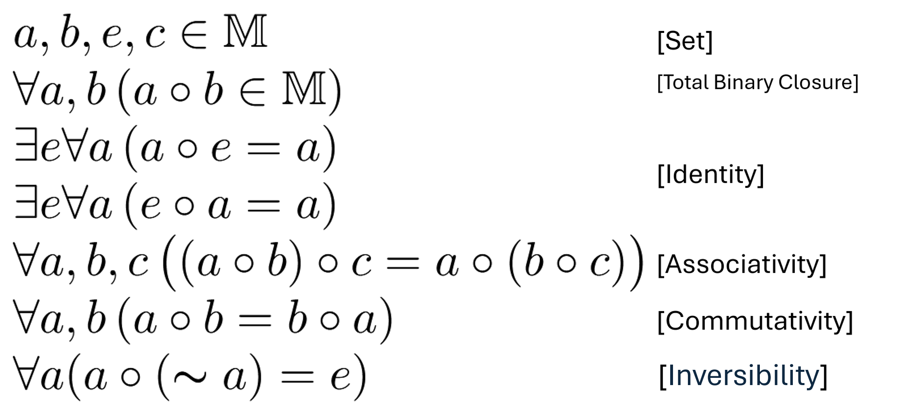




Commutative Groups
Monoid:
Group:

Slide 22
Where are we?

Slide 23


Field = C Group + C Group + Distributivity
[Distributivity]

Slide 24
Where are we?

Slide 25

Ring

Slide 26
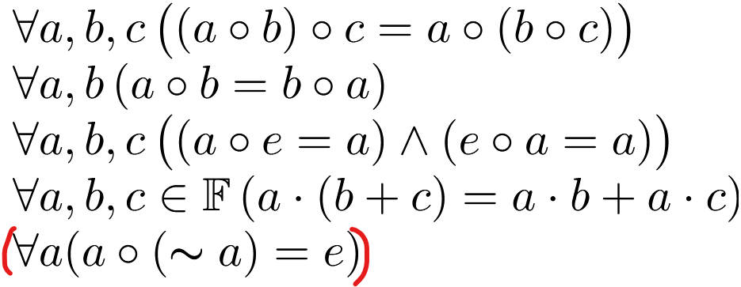
Useful Axioms
Associativity
Commutativity
Identity
Distributivity
(Inversibility)

Slide 27
What is a vector?

Slide 28
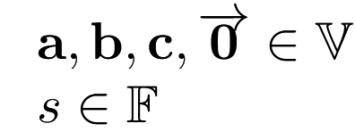

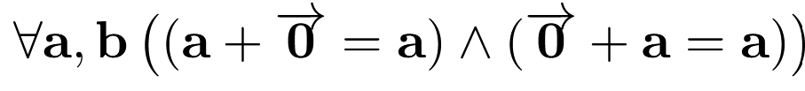
Vector Space = ACID + (Base) Field
Associativity
Commutativity
Identity
Distributivity
Also inverse with scaling by -1; Associative with scalar mul; neutral to 1x but… could not be bothered to latex it)

Slide 29
Matrices are Vectors! (running out of latex)
M+0 = M
M+N = N+M
(M+N)+P= M+(N+P)
s(M+N)= sM + sN
(real proof where we define a matrix as a mapping between V is pretty much the same)
Polynomials, waves, continuous functions, arrows, forces and many more are also vectors

Slide 30
Linear Algebra in 2 slides ^^^

Slide 31
Multilinear Algebra?
Tensor product (x)
Distributivity ((u+v) prod w = …) and (u prod (v+w) = …)
Scalars move anywhere.

Slide 32
Done

