Slide 1
The Quantum Applications of Abstract Multi-Linear Algebra
By
Gyula Rábai
Notes:
Let’s start with a quick summary from part 1. Be sure to pay attention bc it will be very quick

Slide 2
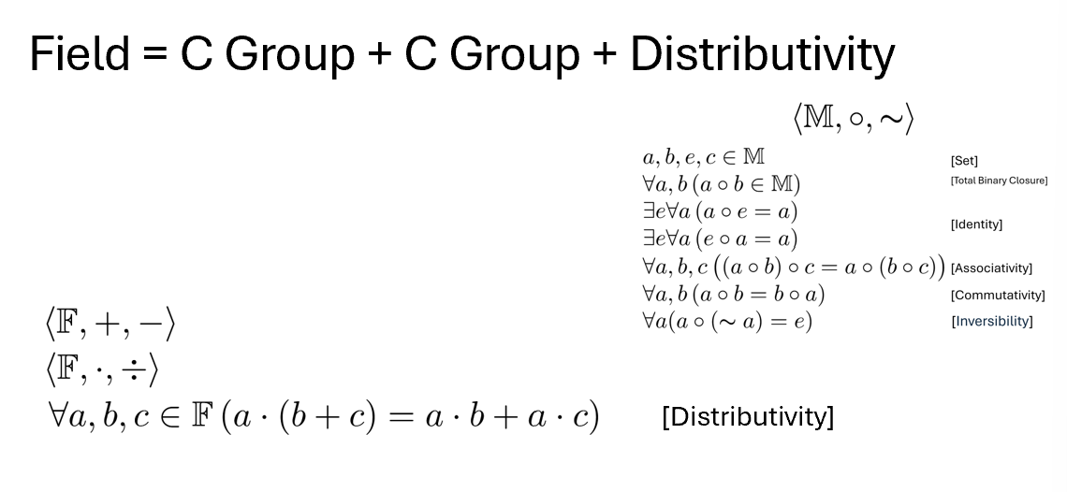
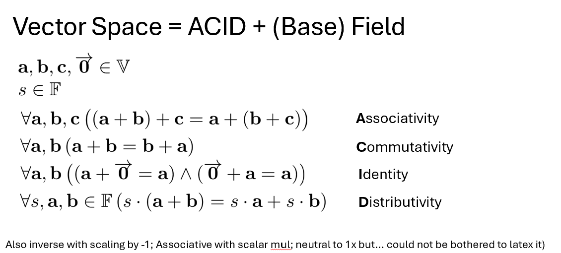
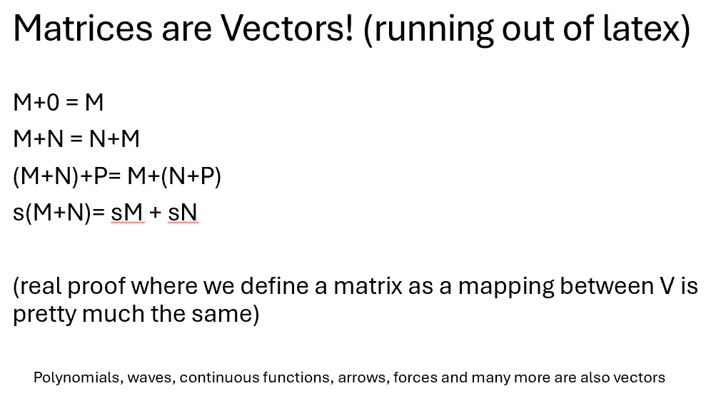
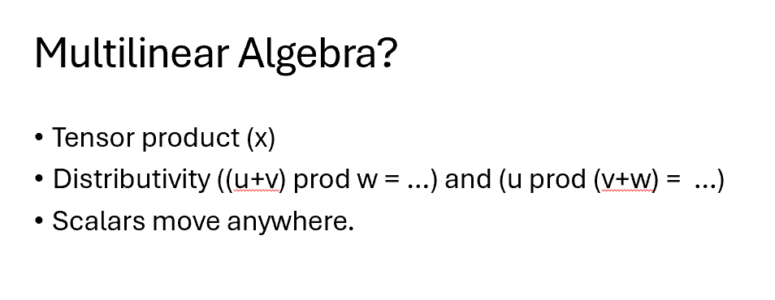
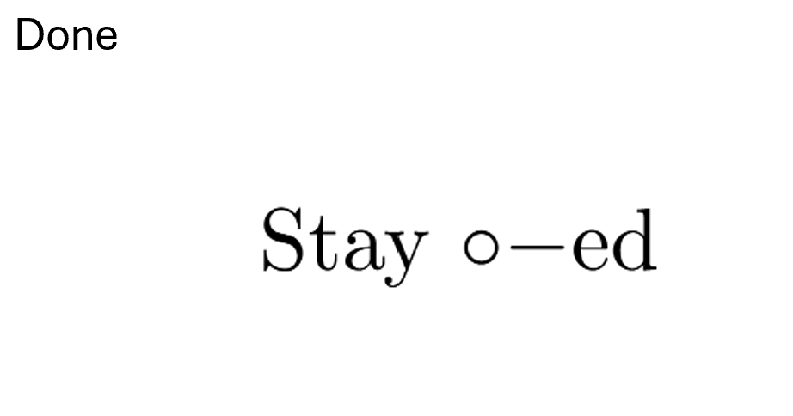
Summary
Notes:
Other than how I progressively ran out of will to use latex we can see how we can make all of algebra just from defining more and more rules on sets.

Slide 3
Did you catch that?
Notes:
OK, now that you are all paying attention.

Slide 4
Summary
Notes:
Latex
Just defining rules

Slide 5
From Set to Magma.

Slide 6
From Set to Magma.
There was a list of things.
[Set]
*Start to all of Maths BTW

Slide 7
From Set to Magma.
There was a list of things called M.
Each pair of things from M could be ‘composed’ to form another thing from M.
[Set]
[Total Binary Closure]
*Start to all of Abstract Algebra BTW

Slide 8
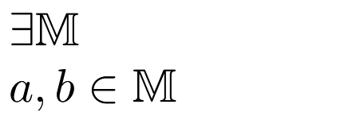
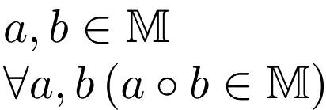
Magma = Set + (Bin-arity + Totality + Closure)
There was a list of things (such as a and b) called M.
[Set]
All possible pairs of things from M can be ‘composed’ to form something else from M.
[Total Binary Closure]
Notes:
Previously I wrote it like this.

Slide 9
Abelian Group = Magma + a lot of rules
There was a list of things (such as a and b) called M.
[Set]
All possible pairs of things from M can be ‘composed’ to form something else from M.
[Total Binary Closure]
The following is true for all possible a, b or c in M
(a ◦ b) ◦ c = a ◦ (b ◦ c)
[Associativity]
There is an e for all possible a where a ◦ e = a
[Identity]
There is an ~a for all possible a where a ◦ ~a = e
[Inversibility]
a ◦ b = b ◦ a
[Commutativity]
Notes:
(all the logical rules have special names btw)

Slide 10
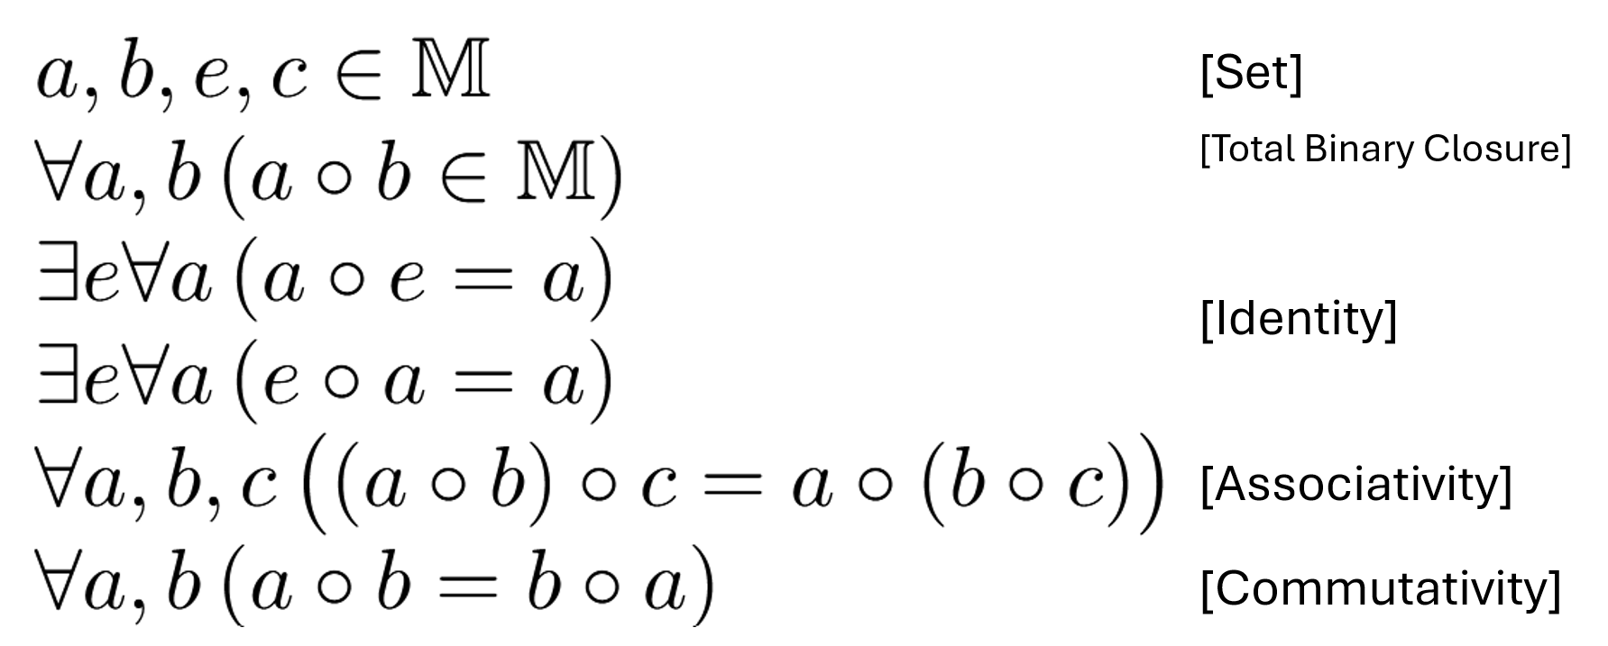
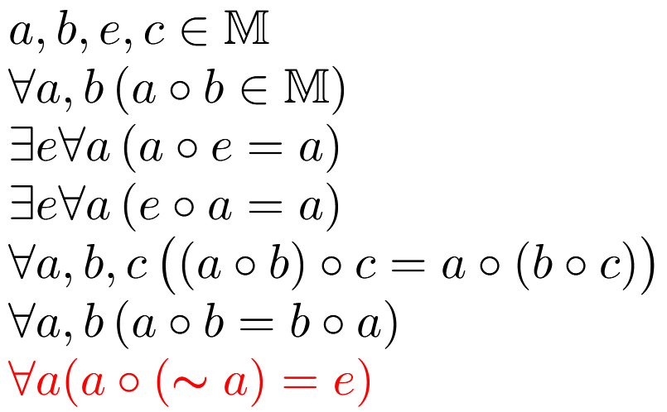
Commutative/Abelian Group
[Inversibility]
Notes:
I never told you what = actually means (all the logical rules have special names btw)

Slide 11
Group example - Integers
For any integers a, b and c:
All integers can add to make another integer [Total binary closure]
a + 0 = a [Identity]
a + (-a) = 0 [Inversibility]
a + b = b + a [Commutativity]
a + (b + c) = (a + b) + c [Associativity]

Slide 12
Commutative/Abelian Group
[Inversibility]
Notes:
I never told you what = actually means

Slide 13
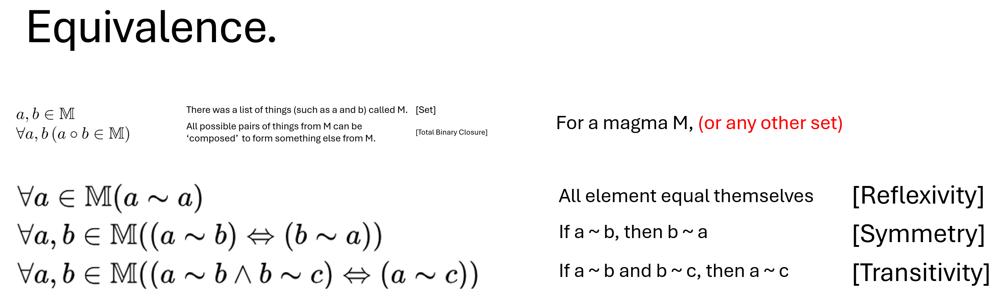

Slide 14
Quotients
Let there be an equivalence where for any integer a:
a ~ a + 2

Slide 15
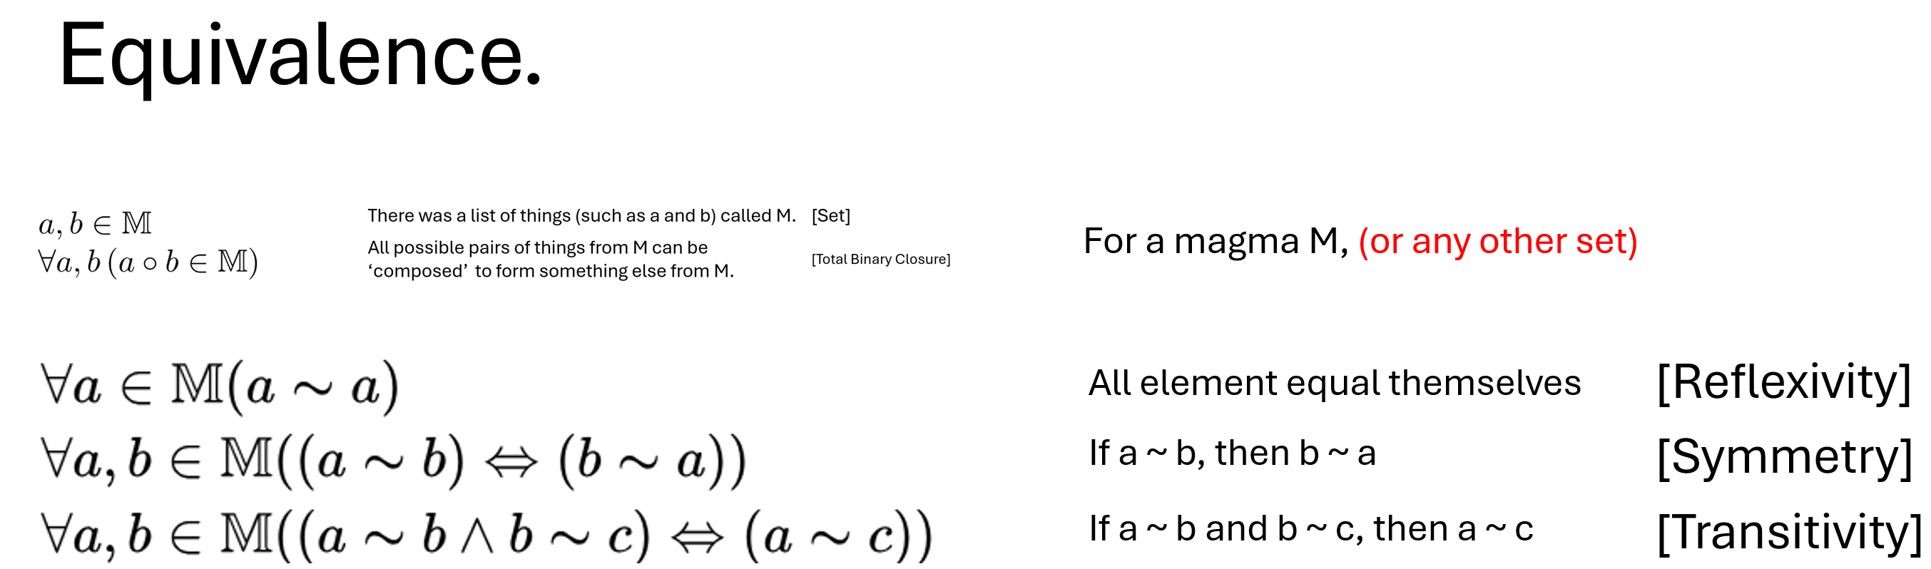
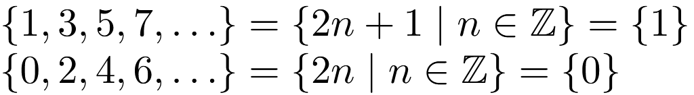
Quotients
Let there be an equivalence where for any integer a:
a ~ a + 2
Here, the only distinction between numbers is even or odd.

Slide 16
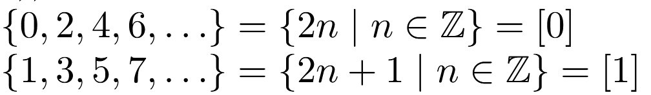
Quotients
Let there be an equivalence where for any integer a:
a ~ a + 2
Here, the only distinction between numbers is even or odd.
These are called equivalence classes and are put in [] generally.

Slide 17
Quotients
Let there be an equivalence where for any integer a:
a ~ a + 2
Here, the only distinction between numbers is even or odd.
These are called equivalence classes and are put in [] generally.

Slide 18

General Quotients
For any* equivalence, you can get the set of the equivalence classes over a set using the mod operator: /
(Note this is not the standard notation for enforcing equivalences. But we never go quantum if we stay bogged down in the notation)
* You generally need to keep the algebraic structure the same:
don’t break the rules you have already set up.

Slide 19
Field summary
You can add and minus (as per a group)
You can multiply and divide (as per a group)
AND
a(b + c) = ab + ac [Distributivity]
E.g. like a complex or real number

Slide 20
A Vector Space
You can add vectors (as per a group)
You can scale vectors with a member of a field.
Vectors are distributive, inversible … with respect to scalar multiplication.

Slide 21
So what about quantum?

Slide 22
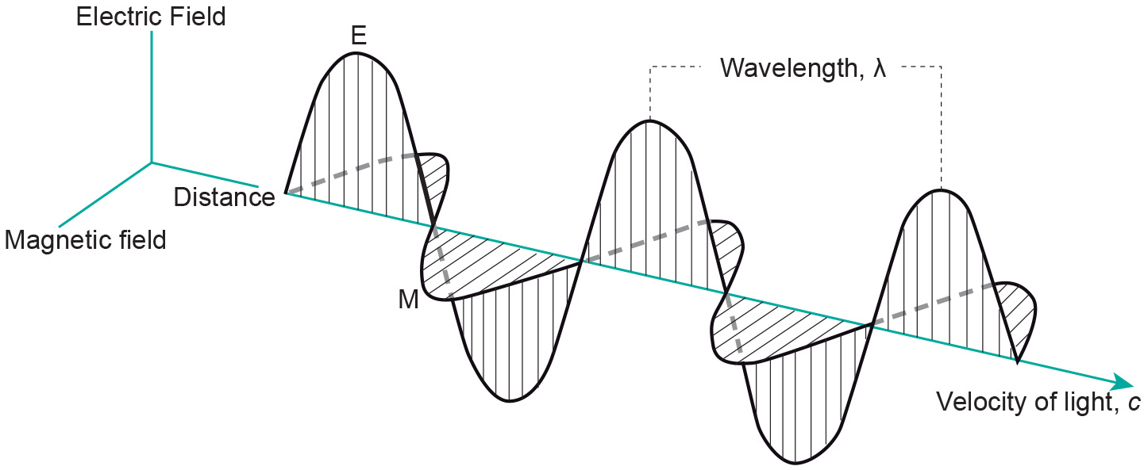
Photon

Slide 23
Photon from the front

Slide 24
Possible Polarizations

Slide 25
Polarisation is a Vector

Slide 26
All vectors are the linear combination of bases

Slide 27
All vectors are the linear combination of bases

Slide 28
All vectors are the linear combination of bases

Slide 29
All vectors are the linear combination of bases

Slide 30


Bases

Slide 31

Superposition

Slide 32
2 Places at Once?
Superpose being here and being there. Each one has a probability. Unfortunately, the more mass the lower the probability that you are elsewhere and not here:
Conclusion: Obesity saves you from quantum teleporting to Mars.

Slide 33

Polaroids Experiment:
Amplitude is meaningless (experimentally).
Probability

Slide 34

Remove magnitude

Slide 35
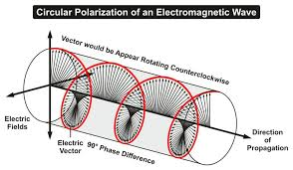
Circular is an Imaginary Polarization

Slide 36

When you multiply by
You get the same polarization because | |=1

Slide 37


Remove Global phase

Slide 38
Quantum Computing
You can let up be 1 and down be 0. You have a qubit!!!

Slide 39
Quantum Computing
You can let up be 1 and down be 0. You have a qubit!!!
Qubits cannot be cloned --> safe way to transfer encryption keys.

Slide 40

Multiple Classical Bits
You take the ‘direct sum’ of the vector spaces representing each qubits states e.g.
V represents qubit 1’s state, W represents qubit 2’s state
This means that we add together the linear combination representing v and the one representing w:
The new vector has 4 new bases instead of 2:

Slide 41
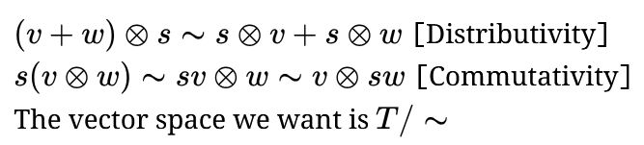
Multiple Qubits
You take the tensor product.
A tensor is a vector space combined of at least 2 other vector spaces defined over the same field as follows
Let us call the resulting vector space T. We introduce the following rules:

Slide 42
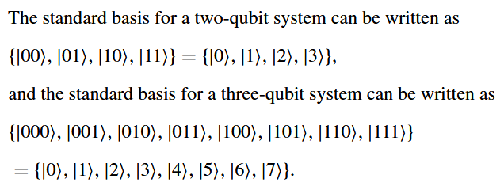
Bases for Multiple Qubits
In quantum computing, you take the ‘tensor product’ and not the ‘direct sum’ of the vector spaces to get the multi-qubit state-space.
If we try 3 qubits:
It works out to be according to our rules about a tensor space T (last slide) and its distributivity:
*Taken from Quantum Computing: A Gentle Introduction

Slide 43

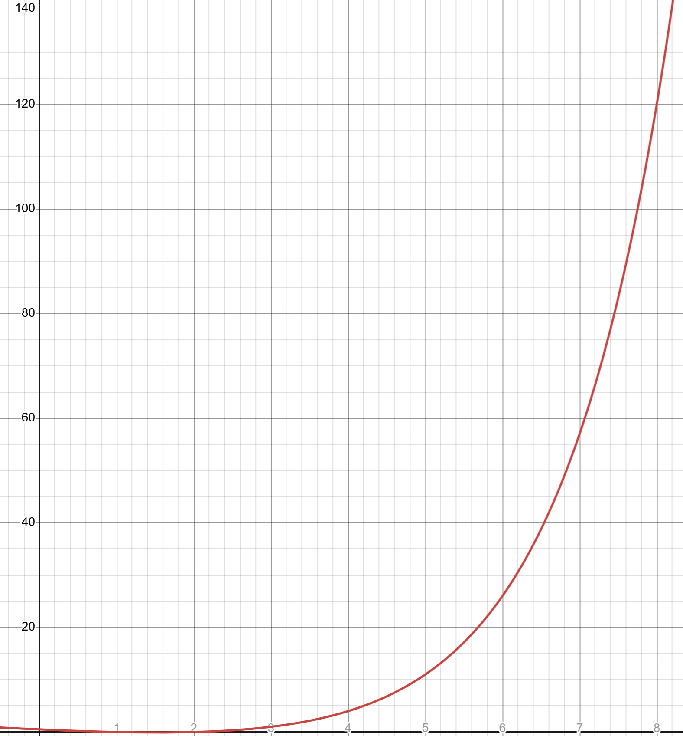
Comparison
3 classical bits gives 3x2=6 bases. 3 qubits gives 2^3=8 bases
n qubits gives classical bits worth of possibilities.
The difference in the number of possibilities as n grows:

Slide 44


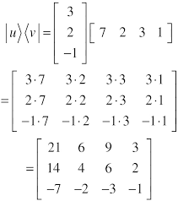
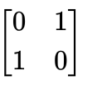
Some states cannot be represented as the sum of 3 individual qubits
The tensor product over is the outer product.
That results in all
Most matrices cannot be made with an outer product but are still

Slide 45
Remember!

