Slide 1
Optimisation in Factory Games with Maths
By
Gyula Rábai

Slide 2
Flow Management

Slide 3
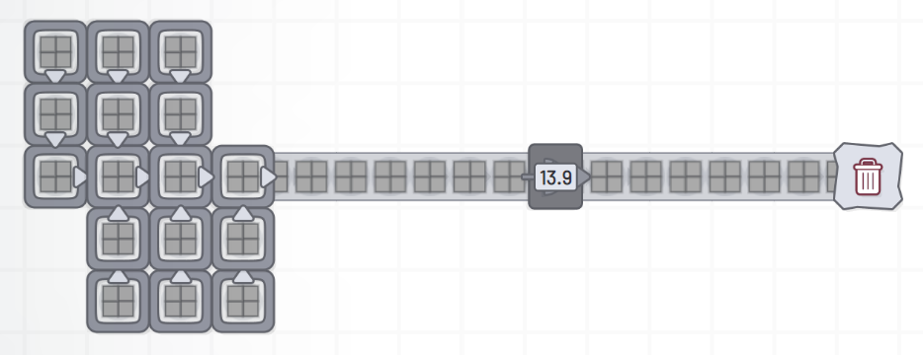
Distributing Tasks

Slide 4
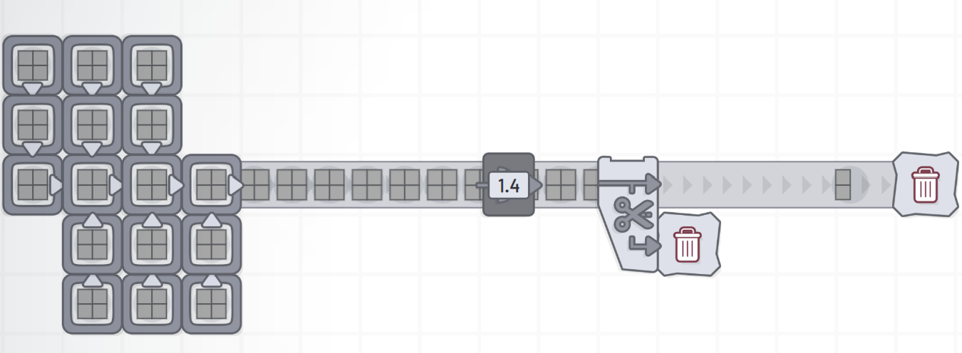
Distributing Tasks - Bottleneck
14 / 1.5 ~ 10

Slide 5
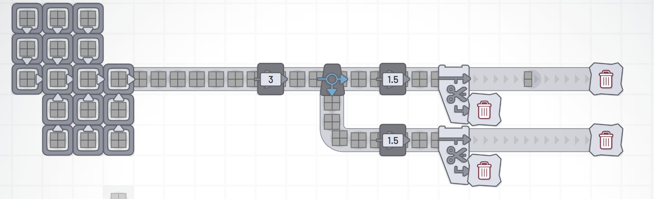
Distributing Tasks - Splitting
Each path has a probability of 0.5.

Slide 6
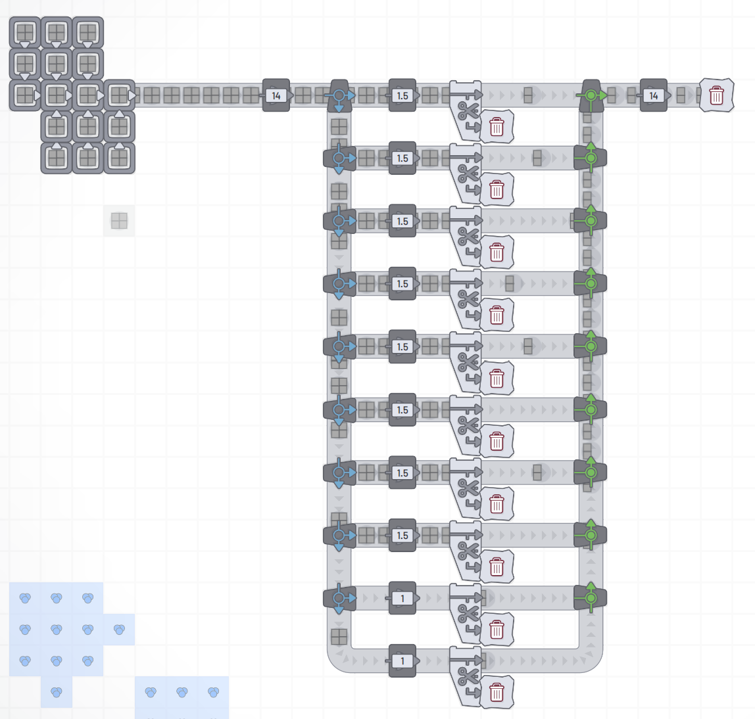
Distributing Tasks - Inefficient splitting Working

Slide 7
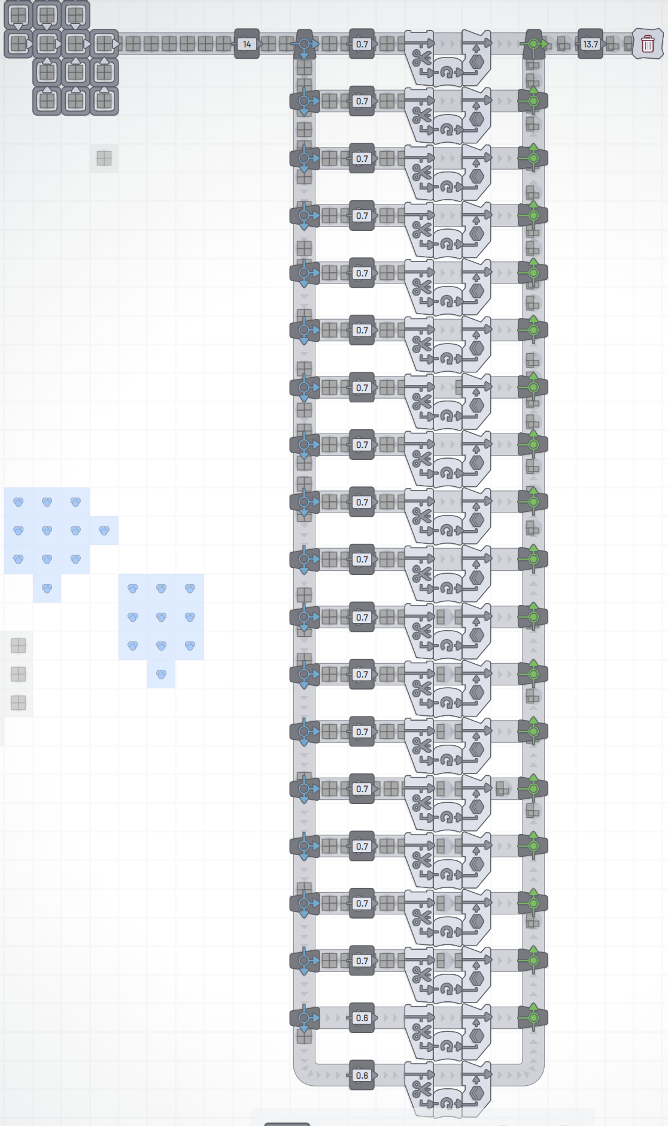
Distributing Tasks - Inefficient splitting not working
New Bottleneck 1.5 → 0.7
Parallel Machines 10 → 20

Slide 8
Distributing Tasks - Inefficient splitting not working
14-13.7 = 0.3 LOSS = 2.1% INEFFICIENCY

Slide 9
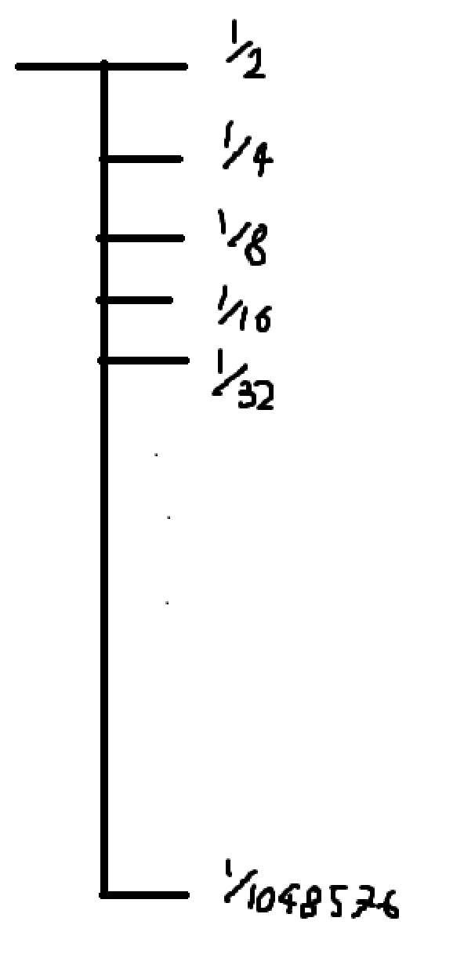
Distributing Tasks - Output probability dist
Exponential Distribution
(This is balanced by the earlier machines blocking but the conveyor belts cannot go fast enough for this effect to persist over a large number of splitters.)

Slide 10
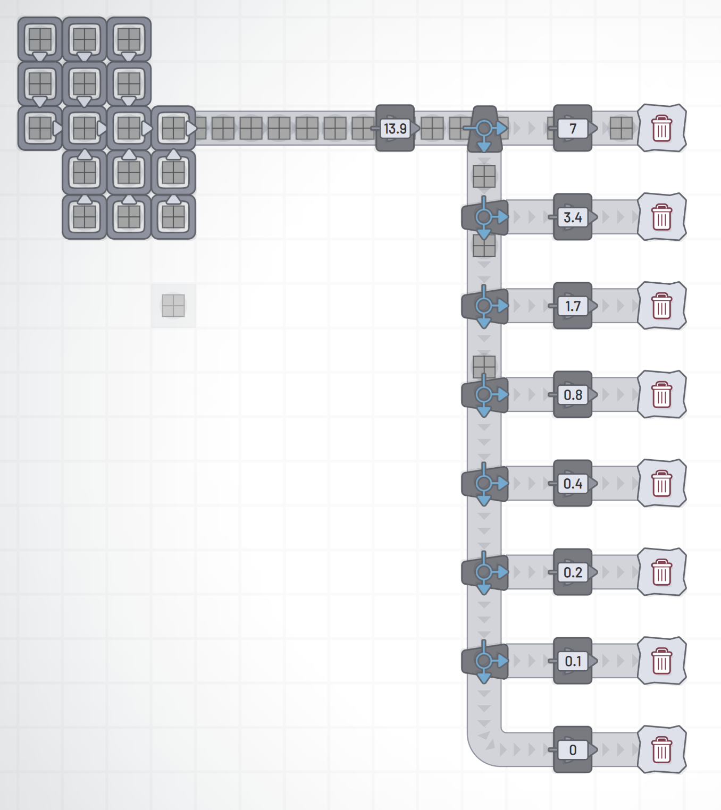
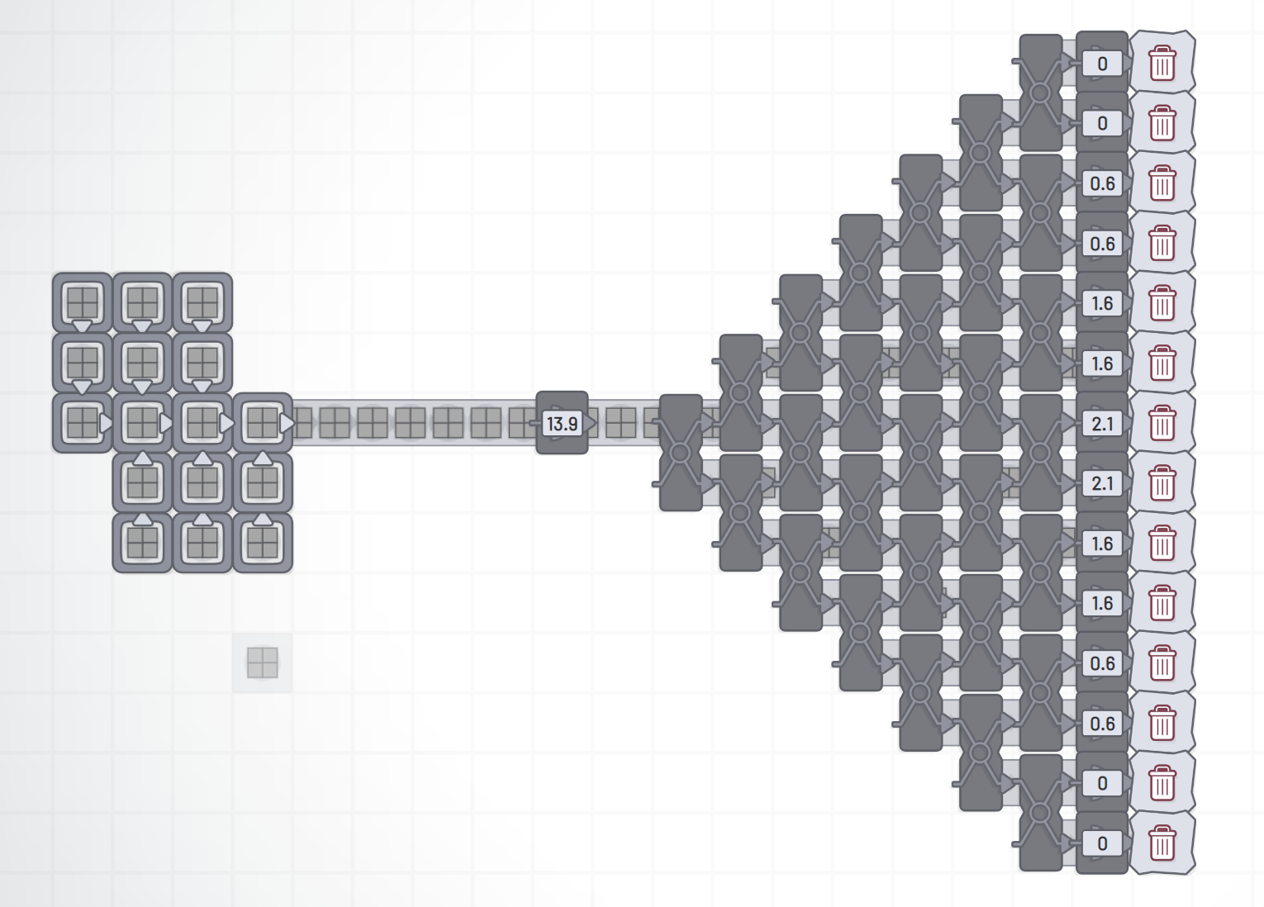
Distributing Tasks - different output probability distributions
Exponential
Binomial

Slide 11
Distributing Tasks - different output probability distributions
Exponential
Binomial

Slide 12
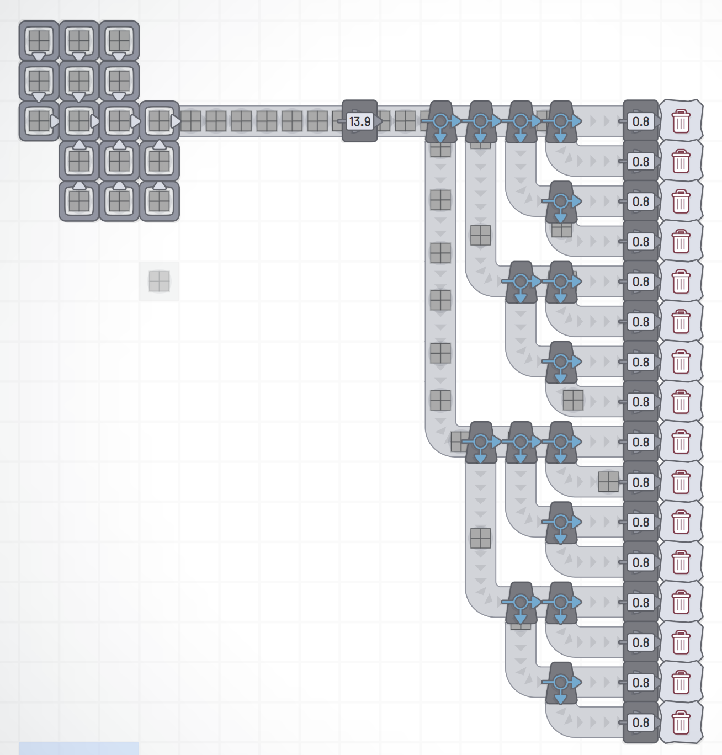
Distributing Tasks - optimal output probability distribution
Only works for powers of 2

Slide 13
Formula for approx 3
Let a, b, c be your channels:
a’ = (a + b)/2
b’ = (a’+ c)/2
c’ = (a’+ c)/2

Slide 14
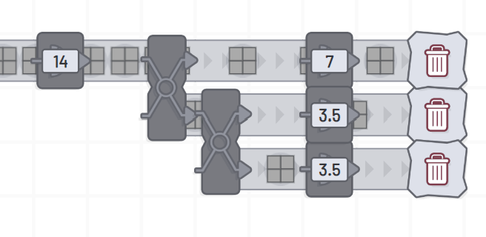
Approx for 3
One iteration of splitting:
a1 = x/2
b1 = x/4
c1 = x/4

Slide 15
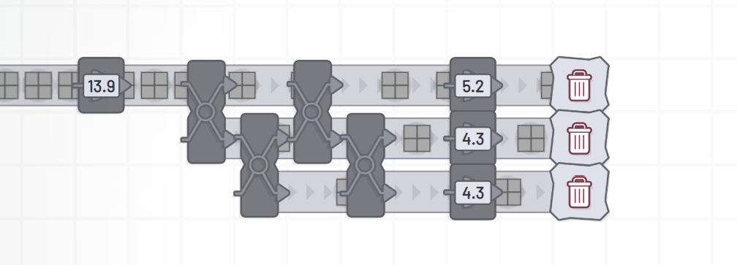
Approx for 3
Second iteration of splitting:
a2 = (x/2 + x/4) / 2 = x/4 + x/8
b2 = (x/4 + x/8 + x/4)/2 = (x/2 +x/8)/2 = x/4 + x/16
c2 = (x/4 + x/8 + x/4)/2 = (x/2 +x/8)/2 = x/4 + x/16

Slide 16
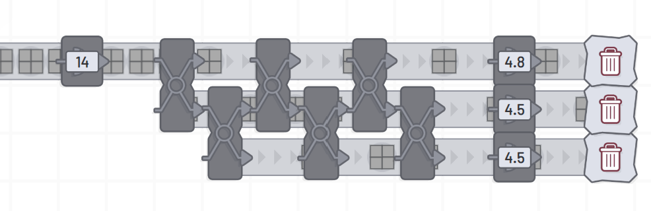
Approx for 3
Third iteration of splitting:
a2 = (x/4 +x/8 + x/4+ x/16) / 2 = x/4 + x/16 + x/32
b2 = (x/4 + x/16 + x/32 + x/4+ x/16)/2 = (x/2 +x/8 +x/32)/2 = x/4 + x/16 + x/64
c2 = (x/4 + x/16 + x/32 + x/4+ x/16)/2 = (x/2 +x/8 +x/32)/2 = x/4 + x/16 + x/64

Slide 17
Approx for 3
Consider b and c:
b = c
n = 1: x/4
n = 2: x/4 + x/16
n = 3: x/4 + x/16 + x/32

Slide 18
Approx for 3
x(1/4)
x(1/4 + 1/16)
x(1/4 + 1/16 + 1/32)

Slide 19
Approx for 3
x(2⁻²)
x(2⁻² + 2⁻⁴)
x(2⁻² + 2⁻⁴ + 2⁻⁶)

Slide 20
Approx for 3
Why?
Consider a:
a = x(2⁻² + 2⁻⁴ + 2⁻⁶+ ... +2^{-2n}+2^{-2n+1})
Consider b:
b = x(2⁻² + 2⁻⁴ + 2⁻⁶+ ... +2^{-2n}+2^{-2(n+1)})

Slide 21
Approx for 3
a = x(2⁻² + 2⁻⁴ + 2⁻⁶ + ... + 2^{-2n} + 2^{-2n-1})
b = x(2⁻² + 2⁻⁴ + 2⁻⁶ + ... + 2^{-2n} + 2^{-2(n+1)})
a’ = (a+b)/2 = x(2⁻² + 2⁻² + 2⁻⁴ + 2⁻⁴ + 2⁻⁶ + 2⁻⁶ + ... + 2^{-2n} +2^{-2n} + 2^{-2n-1} + 2^{-2(n+1)}) / 2
a’ = (a+b)/2 = x(2⁻¹ + 2⁻³ + 2⁻⁵ + ... + 2^{-2n+1} + 2^{-2n-1} + 2^{-2(n+1)}) / 2
a’ = (a+b)/2 = x(2⁻¹ + 2⁻³ + 2⁻⁵ + ... + 2^{-2n+1} + 2^{-2n-1} + 2^{-2(n+1)}) / 2
a’ = (a+b)/2 = x(2⁻² + 2⁻⁴ + 2⁻⁶ + ... + 2^{-2n} + 2^{-2(n+1)} + 2^{-2(n+1) - 1})
This is again in the form (n + 1 → n):
a = x(2⁻² + 2⁻⁴ + 2⁻⁶ + ... + 2^{-2n} + 2^{-2n-1})

Slide 22
Approx for 3
Consider c and b:
c = b
c’ = b’ = (a’+ c)/2 = (a’+ b)/2
a’ = x(2⁻² + 2⁻⁴ + 2⁻⁶ + ... + 2^{-2n} + 2^{-2(n+1)} + 2^{-2(n+1) - 1})
b = x(2⁻² + 2⁻⁴ + 2⁻⁶ + ... + 2^{-2n} + 2^{-2(n+1)})
b’ = (a’+ b)/2 = x(2⁻² + 2⁻² + 2⁻⁴ + 2⁻⁴ + 2⁻⁶ + 2⁻⁶ + ... + 2^{-2n} + 2^{-2n} + 2^{-2(n+1)} + 2^{-2(n+1)} + 2^{-2(n+1) - 1})/2
b’ = (a’+ b)/2 = x(2⁻¹ + 2⁻³ + 2⁻⁵ + ... + 2^{-2n+1} + 2^{-2(n+1) + 1} + 2^{-2(n+1) - 1})/2
b’ = (a’+ b)/2 = x(2⁻² + 2⁻⁴ + 2⁻⁶ + ... + 2^{-2n} + 2^{-2(n+1)} + 2^{-2(n+2)}) Which is again in the same form
(n + 2 → n + 1)
b = x(2⁻² + 2⁻⁴ + 2⁻⁶+ ... +2^{-2n}+2^{-2(n+1)})

Slide 23
Approx 3
Therefore, b and c will always be in the form
b = x(2⁻² + 2⁻⁴ + 2⁻⁶+ ... +2^{-2n})
This is a geometric series series where a = ¼ and r = ¼
As n → ∞: b → xa/(1-r) = x(¼ /(1-¼)) = x(¼/(¾)) = x⅓

Slide 24
Approx 3
Alternatively if we write the expansion in terms of binary
b = x(2⁻² + 2⁻⁴ + 2⁻⁶+ ... +2^{-2n})
b = x(0.010101 …)
0.010101… = ⅓ (the same way 0.3333… = ⅓)
QED

Slide 25
Approx n
(I won’t prove this but) One can construct any 2^n to 2^m mapping where the output has a uniform distribution. By adding powers of two, one can create any integer. By shuffling the power of 2 mappings according to the binary expansion of the fraction we want and stacking it infinitely one can create a mapping between n-inputs and n-outputs where the distribution of the outputs is always uniform.
We can create an exponential dist mapping from one to any integer. We can then map this to a uniform dist using our n-to-n uniform dist mapping.
Therefore, by representing a fraction in binary you can approximate any (discrete) uniform distribution.

Slide 26
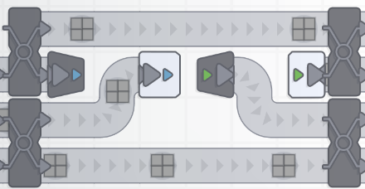
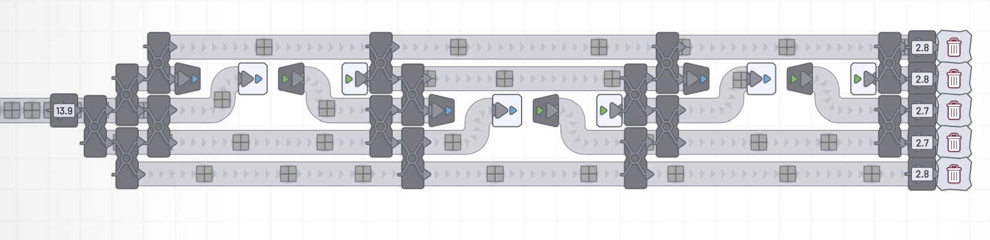
Approx 20 for max efficiency
20 = 4*5 Therefore we need to approx 5.
5 = 0.00110011…
n-to-uniform-n for n=4 looks like this:
4+1 = 5.
By alternating the extra output to an input of the 4-4 mapping every iteration we can approximate 5 (you can get here from 0.0011 also):

Slide 27
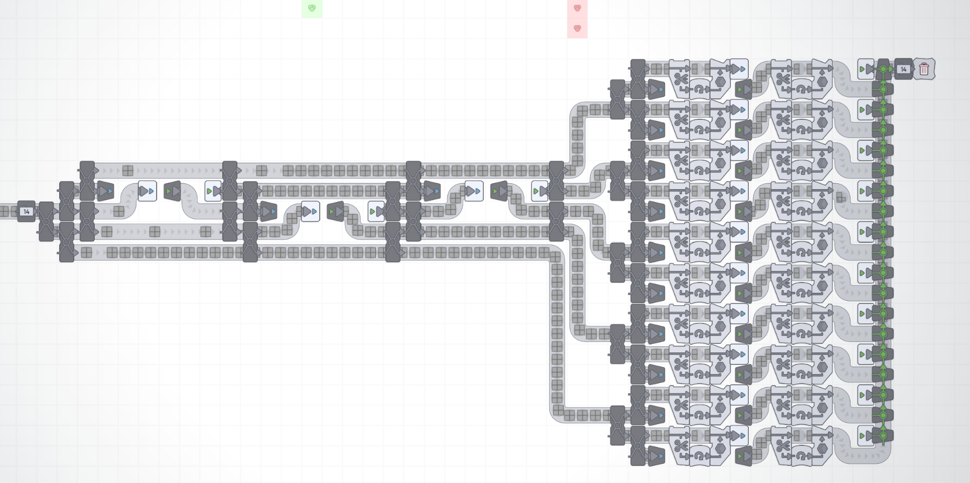
Approx 20 for max efficiency
14/14 = 100% Efficiency

Slide 28
Same set of skills as for software engineer:
E.g. how to multiply 1073741824 numbers with 1024 numbers (token unembedding for llama 1B parameter model) using 124 (not a power of 2) cores on the GPU?
E.g. where is the bottleneck in the code?
Etc.

Slide 29
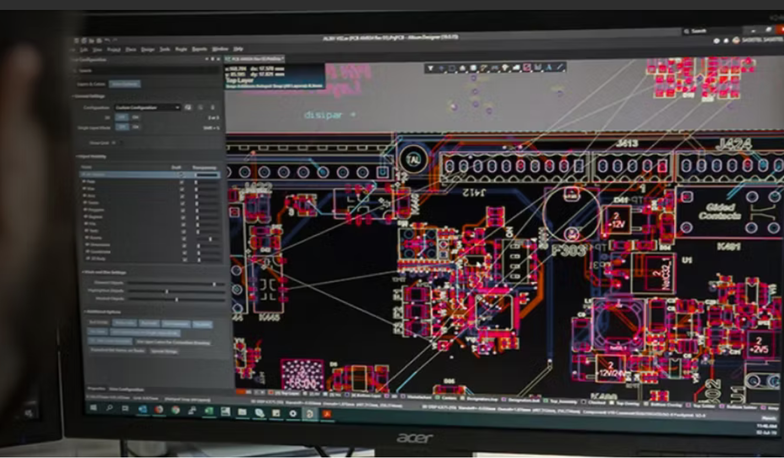
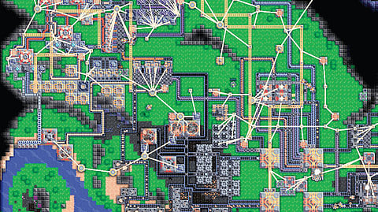
Also chip design

