Slide 1

Our Modelling Challenge
Diart, Gyula, Stan, Calvin
Colchester Royal Grammar School
Team #18907

Slide 2
What technical computing meant to us
Diart
Theory → real-life impact

Slide 3
What technical computing meant to us
Diart
Theory → real-life impact
  Abstraction!

Slide 4
What technical computing meant to us
Diart
Theory → real-life impact
  Abstraction!
This problem was not one equation…

Slide 5
What technical computing meant to us
Diart
Theory → real-life impact
  Abstraction!
This problem was not one equation…
  We had 3 scales

Slide 6
What technical computing meant to us
Diart
Theory → real-life impact
  Abstraction!
This problem was not one equation…
  We had 3 scales
    Household affordability

Slide 7
What technical computing meant to us
Diart
Theory → real-life impact
  Abstraction!
This problem was not one equation…
  We had 3 scales
    Household affordability
    Behavioural gambling dynamics

Slide 8
What technical computing meant to us
Diart
Theory → real-life impact
  Abstraction!
This problem was not one equation…
  We had 3 scales
    Household affordability
    Behavioural gambling dynamics
    Long-run recovery models

Slide 9
What technical computing meant to us
Diart
Theory → real-life impact
  Abstraction!
This problem was not one equation…
  We had 3 scales
    Household affordability
    Behavioural gambling dynamics
    Long-run recovery models
Affordability → Behavioural escalation → Recovery burden
Notes:
“For us, technical computing was about taking mathematical theory and turning it into something that explains a real-world problem.”
“The key idea here was abstraction.”
“Online gambling harm is complicated, so we couldn’t model every individual detail directly.”
“Instead, we broke the problem into simplified but meaningful mathematical layers.”
“This was not a problem that could be solved with one equation.”
“A single formula wouldn’t capture the full process from financial vulnerability to gambling losses to long-term recovery.”
“That’s why we split the problem into three scales.”
“First, household affordability: how much disposable income someone has before gambling.”
“Second, behavioural gambling dynamics: how betting behaviour changes after wins and losses.”
“Third, long-run recovery: how long it takes to financially recover after harmful losses.”
“So the overall chain is: affordability leads into behavioural escalation, which then creates a recovery burden.”

Slide 10
How the models connect
Diart

Slide 11
How the models connect
Diart
Question 1

Slide 12
How the models connect
Diart
Question 1
  identifies vulnerability before gambling begins

Slide 13
How the models connect
Diart
Question 1
  identifies vulnerability before gambling begins
Question 2

Slide 14
How the models connect
Diart
Question 1
  identifies vulnerability before gambling begins
Question 2
  models how behaviour converts vulnerability into losses

Slide 15
How the models connect
Diart
Question 1
  identifies vulnerability before gambling begins
Question 2
  models how behaviour converts vulnerability into losses
Question 3

Slide 16
How the models connect
Diart
Question 1
  identifies vulnerability before gambling begins
Question 2
  models how behaviour converts vulnerability into losses
Question 3
  measures how long the damage lasts after the betting stops
Notes:
“This slide shows how the three questions connect into one framework.”
“Question 1 identifies vulnerability before gambling begins.”
“It asks: how much financial room does someone actually have after tax, rent, food, transport, healthcare, and shocks?”
“Question 2 then models how behaviour converts that vulnerability into losses.”
“So instead of assuming a fixed gambling loss, we simulate how a gambler’s risk changes over time.”
“For example, after losses, some gamblers become more risky and start chasing losses.”
“Question 3 measures how long the damage lasts after betting stops.”
“This is important because the harm is not just the initial gambling loss.”
“If someone uses debt or drains savings, the financial impact can last for months or years.”
“So the project is not three isolated models. It is one pipeline: who is vulnerable, how losses escalate, and how long recovery takes.”

Slide 17
Playing with House Money
Diart

Slide 18
Q1 - an introduction
Diart
Notes:
Model a person’s disposable income from salary and demographics, then test how vulnerable it is to unexpected emergency costs.
We built a 2-part model:
Deterministic layer: calculates money left after taxes and essential costs.
Stochastic layer: adds random financial shocks to measure risk of falling into deficit.

Slide 19
Q1 - an introduction
Diart
Model a person’s disposable income
Notes:
Model a person’s disposable income from salary and demographics, then test how vulnerable it is to unexpected emergency costs.
We built a 2-part model:
Deterministic layer: calculates money left after taxes and essential costs.
Stochastic layer: adds random financial shocks to measure risk of falling into deficit.

Slide 20
Q1 - an introduction
Diart
Model a person’s disposable income
  From salary and demographics
Notes:
Model a person’s disposable income from salary and demographics, then test how vulnerable it is to unexpected emergency costs.
We built a 2-part model:
Deterministic layer: calculates money left after taxes and essential costs.
Stochastic layer: adds random financial shocks to measure risk of falling into deficit.

Slide 21
Q1 - an introduction
Diart
Model a person’s disposable income
  From salary and demographics
  Test how vulnerable it is to unexpected emergency costs
Notes:
Model a person’s disposable income from salary and demographics, then test how vulnerable it is to unexpected emergency costs.
We built a 2-part model:
Deterministic layer: calculates money left after taxes and essential costs.
Stochastic layer: adds random financial shocks to measure risk of falling into deficit.

Slide 22
Q1 - an introduction
Diart
Model a person’s disposable income
  From salary and demographics
  Test how vulnerable it is to unexpected emergency costs
We built a 2-part model:
Notes:
Model a person’s disposable income from salary and demographics, then test how vulnerable it is to unexpected emergency costs.
We built a 2-part model:
Deterministic layer: calculates money left after taxes and essential costs.
Stochastic layer: adds random financial shocks to measure risk of falling into deficit.

Slide 23
Q1 - an introduction
Diart
Model a person’s disposable income
  From salary and demographics
  Test how vulnerable it is to unexpected emergency costs
We built a 2-part model:
  Deterministic layer
Notes:
Model a person’s disposable income from salary and demographics, then test how vulnerable it is to unexpected emergency costs.
We built a 2-part model:
Deterministic layer: calculates money left after taxes and essential costs.
Stochastic layer: adds random financial shocks to measure risk of falling into deficit.

Slide 24
Q1 - an introduction
Diart
Model a person’s disposable income
  From salary and demographics
  Test how vulnerable it is to unexpected emergency costs
We built a 2-part model:
  Deterministic layer
  Stochastic layer
Notes:
“Question 1 is about modelling a person’s disposable income.”
“We start from salary and demographics.”
“Salary gives us the income side.”
“Demographics affect costs, such as age, country, region, and household size.”
“Then we test how vulnerable that disposable income is to unexpected emergency costs.”
“This matters because someone might look stable on average, but one large emergency cost could push them into debt.”
“We built a two-part model.”
“The first part is the deterministic layer.”
“This handles predictable costs: tax, housing, food, transport, healthcare, and utilities.”
“The second part is the stochastic layer.”
“This handles random emergency shocks, such as medical bills, car repairs, or sudden household costs.”
“These are uncertain, so we model them probabilistically.”
“Together, these layers let us estimate not only disposable income, but also how fragile that income is.”

Slide 25
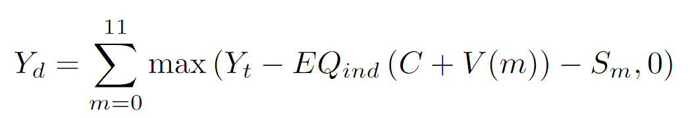
Simplified Overview
Diart

Slide 26
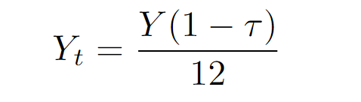
Simplified Overview
Diart
Net Income

Slide 27
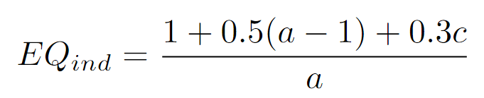
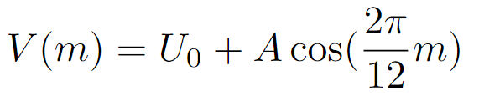

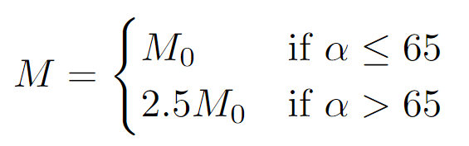
Simplified Overview
Diart
Essential Costs
Net Income

Slide 28
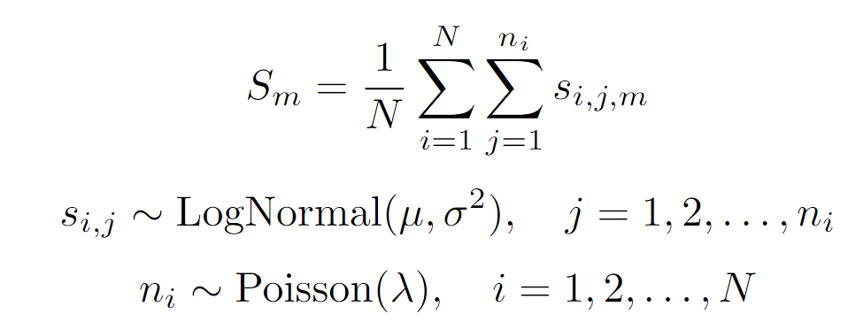
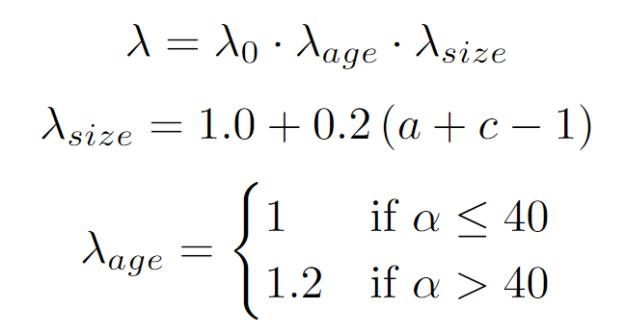
Simplified Overview
Diart
Emergency Costs
Essential Costs
Net Income
Notes:
Opening line
“This is the core equation behind Question 1, but I’ll break it down into three main parts.”
Point to Net Income
“First, on the left side inside the equation, we have monthly net income.”
“We start with gross salary, apply tax, and divide by 12 to get monthly post-tax income.”
“So this represents the money available before essential spending.”
Point to Essential Costs
“Next, we subtract essential costs.”
“These include housing, food, transport, healthcare, and utilities.”
“We also adjust these costs using the OECD household scale.”
“That matters because a family of four does not spend exactly four times as much as a single person.”
“Some costs are shared, like housing and utilities.”
“Utilities are modelled seasonally using a cosine function.”
“This lets us capture the fact that energy costs are higher in some months, especially winter.”
“Healthcare is also age-adjusted.”
“For older individuals, especially in the US, healthcare costs are higher.”
Point to Emergency Costs
“Finally, we subtract emergency costs.”
“These are not fixed costs, so we don’t treat them deterministically.”
“Instead, we use a stochastic shock model.”
“The number of shocks in a month is modelled with a Poisson distribution.”
“The size of each shock is modelled with a log-normal distribution.”
“That works because most emergency costs are small or zero, but occasionally there are very large costs.”
Explain the max(..., 0) part
“The max function means disposable income cannot go below zero in the deterministic baseline.”
“If essential costs are greater than income, we record disposable income as zero rather than negative.”
“Then the stochastic emergency shock layer can show when someone is pushed into deficit.”
Closing line
“So in simple terms, this equation says: take monthly post-tax income, subtract scaled essential costs, subtract emergency shocks, and sum this across the year.”

Slide 29
What data did we use?
Stan
Notes:
Tax:
Official tax brackets from websites of IRS, UK Gov and States
Cost of Living:
ONS
MIT Living Wage Calculator
Research Journals
How we used the data:
Parsed deterministic Cost of Living into csv file using python scripts
What should i say how sine parameters were decided?
Parameters of shock distribution and intensity calculated from research data

Slide 30
What data did we use?
Stan
Tax
Notes:
Tax:
Official tax brackets from websites of IRS, UK Gov and States
Cost of Living:
ONS
MIT Living Wage Calculator
Research Journals
How we used the data:
Parsed deterministic Cost of Living into csv file using python scripts
What should i say how sine parameters were decided?
Parameters of shock distribution and intensity calculated from research data

Slide 31
What data did we use?
Stan
Tax
  IRS, UK Gov and States
Notes:
Tax:
Official tax brackets from websites of IRS, UK Gov and States
Cost of Living:
ONS
MIT Living Wage Calculator
Research Journals
How we used the data:
Parsed deterministic Cost of Living into csv file using python scripts
What should i say how sine parameters were decided?
Parameters of shock distribution and intensity calculated from research data

Slide 32
What data did we use?
Stan
Tax
  IRS, UK Gov and States
Cost of Living
Notes:
Tax:
Official tax brackets from websites of IRS, UK Gov and States
Cost of Living:
ONS
MIT Living Wage Calculator
Research Journals
How we used the data:
Parsed deterministic Cost of Living into csv file using python scripts
What should i say how sine parameters were decided?
Parameters of shock distribution and intensity calculated from research data

Slide 33
What data did we use?
Stan
Tax
  IRS, UK Gov and States
Cost of Living
  ONS, MIT Living Wage Calculator, Research Journals
Notes:
Tax:
Official tax brackets from websites of IRS, UK Gov and States
Cost of Living:
ONS
MIT Living Wage Calculator
Research Journals
How we used the data:
Parsed deterministic Cost of Living into csv file using python scripts
What should i say how sine parameters were decided?
Parameters of shock distribution and intensity calculated from research data

Slide 34
What data did we use?
Stan
Tax
  IRS, UK Gov and States
Cost of Living
  ONS, MIT Living Wage Calculator, Research Journals
How we used the data
Notes:
Tax:
Official tax brackets from websites of IRS, UK Gov and States
Cost of Living:
ONS
MIT Living Wage Calculator
Research Journals
How we used the data:
Parsed deterministic Cost of Living into csv file using python scripts
What should i say how sine parameters were decided?
Parameters of shock distribution and intensity calculated from research data

Slide 35
What data did we use?
Stan
Tax
  IRS, UK Gov and States
Cost of Living
  ONS, MIT Living Wage Calculator, Research Journals
How we used the data
  Parsed deterministic Cost of Living into a CSV file (with Python scripts)
Notes:
Tax:
Official tax brackets from websites of IRS, UK Gov and States
Cost of Living:
ONS
MIT Living Wage Calculator
Research Journals
How we used the data:
Parsed deterministic Cost of Living into csv file using python scripts
What should i say how sine parameters were decided?
Parameters of shock distribution and intensity calculated from research data

Slide 36
What data did we use?
Stan
Tax
  IRS, UK Gov and States
Cost of Living
  ONS, MIT Living Wage Calculator, Research Journals
How we used the data
  Parsed deterministic Cost of Living into a CSV file (with Python scripts)
  Parameters of shock distribution and intensity calculated from research data
Notes:
Tax:
Official tax brackets from websites of IRS, UK Gov and States
Cost of Living:
ONS
MIT Living Wage Calculator
Research Journals
How we used the data:
Parsed deterministic Cost of Living into csv file using python scripts
What should i say how sine parameters were decided?
Parameters of shock distribution and intensity calculated from research data

Slide 37
Data used
Stan
Notes:
[Just add and note the citations]

Slide 38
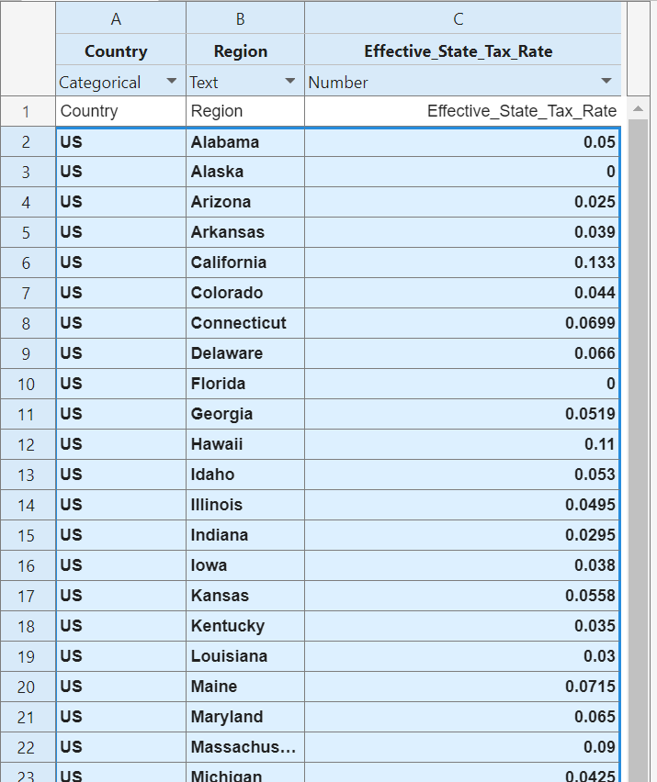
Data used
Stan
1 - Tax Rates
Notes:
[Just add and note the citations]

Slide 39
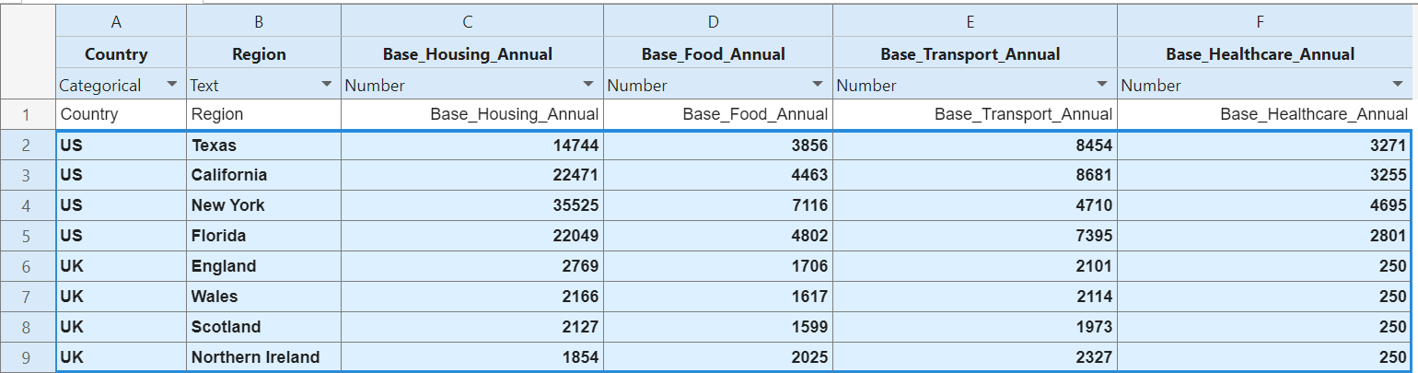
Data used
Stan
1 - Tax Rates
2 - Essential Costs
Notes:
[Just add and note the citations]

Slide 40
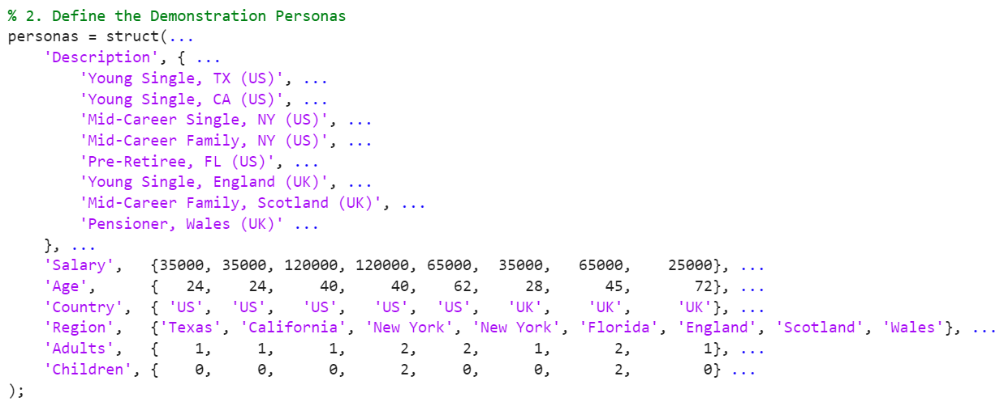
Model Structure
Stan
(1) Create the ‘personas’

Slide 41
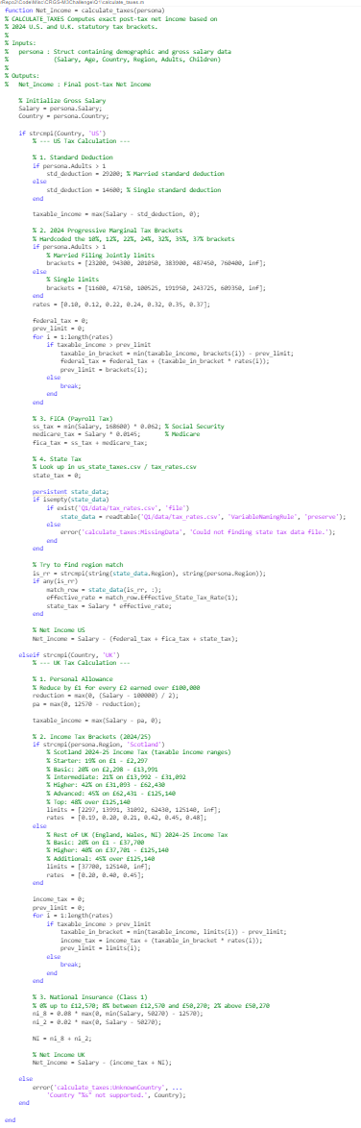
Model Structure
Stan
(1) Create the ‘Personas’
(2) Apply Taxes on ‘Personas’
Tax Rates
Symbol | Variable
Y_{t} | Monthly Net Income
Y | Gross Income
𝜏 | Tax Rate

Slide 42
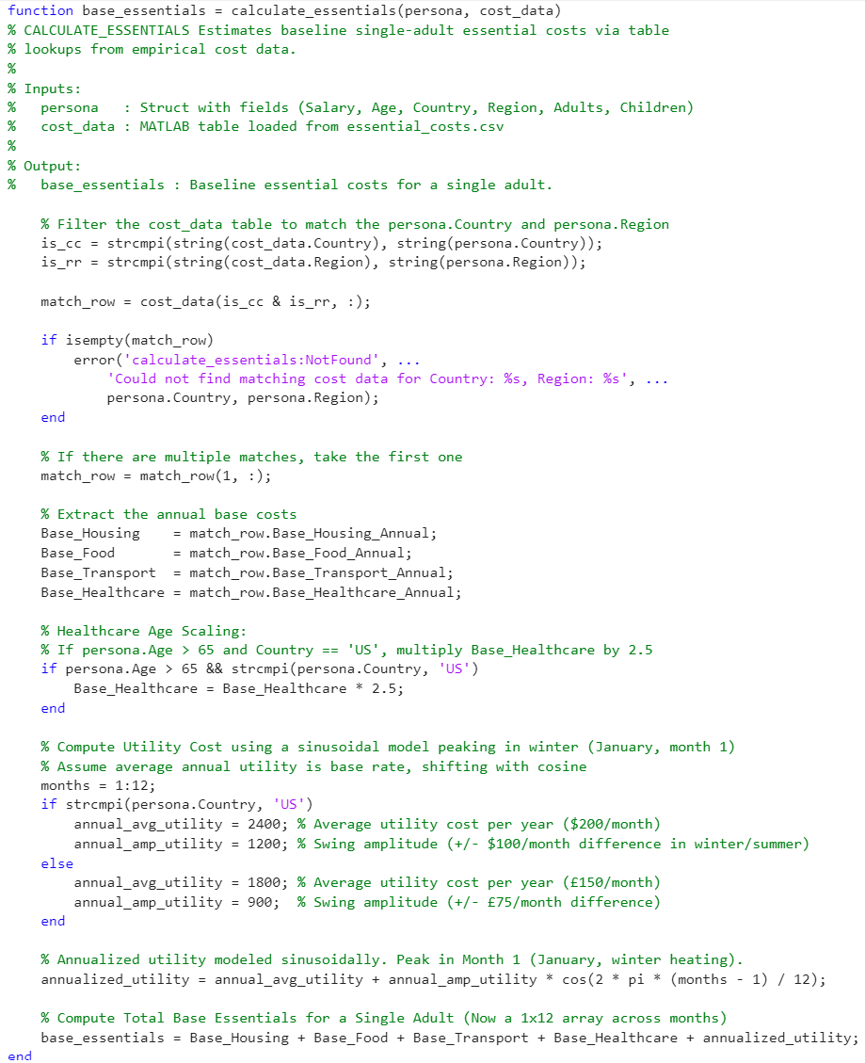
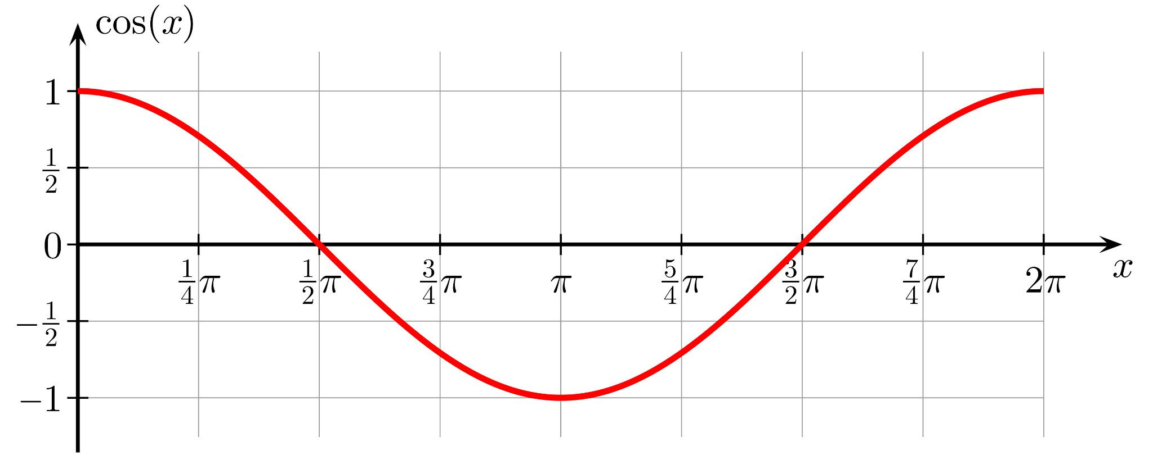
Model Structure
Stan
(2) Apply Taxes on ‘Personas’
(1) Create the ‘Personas’
Tax Rates
(3) Calculate Essential Costs - Part 1
Essential Costs
Symbol | Variable
C | Fixed Costs
H | Housing Costs
F | Food Costs
T | Transportation
M | Medical Costs
M₀ | Base Medical Costs
𝛼 | Age
+

Slide 43
Model Structure
Stan
(2) Apply Taxes on ‘Personas’
(1) Create the ‘Personas’
Tax Rates
(3) Calculate Essential Costs - Part 2
Essential Costs
Symbol | Variable
V(m) | Monthly Variable Costs
U₀ | Base Utility Costs
A | Variation Amplitude
m | Month (from 0 to 11)
+

Slide 44
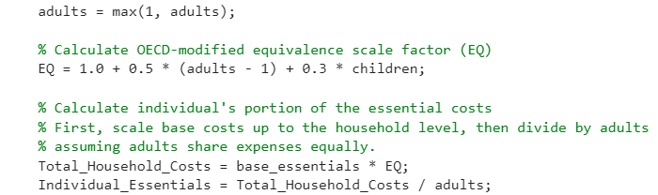
Model Structure
Gyula
(1) Create the ‘Personas’
(2) Apply Taxes
(3) Subtract Essential costs
Tax Rates
Essential Costs
+
(4) Apply Household Structure
Symbol | Variable
EQ_{ind} | OECD-modified equivalence scale
a | Number of Adults
c | Number of Child

Slide 45
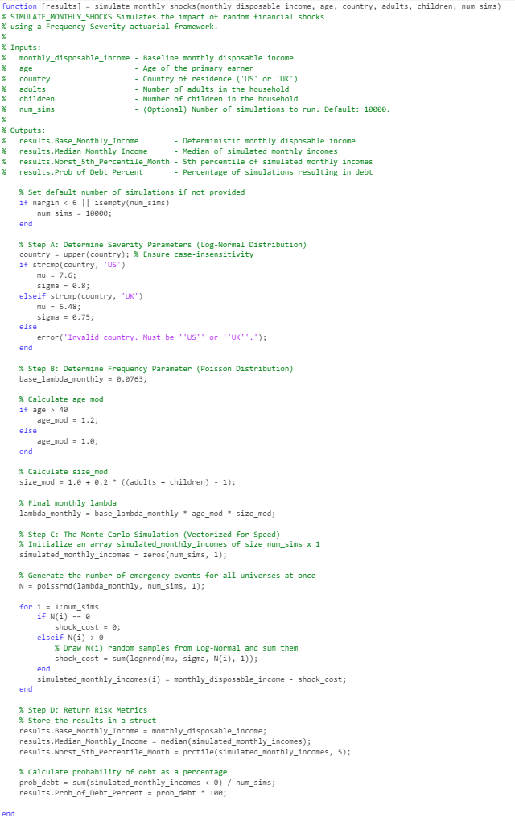
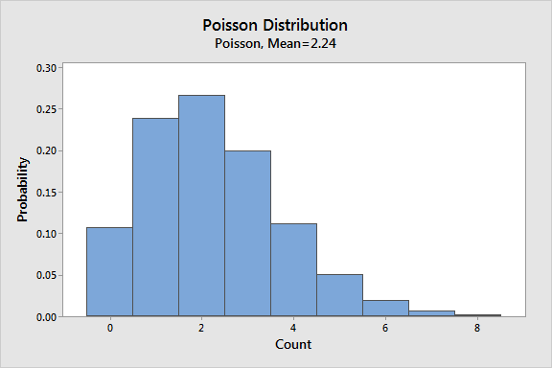
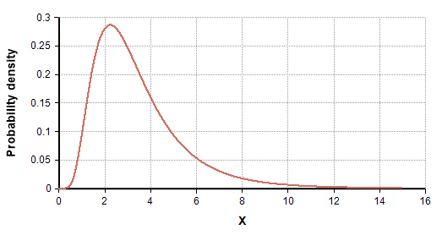
Model Structure
Gyula
(1) Create the ‘Personas’
(2) Apply Taxes
(3) Subtract Essential costs
Tax Rates
Essential Costs
+
(3) Apply Household Structure
(5) Apply Financial Shocks - Part 1
Symbol | Variable
λ | Mean Shock Rate
λ₀ | Base Rate
λ_{size} | Size Rate Modifier
λ_{age} | Age Rate Modifier
𝛼 | Age
+
Log-normal Distribution

Slide 46
Model Structure
Gyula
(1) Create the ‘Personas’
(2) Apply Taxes
(3) Subtract Essential costs
Tax Rates
Essential Costs
+
(3) Apply Household Structure
(5) Apply Financial Shocks - Part 2
Symbol | Variable
S_{m} | Shock for Month m
N | Simulation Count
n_{i} | Shock Count for Simulation i
s | Simulated Shock
𝜇 | Mean for Log of Shock Severity
𝜎 | Std. Deviation for Log of Shock Severity
λ | Mean Shock Rate
+
Log-normal Distribution

Slide 47
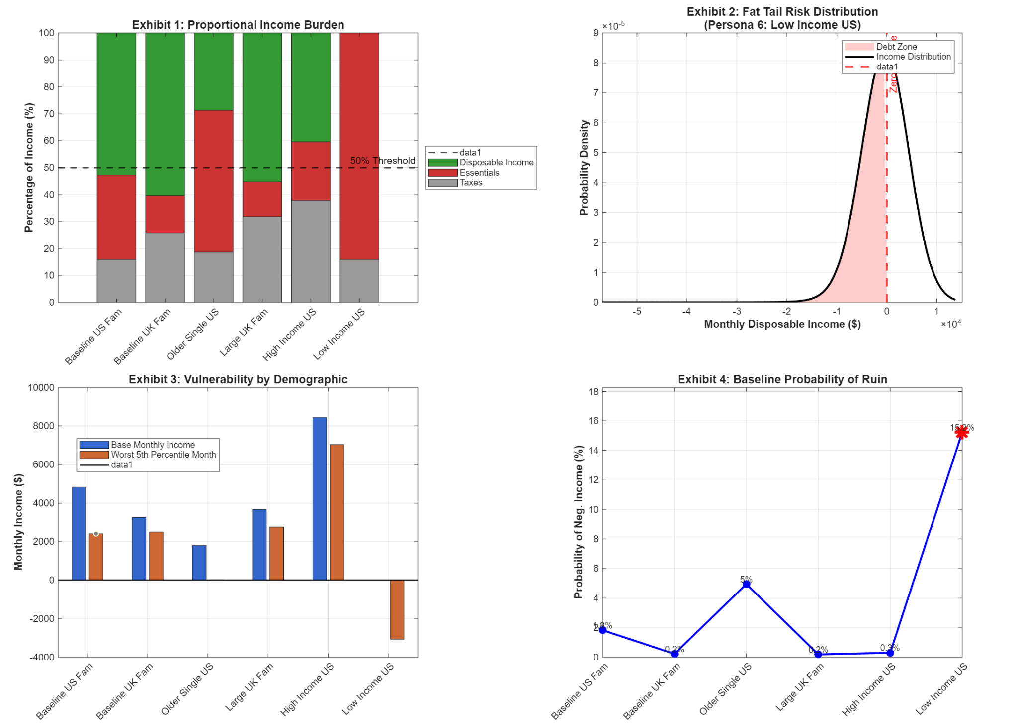
Model Structure
Gyula
(1) Create the ‘Personas’
(2) Apply Taxes
(3) Subtract Essential costs
Tax Rates
(5) Apply Financial Shocks
(4) Apply Household Structure
Essential Costs
(6) Acquire and Visualize Results
+
Log-normal Distribution
+
Symbol | Variable
Y_{d} | Annual Disposable Income
Y_{d} | Net Income
EQ_{ind} | OECD-modified Equivalence Scale per person
C | Fixed Monthly Costs
V(m) | Variable Monthly Costs for month m
S_{m} | Financial Shock for month m
m | Month (from 0 to 11)

Slide 48
Model Structure
Gyula
(1) Create the ‘Personas’
(2) Apply Taxes
(3) Subtract Essential costs
Tax Rates
Essential Costs
+
(5) Apply Financial Shocks
(6) Visualize Results
(4) Apply Household Structure
+
Log-normal Distribution

Slide 49
Financial Vulnerability Showcase:
Impact Analysis
Stan

Slide 50
Financial Vulnerability Showcase: Impact Analysis
Stan

Slide 51
Financial Vulnerability Showcase: Impact Analysis
Stan
Disproportionate Income Burden: Low-income demographics spend a high percentage of their monthly income on essential needs.

Slide 52
Financial Vulnerability Showcase: Impact Analysis
Stan
Disproportionate Income Burden: Low-income demographics spend a high percentage of their monthly income on essential needs.
Country inequality: Low to mid income US personas are far more likely to end up in debt than their UK counterparts, whereas high enjoy a much higher disposable income.

Slide 53
Financial Vulnerability Showcase: Impact Analysis
Stan
Disproportionate Income Burden: Low-income demographics spend a high percentage of their monthly income on essential needs.
Country inequality: Low to mid income US personas are far more likely to end up in debt than their UK counterparts, whereas high enjoy a much higher disposable income.
Severe Vulnerability to Shocks: When subjected to a 1-in-20 worst-case economic shock, low-income households are driven into severe monthly deficits.

Slide 54
Financial Vulnerability Showcase: Impact Analysis
Stan
Disproportionate Income Burden: Low-income demographics spend a high percentage of their monthly income on essential needs.
Country inequality: Low to mid income US personas are far more likely to end up in debt than their UK counterparts, whereas high enjoy a much higher disposable income.
Severe Vulnerability to Shocks: When subjected to a 1-in-20 worst-case economic shock, low-income households are driven into severe monthly deficits.
Elevated Probability of Debt: the baseline risk of going into debt simply to cover essential purchases spikes for low-income populations

Slide 55
Sensitivity Analysis
Calvin
Notes:
NEW VERSION
Local sensitivity analysis shows our model is highly stable, displaying perfectly symmetric, linear responses to minor parameter changes (e.g., housing or food costs).
OLD VERSION
First, we performed a standard local sensitivity analysis. The figure shows the 5 variables which caused the largest change to the baseline disposable income. As you can see, for small changes in parameters like housing or food, the impact on disposable income is perfectly symmetric and linear, confirming the model is stable around our baseline
However, we didn't just want to test small changes; we wanted to stress-test the model's boundaries. When we push the gross salary up significantly, the symmetry ever so slightly breaks because the model dynamically pushes the persona into a higher 42% tax bracket, taxing that extra £2230 at a steeper rate. This proves our model isn't just a blind linear equation - it structurally adapts to real-world, non-linear financial thresholds.

Slide 56
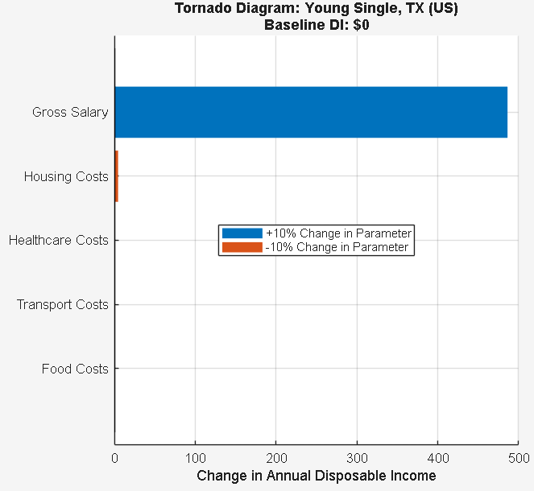
Sensitivity Analysis
Calvin
Notes:
NEW VERSION
Local sensitivity analysis shows our model is highly stable, displaying perfectly symmetric, linear responses to minor parameter changes (e.g., housing or food costs).
OLD VERSION
First, we performed a standard local sensitivity analysis. The figure shows the 5 variables which caused the largest change to the baseline disposable income. As you can see, for small changes in parameters like housing or food, the impact on disposable income is perfectly symmetric and linear, confirming the model is stable around our baseline
However, we didn't just want to test small changes; we wanted to stress-test the model's boundaries. When we push the gross salary up significantly, the symmetry ever so slightly breaks because the model dynamically pushes the persona into a higher 42% tax bracket, taxing that extra £2230 at a steeper rate. This proves our model isn't just a blind linear equation - it structurally adapts to real-world, non-linear financial thresholds.

Slide 57
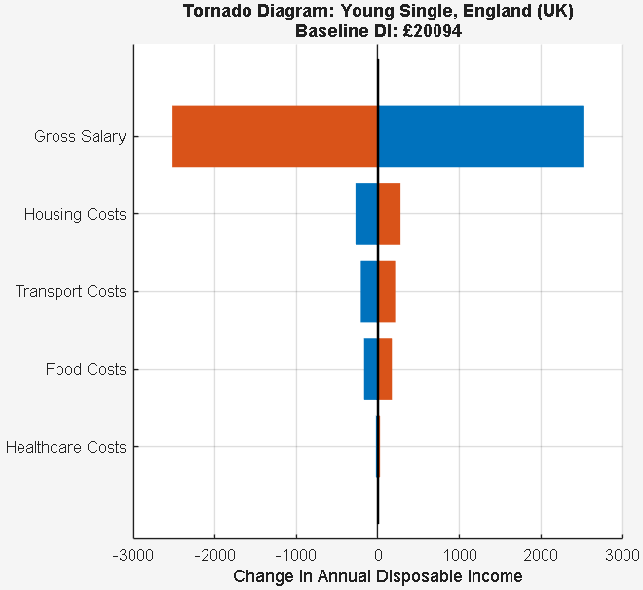
Sensitivity Analysis
Calvin
Notes:
NEW VERSION
Local sensitivity analysis shows our model is highly stable, displaying perfectly symmetric, linear responses to minor parameter changes (e.g., housing or food costs).
OLD VERSION
First, we performed a standard local sensitivity analysis. The figure shows the 5 variables which caused the largest change to the baseline disposable income. As you can see, for small changes in parameters like housing or food, the impact on disposable income is perfectly symmetric and linear, confirming the model is stable around our baseline
However, we didn't just want to test small changes; we wanted to stress-test the model's boundaries. When we push the gross salary up significantly, the symmetry ever so slightly breaks because the model dynamically pushes the persona into a higher 42% tax bracket, taxing that extra £2230 at a steeper rate. This proves our model isn't just a blind linear equation - it structurally adapts to real-world, non-linear financial thresholds.

Slide 58
Sensitivity Analysis
Calvin
Local sensitivity analysis → our model is highly stable
Notes:
NEW VERSION
Local sensitivity analysis shows our model is highly stable, displaying perfectly symmetric, linear responses to minor parameter changes (e.g., housing or food costs).
OLD VERSION
First, we performed a standard local sensitivity analysis. The figure shows the 5 variables which caused the largest change to the baseline disposable income. As you can see, for small changes in parameters like housing or food, the impact on disposable income is perfectly symmetric and linear, confirming the model is stable around our baseline
However, we didn't just want to test small changes; we wanted to stress-test the model's boundaries. When we push the gross salary up significantly, the symmetry ever so slightly breaks because the model dynamically pushes the persona into a higher 42% tax bracket, taxing that extra £2230 at a steeper rate. This proves our model isn't just a blind linear equation - it structurally adapts to real-world, non-linear financial thresholds.

Slide 59
Sensitivity Analysis
Calvin
Local sensitivity analysis → our model is highly stable
  displaying perfectly symmetric, linear responses to minor parameter changes (e.g., housing or food costs)
Notes:
NEW VERSION
Local sensitivity analysis shows our model is highly stable, displaying perfectly symmetric, linear responses to minor parameter changes (e.g., housing or food costs).
OLD VERSION
First, we performed a standard local sensitivity analysis. The figure shows the 5 variables which caused the largest change to the baseline disposable income. As you can see, for small changes in parameters like housing or food, the impact on disposable income is perfectly symmetric and linear, confirming the model is stable around our baseline
However, we didn't just want to test small changes; we wanted to stress-test the model's boundaries. When we push the gross salary up significantly, the symmetry ever so slightly breaks because the model dynamically pushes the persona into a higher 42% tax bracket, taxing that extra £2230 at a steeper rate. This proves our model isn't just a blind linear equation - it structurally adapts to real-world, non-linear financial thresholds.

Slide 60
Stress Testing
Calvin
Notes:
NEW VERSION
Stress-testing boundaries—like significant salary increases—breaks this symmetry as personas enter higher tax brackets. This proves our model isn't a static equation, but structurally adapts to real-world, non-linear financial thresholds.
OLD VERSION
First, we performed a standard local sensitivity analysis. The figure shows the 5 variables which caused the largest change to the baseline disposable income. As you can see, for small changes in parameters like housing or food, the impact on disposable income is perfectly symmetric and linear, confirming the model is stable around our baseline
However, we didn't just want to test small changes; we wanted to stress-test the model's boundaries. When we push the gross salary up significantly, the symmetry ever so slightly breaks because the model dynamically pushes the persona into a higher 42% tax bracket, taxing that extra £2230 at a steeper rate. This proves our model isn't just a blind linear equation - it structurally adapts to real-world, non-linear financial thresholds.

Slide 61
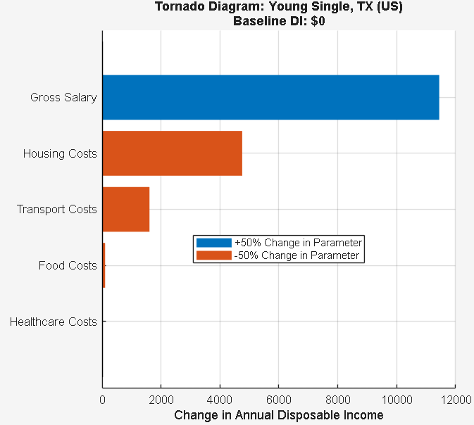
Stress Testing
Calvin
Notes:
NEW VERSION
Stress-testing boundaries—like significant salary increases—breaks this symmetry as personas enter higher tax brackets. This proves our model isn't a static equation, but structurally adapts to real-world, non-linear financial thresholds.
OLD VERSION
First, we performed a standard local sensitivity analysis. The figure shows the 5 variables which caused the largest change to the baseline disposable income. As you can see, for small changes in parameters like housing or food, the impact on disposable income is perfectly symmetric and linear, confirming the model is stable around our baseline
However, we didn't just want to test small changes; we wanted to stress-test the model's boundaries. When we push the gross salary up significantly, the symmetry ever so slightly breaks because the model dynamically pushes the persona into a higher 42% tax bracket, taxing that extra £2230 at a steeper rate. This proves our model isn't just a blind linear equation - it structurally adapts to real-world, non-linear financial thresholds.

Slide 62
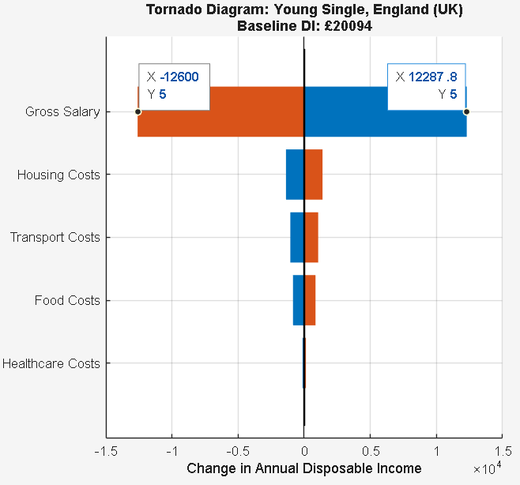
Stress Testing
Calvin
Notes:
NEW VERSION
Stress-testing boundaries—like significant salary increases—breaks this symmetry as personas enter higher tax brackets. This proves our model isn't a static equation, but structurally adapts to real-world, non-linear financial thresholds.
OLD VERSION
First, we performed a standard local sensitivity analysis. The figure shows the 5 variables which caused the largest change to the baseline disposable income. As you can see, for small changes in parameters like housing or food, the impact on disposable income is perfectly symmetric and linear, confirming the model is stable around our baseline
However, we didn't just want to test small changes; we wanted to stress-test the model's boundaries. When we push the gross salary up significantly, the symmetry ever so slightly breaks because the model dynamically pushes the persona into a higher 42% tax bracket, taxing that extra £2230 at a steeper rate. This proves our model isn't just a blind linear equation - it structurally adapts to real-world, non-linear financial thresholds.

Slide 63
Stress Testing
Calvin
Stress-testing boundaries, like significant salary increases, breaks this symmetry as personas enter higher tax brackets.
Notes:
NEW VERSION
Stress-testing boundaries—like significant salary increases—breaks this symmetry as personas enter higher tax brackets. This proves our model isn't a static equation, but structurally adapts to real-world, non-linear financial thresholds.
OLD VERSION
First, we performed a standard local sensitivity analysis. The figure shows the 5 variables which caused the largest change to the baseline disposable income. As you can see, for small changes in parameters like housing or food, the impact on disposable income is perfectly symmetric and linear, confirming the model is stable around our baseline
However, we didn't just want to test small changes; we wanted to stress-test the model's boundaries. When we push the gross salary up significantly, the symmetry ever so slightly breaks because the model dynamically pushes the persona into a higher 42% tax bracket, taxing that extra £2230 at a steeper rate. This proves our model isn't just a blind linear equation - it structurally adapts to real-world, non-linear financial thresholds.

Slide 64
Stress Testing
Calvin
Stress-testing boundaries, like significant salary increases, breaks this symmetry as personas enter higher tax brackets.
  This proves our model isn't a static equation, but structurally adapts to real-world, non-linear financial thresholds.
Notes:
NEW VERSION
Stress-testing boundaries—like significant salary increases—breaks this symmetry as personas enter higher tax brackets. This proves our model isn't a static equation, but structurally adapts to real-world, non-linear financial thresholds.
OLD VERSION
First, we performed a standard local sensitivity analysis. The figure shows the 5 variables which caused the largest change to the baseline disposable income. As you can see, for small changes in parameters like housing or food, the impact on disposable income is perfectly symmetric and linear, confirming the model is stable around our baseline
However, we didn't just want to test small changes; we wanted to stress-test the model's boundaries. When we push the gross salary up significantly, the symmetry ever so slightly breaks because the model dynamically pushes the persona into a higher 42% tax bracket, taxing that extra £2230 at a steeper rate. This proves our model isn't just a blind linear equation - it structurally adapts to real-world, non-linear financial thresholds.

Slide 65
Model Evaluation
Calvin
Notes:
OLD VERSION
Because we built a mechanistic, modular model rather than just curve-fitting historical data, our framework doesn't break when the economy changes.
It is highly extensible, allowing us to plug in new economic shocks or cost parameters as the real world evolves.
Furthermore, by tracking income on a monthly basis, we successfully capture seasonal fluctuations, such as the spike in winter utility bills.
Financial emergencies are extremely random, so instead of spitting out a single, fragile 'average' number, our Monte Carlo simulation embraces real-world unpredictability to provide a highly accurate, probabilistic assessment of risk to one’s finances.
Key strengths
Mechanistic & Extensible:
Built on modular logic rather than historical curve-fitting
Our framework adapts to economic shifts and allows new parameters to be integrated.
High Granularity:
Monthly tracking successfully captures seasonal variations, such as winter utility spikes.
Probabilistic Accuracy:
Instead of fragile "averages," our Monte Carlo simulation embraces real-world unpredictability to accurately model random financial emergencies.

Slide 66
Model Evaluation
Calvin
Key strengths
Notes:
OLD VERSION
Because we built a mechanistic, modular model rather than just curve-fitting historical data, our framework doesn't break when the economy changes.
It is highly extensible, allowing us to plug in new economic shocks or cost parameters as the real world evolves.
Furthermore, by tracking income on a monthly basis, we successfully capture seasonal fluctuations, such as the spike in winter utility bills.
Financial emergencies are extremely random, so instead of spitting out a single, fragile 'average' number, our Monte Carlo simulation embraces real-world unpredictability to provide a highly accurate, probabilistic assessment of risk to one’s finances.
Key strengths
Mechanistic & Extensible:
Built on modular logic rather than historical curve-fitting
Our framework adapts to economic shifts and allows new parameters to be integrated.
High Granularity:
Monthly tracking successfully captures seasonal variations, such as winter utility spikes.
Probabilistic Accuracy:
Instead of fragile "averages," our Monte Carlo simulation embraces real-world unpredictability to accurately model random financial emergencies.

Slide 67
Model Evaluation
Calvin
Key strengths
  Mechanistic & Extensible
Notes:
OLD VERSION
Because we built a mechanistic, modular model rather than just curve-fitting historical data, our framework doesn't break when the economy changes.
It is highly extensible, allowing us to plug in new economic shocks or cost parameters as the real world evolves.
Furthermore, by tracking income on a monthly basis, we successfully capture seasonal fluctuations, such as the spike in winter utility bills.
Financial emergencies are extremely random, so instead of spitting out a single, fragile 'average' number, our Monte Carlo simulation embraces real-world unpredictability to provide a highly accurate, probabilistic assessment of risk to one’s finances.
Key strengths
Mechanistic & Extensible:
Built on modular logic rather than historical curve-fitting
Our framework adapts to economic shifts and allows new parameters to be integrated.
High Granularity:
Monthly tracking successfully captures seasonal variations, such as winter utility spikes.
Probabilistic Accuracy:
Instead of fragile "averages," our Monte Carlo simulation embraces real-world unpredictability to accurately model random financial emergencies.

Slide 68
Model Evaluation
Calvin
Key strengths
  Mechanistic & Extensible
    Built on modular logic rather than historical curve-fitting
Notes:
OLD VERSION
Because we built a mechanistic, modular model rather than just curve-fitting historical data, our framework doesn't break when the economy changes.
It is highly extensible, allowing us to plug in new economic shocks or cost parameters as the real world evolves.
Furthermore, by tracking income on a monthly basis, we successfully capture seasonal fluctuations, such as the spike in winter utility bills.
Financial emergencies are extremely random, so instead of spitting out a single, fragile 'average' number, our Monte Carlo simulation embraces real-world unpredictability to provide a highly accurate, probabilistic assessment of risk to one’s finances.
Key strengths
Mechanistic & Extensible:
Built on modular logic rather than historical curve-fitting
Our framework adapts to economic shifts and allows new parameters to be integrated.
High Granularity:
Monthly tracking successfully captures seasonal variations, such as winter utility spikes.
Probabilistic Accuracy:
Instead of fragile "averages," our Monte Carlo simulation embraces real-world unpredictability to accurately model random financial emergencies.

Slide 69
Model Evaluation
Calvin
Key strengths
  Mechanistic & Extensible
    Built on modular logic rather than historical curve-fitting
  High Granularity
Notes:
OLD VERSION
Because we built a mechanistic, modular model rather than just curve-fitting historical data, our framework doesn't break when the economy changes.
It is highly extensible, allowing us to plug in new economic shocks or cost parameters as the real world evolves.
Furthermore, by tracking income on a monthly basis, we successfully capture seasonal fluctuations, such as the spike in winter utility bills.
Financial emergencies are extremely random, so instead of spitting out a single, fragile 'average' number, our Monte Carlo simulation embraces real-world unpredictability to provide a highly accurate, probabilistic assessment of risk to one’s finances.
Key strengths
Mechanistic & Extensible:
Built on modular logic rather than historical curve-fitting
Our framework adapts to economic shifts and allows new parameters to be integrated.
High Granularity:
Monthly tracking successfully captures seasonal variations, such as winter utility spikes.
Probabilistic Accuracy:
Instead of fragile "averages," our Monte Carlo simulation embraces real-world unpredictability to accurately model random financial emergencies.

Slide 70
Model Evaluation
Calvin
Key strengths
  Mechanistic & Extensible
    Built on modular logic rather than historical curve-fitting
  High Granularity
    Monthly tracking successfully captures seasonal variations, such as winter utility spikes
Notes:
OLD VERSION
Because we built a mechanistic, modular model rather than just curve-fitting historical data, our framework doesn't break when the economy changes.
It is highly extensible, allowing us to plug in new economic shocks or cost parameters as the real world evolves.
Furthermore, by tracking income on a monthly basis, we successfully capture seasonal fluctuations, such as the spike in winter utility bills.
Financial emergencies are extremely random, so instead of spitting out a single, fragile 'average' number, our Monte Carlo simulation embraces real-world unpredictability to provide a highly accurate, probabilistic assessment of risk to one’s finances.
Key strengths
Mechanistic & Extensible:
Built on modular logic rather than historical curve-fitting
Our framework adapts to economic shifts and allows new parameters to be integrated.
High Granularity:
Monthly tracking successfully captures seasonal variations, such as winter utility spikes.
Probabilistic Accuracy:
Instead of fragile "averages," our Monte Carlo simulation embraces real-world unpredictability to accurately model random financial emergencies.

Slide 71
Model Evaluation
Calvin
Key strengths
  Mechanistic & Extensible
    Built on modular logic rather than historical curve-fitting
  High Granularity
    Monthly tracking successfully captures seasonal variations, such as winter utility spikes
  Probabilistic Accuracy
Notes:
OLD VERSION
Because we built a mechanistic, modular model rather than just curve-fitting historical data, our framework doesn't break when the economy changes.
It is highly extensible, allowing us to plug in new economic shocks or cost parameters as the real world evolves.
Furthermore, by tracking income on a monthly basis, we successfully capture seasonal fluctuations, such as the spike in winter utility bills.
Financial emergencies are extremely random, so instead of spitting out a single, fragile 'average' number, our Monte Carlo simulation embraces real-world unpredictability to provide a highly accurate, probabilistic assessment of risk to one’s finances.
Key strengths
Mechanistic & Extensible:
Built on modular logic rather than historical curve-fitting
Our framework adapts to economic shifts and allows new parameters to be integrated.
High Granularity:
Monthly tracking successfully captures seasonal variations, such as winter utility spikes.
Probabilistic Accuracy:
Instead of fragile "averages," our Monte Carlo simulation embraces real-world unpredictability to accurately model random financial emergencies.

Slide 72
Model Evaluation
Calvin
Key strengths
  Mechanistic & Extensible
    Built on modular logic rather than historical curve-fitting
  High Granularity
    Monthly tracking successfully captures seasonal variations, such as winter utility spikes
  Probabilistic Accuracy
    Instead of fragile "averages," our Monte Carlo simulation embraces real-world unpredictability
Notes:
OLD VERSION
Because we built a mechanistic, modular model rather than just curve-fitting historical data, our framework doesn't break when the economy changes.
It is highly extensible, allowing us to plug in new economic shocks or cost parameters as the real world evolves.
Furthermore, by tracking income on a monthly basis, we successfully capture seasonal fluctuations, such as the spike in winter utility bills.
Financial emergencies are extremely random, so instead of spitting out a single, fragile 'average' number, our Monte Carlo simulation embraces real-world unpredictability to provide a highly accurate, probabilistic assessment of risk to one’s finances.
Key strengths
Mechanistic & Extensible:
Built on modular logic rather than historical curve-fitting
Our framework adapts to economic shifts and allows new parameters to be integrated.
High Granularity:
Monthly tracking successfully captures seasonal variations, such as winter utility spikes.
Probabilistic Accuracy:
Instead of fragile "averages," our Monte Carlo simulation embraces real-world unpredictability to accurately model random financial emergencies.

Slide 73
Know the spread
Diart

Slide 74
Q2 - an introduction
Diart
Notes:
Model a person’s disposable income from salary and demographics, then test how vulnerable it is to unexpected emergency costs.
You did not assume a fixed yearly loss rate
Instead, you modelled gambling as an agent-based Markov state automaton
The gambler’s state includes:
current risk tolerance
wealth
cumulative profit
session profit
month/session position
We built a 2-part model:
Deterministic layer: calculates money left after taxes and essential costs.
Stochastic layer: adds random financial shocks to measure risk of falling into deficit.

Slide 75
Q2 - an introduction
Diart
Model gambling behaviour evolving over time
Notes:
Model a person’s disposable income from salary and demographics, then test how vulnerable it is to unexpected emergency costs.
You did not assume a fixed yearly loss rate
Instead, you modelled gambling as an agent-based Markov state automaton
The gambler’s state includes:
current risk tolerance
wealth
cumulative profit
session profit
month/session position
We built a 2-part model:
Deterministic layer: calculates money left after taxes and essential costs.
Stochastic layer: adds random financial shocks to measure risk of falling into deficit.

Slide 76
Q2 - an introduction
Diart
Model gambling behaviour evolving over time
  Track risk tolerance, wealth, profit and session behaviour
Notes:
Model a person’s disposable income from salary and demographics, then test how vulnerable it is to unexpected emergency costs.
You did not assume a fixed yearly loss rate
Instead, you modelled gambling as an agent-based Markov state automaton
The gambler’s state includes:
current risk tolerance
wealth
cumulative profit
session profit
month/session position
We built a 2-part model:
Deterministic layer: calculates money left after taxes and essential costs.
Stochastic layer: adds random financial shocks to measure risk of falling into deficit.

Slide 77
Q2 - an introduction
Diart
Model gambling behaviour evolving over time
  Track risk tolerance, wealth, profit and session behaviour
We built a model with:
Notes:
Model a person’s disposable income from salary and demographics, then test how vulnerable it is to unexpected emergency costs.
You did not assume a fixed yearly loss rate
Instead, you modelled gambling as an agent-based Markov state automaton
The gambler’s state includes:
current risk tolerance
wealth
cumulative profit
session profit
month/session position
We built a 2-part model:
Deterministic layer: calculates money left after taxes and essential costs.
Stochastic layer: adds random financial shocks to measure risk of falling into deficit.

Slide 78
Q2 - an introduction
Diart
Model gambling behaviour evolving over time
  Track risk tolerance, wealth, profit and session behaviour
We built a model with:
  A baseline demographic risk
Notes:
Model a person’s disposable income from salary and demographics, then test how vulnerable it is to unexpected emergency costs.
You did not assume a fixed yearly loss rate
Instead, you modelled gambling as an agent-based Markov state automaton
The gambler’s state includes:
current risk tolerance
wealth
cumulative profit
session profit
month/session position
We built a 2-part model:
Deterministic layer: calculates money left after taxes and essential costs.
Stochastic layer: adds random financial shocks to measure risk of falling into deficit.

Slide 79
Q2 - an introduction
Diart
Model gambling behaviour evolving over time
  Track risk tolerance, wealth, profit and session behaviour
We built a model with:
  A baseline demographic risk
  Dynamic bet selection and stake sizing
Notes:
Model a person’s disposable income from salary and demographics, then test how vulnerable it is to unexpected emergency costs.
You did not assume a fixed yearly loss rate
Instead, you modelled gambling as an agent-based Markov state automaton
The gambler’s state includes:
current risk tolerance
wealth
cumulative profit
session profit
month/session position
We built a 2-part model:
Deterministic layer: calculates money left after taxes and essential costs.
Stochastic layer: adds random financial shocks to measure risk of falling into deficit.

Slide 80
Q2 - an introduction
Diart
Model gambling behaviour evolving over time
  Track risk tolerance, wealth, profit and session behaviour
We built a model with:
  A baseline demographic risk
  Dynamic bet selection and stake sizing
  Win/loss feedback through loss-chasing
Notes:
Model a person’s disposable income from salary and demographics, then test how vulnerable it is to unexpected emergency costs.
You did not assume a fixed yearly loss rate
Instead, you modelled gambling as an agent-based Markov state automaton
The gambler’s state includes:
current risk tolerance
wealth
cumulative profit
session profit
month/session position
We built a 2-part model:
Deterministic layer: calculates money left after taxes and essential costs.
Stochastic layer: adds random financial shocks to measure risk of falling into deficit.

Slide 81
Q2 - an introduction
Diart
Model gambling behaviour evolving over time
  Track risk tolerance, wealth, profit and session behaviour
We built a model with:
  A baseline demographic risk
  Dynamic bet selection and stake sizing
  Win/loss feedback through loss-chasing
This was possible with an agent-based Markov state automaton!
Notes:
“In Question 2, we move from household finance into gambling behaviour itself.”
“The aim here is to model gambling behaviour evolving over time, rather than treating gambling loss as a fixed number.”
“We track four main things during the simulation.”
“First, risk tolerance: how willing the gambler is to take risky bets.”
“Second, wealth: how much money they have available to keep betting.”
“Third, profit: whether they are up or down overall.”
“And fourth, session behaviour: whether they continue or stop betting.”
“The model starts with a baseline demographic risk.”
“This means age and gender help initialise how risky the gambler is at the start.”
“Then we use dynamic bet selection and stake sizing.”
“So the model chooses not only whether the gambler bets, but also what type of bet they take and how much they stake.”
“The most important behavioural feature is the win/loss feedback loop.”
“After a win, the gambler tends to return closer to baseline.”
“After a loss, risk can increase through loss-chasing.”
“That is why we used an agent-based Markov state automaton.”
“Each gambler is an agent.”
“Their current state determines what happens next.”
“Then every bet updates that state.”

Slide 82
Model Overview
Diart

Slide 83
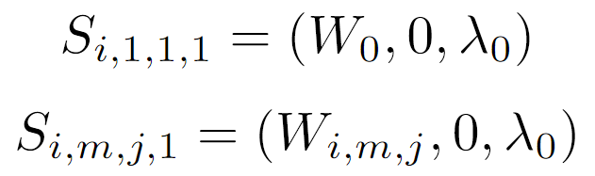
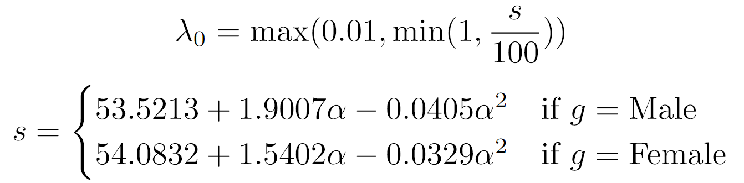
Model Overview
Diart
Initialize Automaton
Notes:
“We begin by initialising the gambler.”
“The state contains wealth, profit, and risk tolerance.”
“Risk tolerance starts from demographic characteristics.”
“So different age and gender profiles begin with different baseline risk levels.”

Slide 84
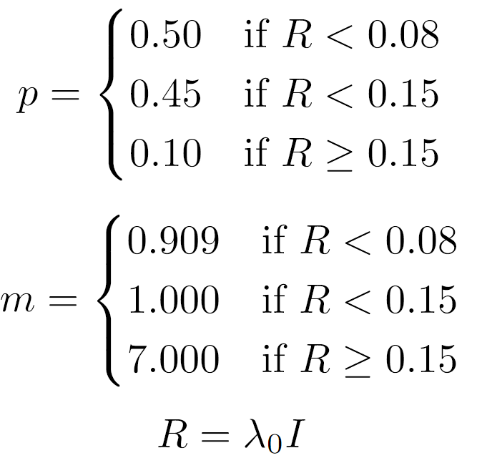

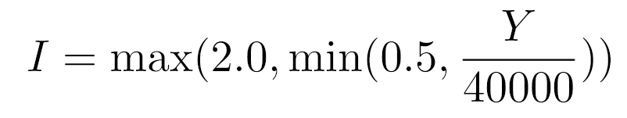
Model Overview
Diart
Initialize Automaton
Decide on Bet
Notes:
“Next, the model decides what kind of bet the gambler takes.”
“This depends on their current risk level.”
“Low-risk gamblers are more likely to choose safer bets.”
“Higher-risk gamblers are more likely to choose high-volatility bets, like bets with lower win probability but larger payout.”
“This is important because risk affects both the type of bet and the stake size.”

Slide 85
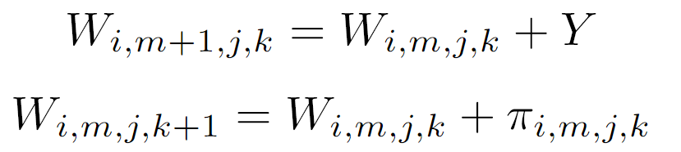
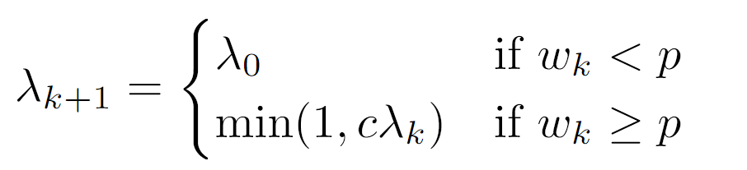
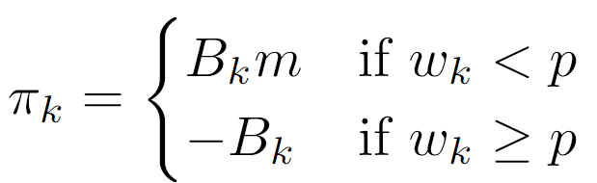
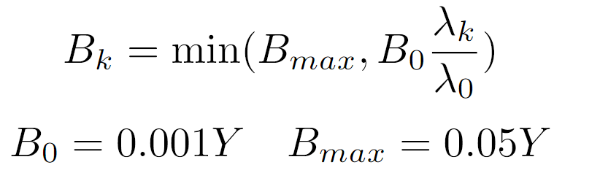
Model Overview
Diart
Place Bet
Initialize Automaton
Decide on Bet
Notes:
“Here the bet is actually simulated.”
“A random draw determines whether the gambler wins or loses.”
“If they win, profit increases and risk tolerance resets closer to baseline.”
“If they lose, profit decreases and the loss-chasing mechanism can increase their risk tolerance.”
“That is how behaviour changes over time instead of staying fixed.”

Slide 86
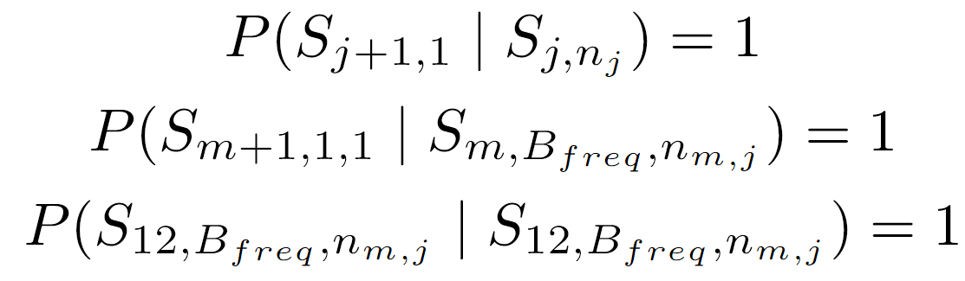
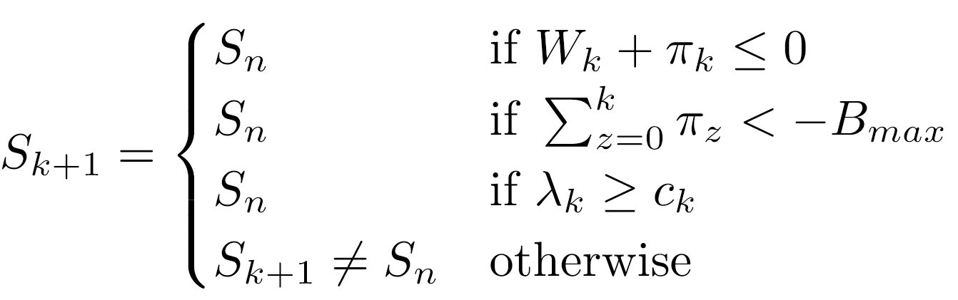
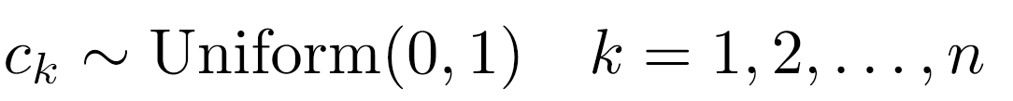
Model Overview
Diart
Quit or Continue
Initialize Automaton
Place Bet
Decide on Bet
Notes:
“After each bet, the model checks whether the gambler continues.”
“They may stop if they run out of wealth, hit a loss boundary, or randomly choose to quit.”
“This makes the model more realistic because gamblers do not place a fixed number of bets every time.”

Slide 87
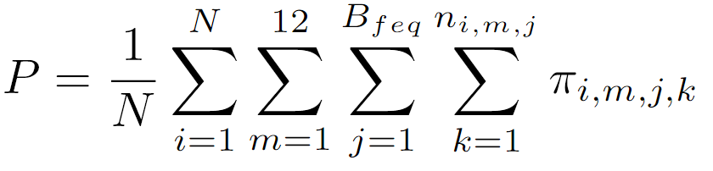
Model Overview
Diart
Calculate Total Profits
Quit or Continue
Initialize Automaton
Place Bet
Decide on Bet
Notes:
“Finally, we repeat this process across sessions, months, and simulations.”
“The output is the average yearly profit or loss.”
“So rather than one single deterministic result, we get an expected outcome from many stochastic simulations.”

Slide 88
Model Overview
Diart
Quit or Continue
Initialize Automaton
Place Bet
Calculate Total Profits
Decide on Bet
Notes:
“The key point is that gambling losses emerge from repeated state updates: risk affects betting, betting affects profit, and profit then feeds back into future risk.”

Slide 89
Data used
Stan

Slide 90
Data used
Stan
Risk-taking variation with age:

Slide 91
Data used
Stan
Risk-taking variation with age:
  Journal of Youth and Adolescence

Slide 92
Data used
Stan
Risk-taking variation with age:
  Journal of Youth and Adolescence
Risk-taking variation with gender:

Slide 93
Data used
Stan
Risk-taking variation with age:
  Journal of Youth and Adolescence
Risk-taking variation with gender:
  Gender differences in risk taking: A meta-analysis

Slide 94
Data used
Stan
Risk-taking variation with age:
  Journal of Youth and Adolescence
Risk-taking variation with gender:
  Gender differences in risk taking: A meta-analysis
Used as base parameters for our simulation

Slide 95
Design overview
Calvin

Slide 96
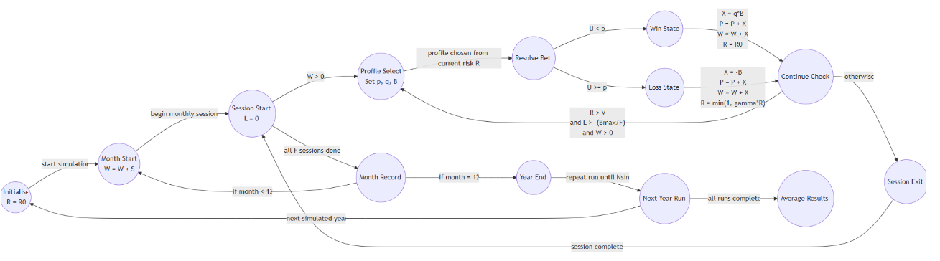
Design overview
Calvin
1) Markov Automata

Slide 97

Design overview
Calvin
1) Markov Automata
2) Agentic Simulation

Slide 98

Design overview
Calvin
1) Markov Automata
2) Agentic Simulation
3) Psychological Model

Slide 99

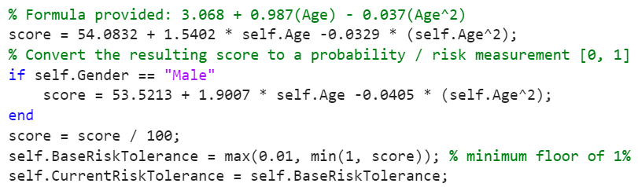
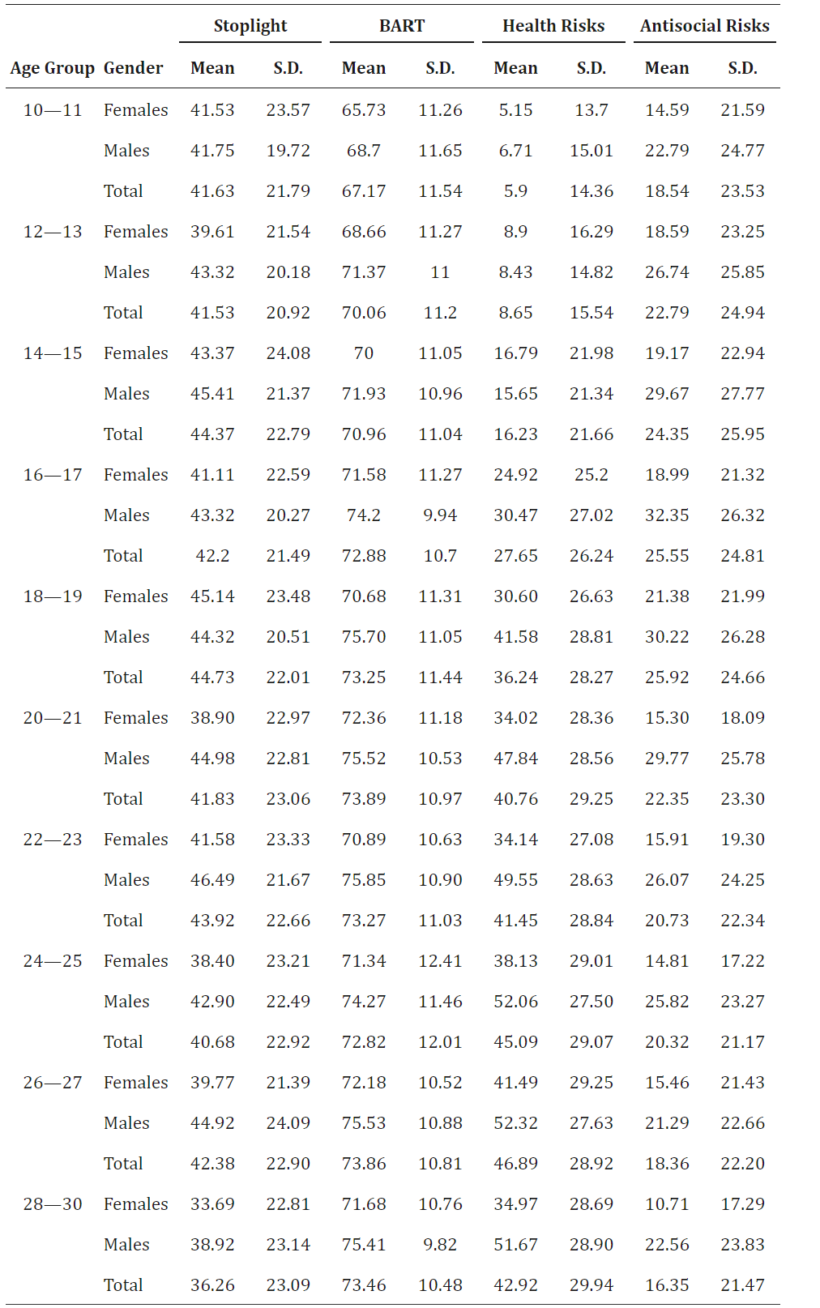
Model Structure
Gyula
(1) Markov Automaton Construction - Part 1
Symbol | Variable
λ₀ | Base Risk Tolerance
s | Estimated BART Score (as percentage)
g | Gender (‘Male’ or ‘Female’)
𝛼 | Age
Duell, N. et al. (2018). Age Patterns in Risk Taking Across the World. Journal of youth and adolescence, 47(5), 1052–1072. https://doi.org/10.1007/s10964-017-0752-y

Slide 100
Model Structure
Gyula
(1) Markov Automaton Construction - Part 2
Symbol | Variable
S_{i,m,j,k} | Automaton State for agent i, month m, session j, bet m
W_{i,m,j,k} | Wealth of Agent for agent i, month m, session j, bet m
W₀ | OECD-modified Equivalence Scale per person
λ₀ | Base Risk Tolerance
𝜋_{i,m,j,k} | Profit on Bet for agent i, month m, session j, bet k

Slide 101
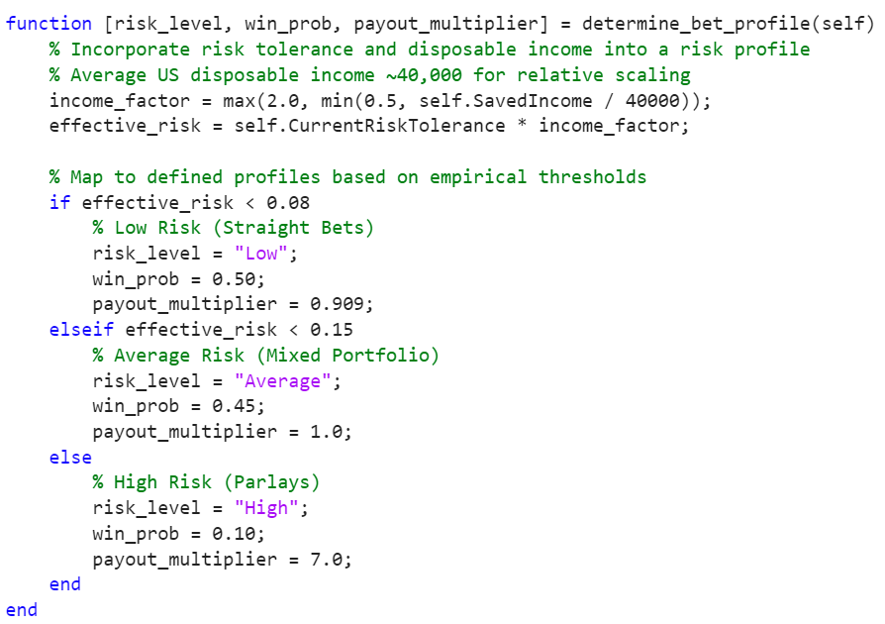
Model Structure
(1) Markov Automaton Construction
Gyula
(2) Bet Determination
Symbol | Variable
Y | Income per month
I | Income factor for risk-taking
λ_{k} | Risk Tolerance for for bet k
R | Effective risk Tolerance for bet k
p | Bet Winning Probability
m | Payout Multiplier

Slide 102
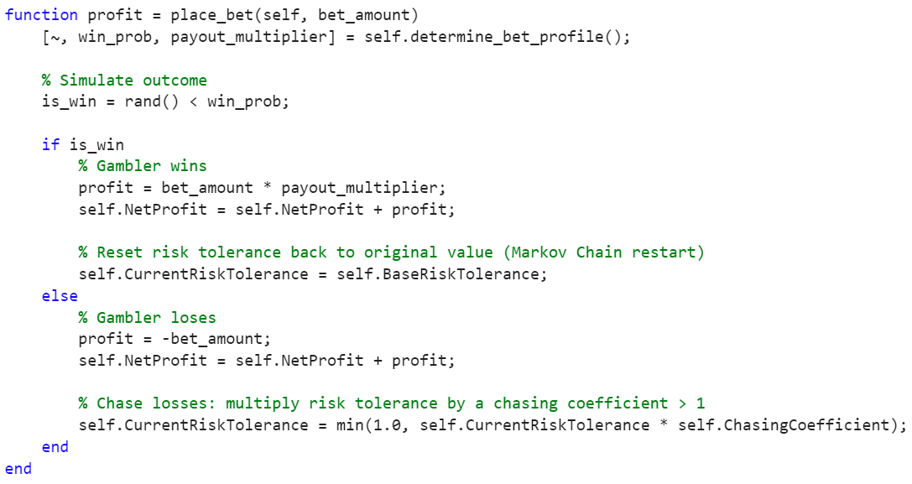
Model Structure
Gyula
(1) Markov Automaton Construction
(2) Bet Determination
(3) Placing the Bet - Part 1
Symbol | Variable
w_{k} | Winning Boundary
B_{k} | Betting amount for bet k
B_{max} | Maximum Betting Amount
B₀ | Minimum Betting Amount
λ_{k} | Risk Tolerance for bet k
λ₀ | Base Risk Tolerance

Slide 103
Model Structure
Gyula
(1) Markov Automaton Construction
(2) Bet Determination
(3) Placing the Bet - Part 2
Symbol | Variable
λ_{k} | Risk Tolerance for bet k
λ₀ | Base Risk Tolerance
c | Chasing coef.
w_{k} | Winning Boundary
p | Probability of winning
𝜋_{k} | Profit for bet k
B_{k} | Bet Amount for bet k
m | Payout multiplier

Slide 104
Model Structure
Gyula
(1) Markov Automaton Construction
(2) Bet Determination
(3) Placing the Bet - Part 3
Symbol | Variable
w_{i,m,j,k} | Agent’s wealth for agent i, month m, session j, bet k
Y | Monthly income
𝜋_{i,m,j,k} | Profit on Bet for agent i, month m, session j, bet k

Slide 105
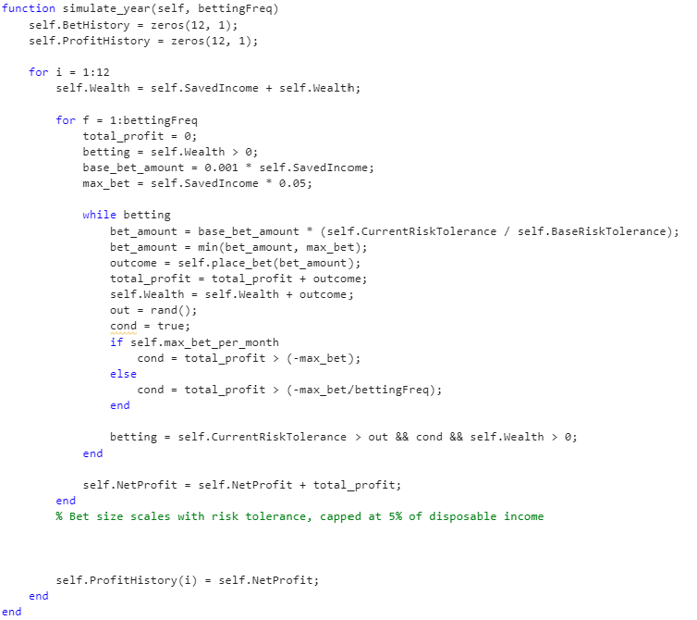
Model Structure
Gyula
(1) Markov Automaton Construction
(3) Placing the Bet
(2) Bet Determination
(4) Automaton Termination - Part 1
Symbol | Variable
S_{k+1} | Automaton State after bet k
S_{n} | Final Automaton State for a Session
W_{k} | Wealth before bet k
𝜋_{k} | Profit on bet k
B_{max} | Maximum Bet Amount
λ_{k} | Risk Tolerance for bet k
c_{k} | Stochastic Termination Boundary

Slide 106
Model Structure
Gyula
(1) Markov Automaton Construction
(3) Placing the Bet
(2) Bet Determination
(4) Automaton Termination - Part 2
Symbol | Variable
S_{m,j,k} | Agent’s State for month m, session j, bet k
B_{freq} | Number of Betting Sessions per Month
n_{m,j} | Number of bets for month m, session j

Slide 107
Model Structure
Gyula
(1) Markov Automaton Construction
(3) Placing the Bet
(2) Bet Determination
(4) Automaton Termination
Symbol | Variable
N | Number of Agents/Simulations
B_{freq} | Number of Betting Sessions per Month
n_{i,m,j} | Number of bets for agent i, month m, session j
𝜋_{i,m,j,k} | Profit on Bet for agent i, month m, session j, bet k

Slide 108
Model Overview
Gyula
Quit or Continue
Initialize Automaton
Place Bet
Calculate Total Profits
Decide on Bet

Slide 109
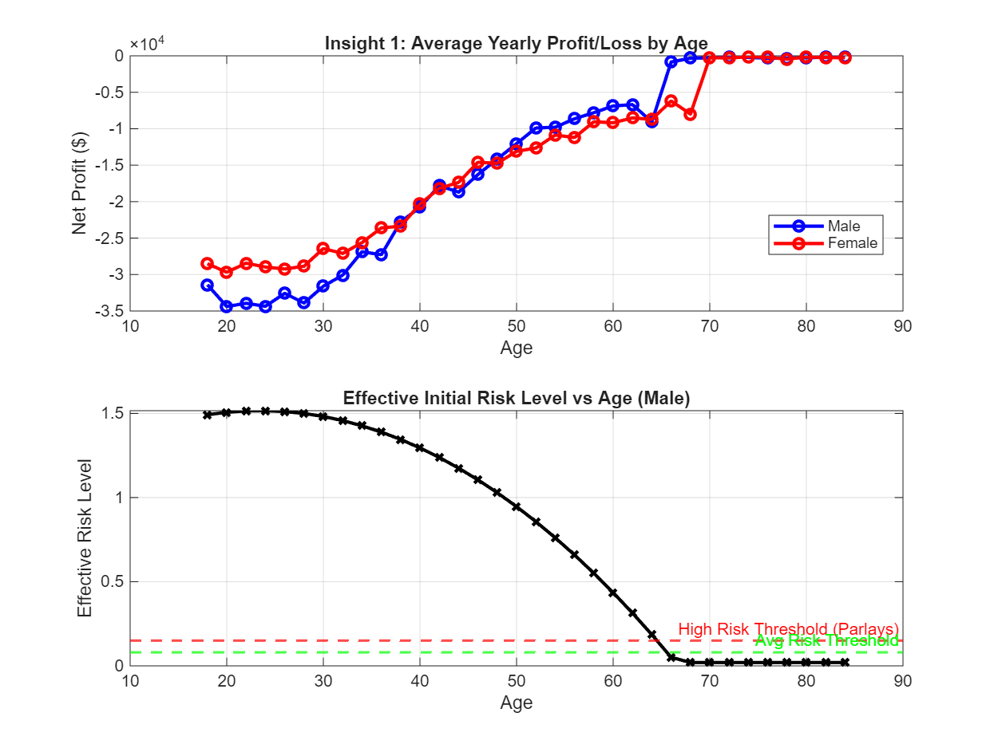
Psychological Factors in Financial Decision Making
Calvin

Slide 110
Psychological Factors in Financial Decision Making
Calvin
Youth Correlates with Financial Losses.

Slide 111
Psychological Factors in Financial Decision Making
Calvin
Youth Correlates with Financial Losses.
Extreme Risk Appetite in Younger Males: These steep early losses are driven by disproportionate risk-taking.

Slide 112
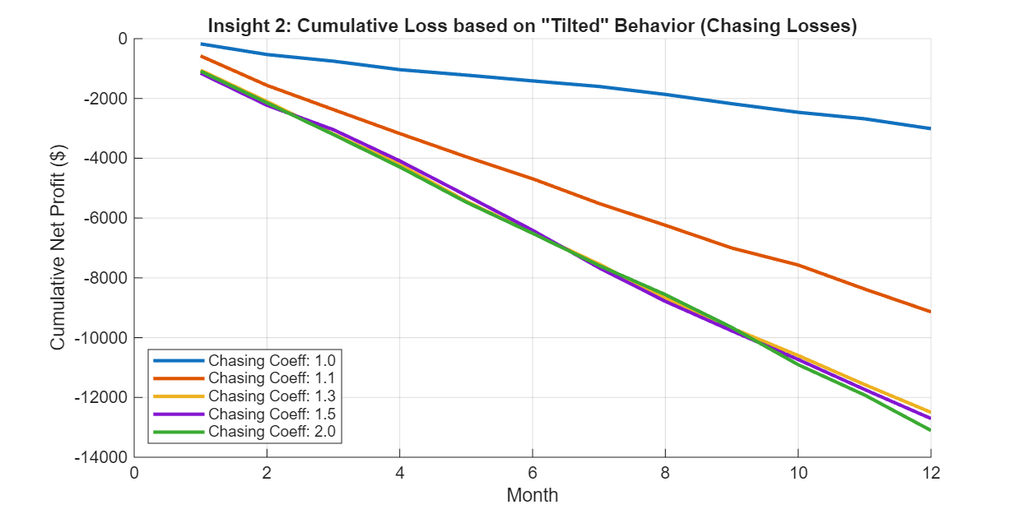
Psychological Factors in Financial Decision Making
Calvin
Youth Correlates with Financial Losses.
Extreme Risk Appetite in Younger Males: These steep early losses are driven by disproportionate risk-taking.

Slide 113
Psychological Factors in Financial Decision Making
Calvin
Impact of "Chasing Losses": Falling into "tilted" behavior drastically accelerates financial ruin.
Youth Correlates with Financial Losses.
Extreme Risk Appetite in Younger Males: These steep early losses are driven by disproportionate risk-taking.

Slide 114
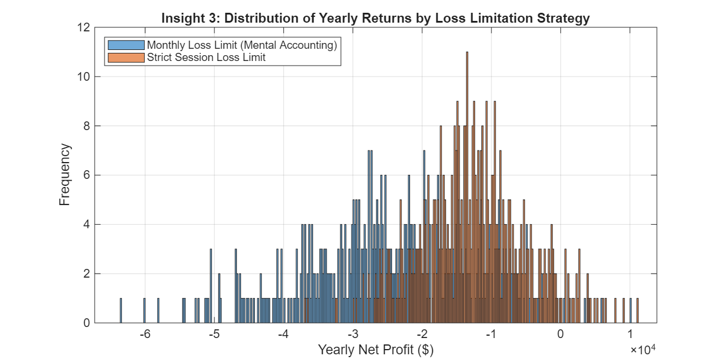
Financial Distribution & Income Impact Analysis
Stan

Slide 115
Financial Distribution & Income Impact Analysis
Stan
Strict Limits Prevent Extreme Ruin.

Slide 116
Financial Distribution & Income Impact Analysis
Stan
Strict Limits Prevent Extreme Ruin.
Relying on informal "monthly mental accounting" is highly ineffective.

Slide 117
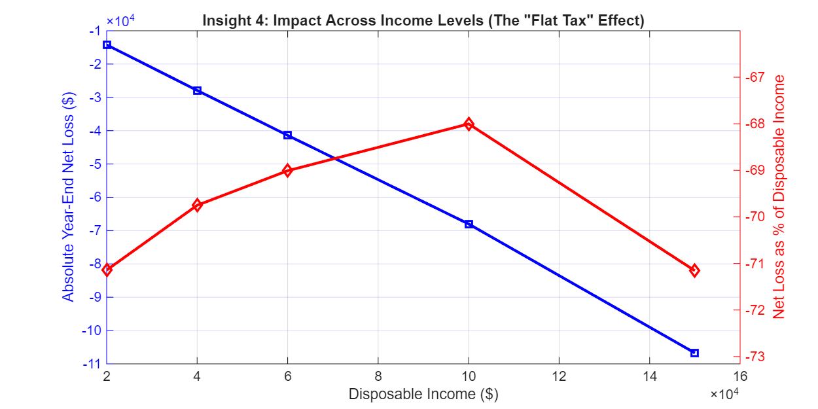
Financial Distribution & Income Impact Analysis
Stan
Strict Limits Prevent Extreme Ruin.
Relying on informal "monthly mental accounting" is highly ineffective.

Slide 118
Financial Distribution & Income Impact Analysis
Stan
Absolute Losses Scale with Wealth.
Strict Limits Prevent Extreme Ruin.
Relying on informal "monthly mental accounting" is highly ineffective.

Slide 119
Financial Distribution & Income Impact Analysis
Stan
Absolute Losses Scale with Wealth.
The "Flat Tax" Proportionality: Despite higher earners losing more total dollars, the relative financial damage is uniform.
Strict Limits Prevent Extreme Ruin.
Relying on informal "monthly mental accounting" is highly ineffective.

Slide 120
Sensitivity And Scenario Analysis
Calvin
Notes:
NEW VERSION
Testing across typical gambler demographics confirms our simulation scales smoothly and remains strictly bounded, proving its reliability for population-level modeling. Furthermore, we applied a Behavioral Stress Test to the Chasing Coefficient. By flipping the psychology from 'loss-chasing' (1.3) to 'loss-averse' (0.9), we validated that our Markov Chain accurately models distinct psychological profiles without mathematical breakdown.
OLD VERSION
Our sensitivity analysis confirms the mathematical stability of our simulation. When testing across a realistic spectrum of typical gambler demographics, the model's outputs scale smoothly and remain strictly bounded. The absence of volatile shifts or runaways across these plausible real-world ranges demonstrates that our Markov framework is robust, predictable, and reliable for population-level analysis.
While we conducted standard sensitivity analysis on continuous variables like age and income, we treated the Chasing Coefficient differently. Because 1 is the mathematical baseline, dropping the multiplier below it fundamentally changes the agent's behavior. Instead of a sensitivity analysis, we reframed this as a Behavioral Stress Test. We wanted to see how the model behaves when we flip a gambler's psychology from 'loss-chasing' (Coefficient = 1.3) to 'loss-averse' (Coefficient = 0.9). This validated that our Markov Chain accurately reflects different psychological profiles without breaking.

Slide 121
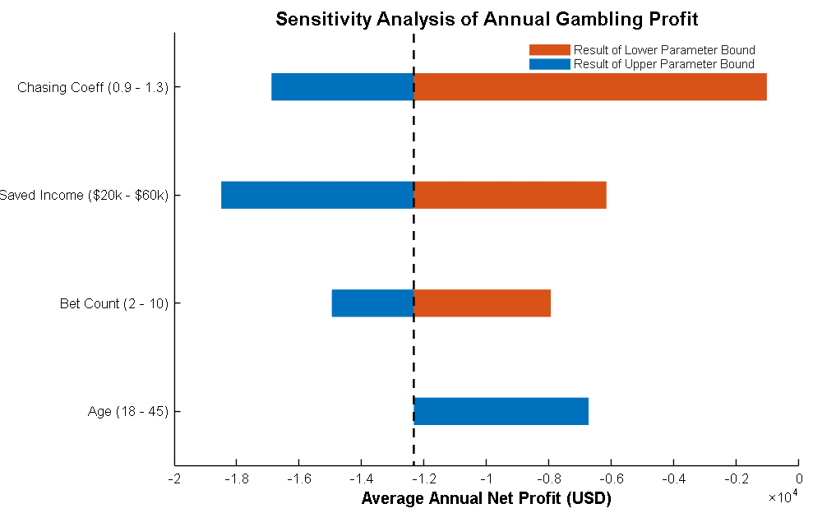
Sensitivity And Scenario Analysis
Calvin
Notes:
Testing across typical gambler demographics confirms our simulation scales smoothly and remains strictly bounded, proving its reliability for population-level modeling.
Furthermore, we applied a Behavioral Stress Test to the Chasing Coefficient. By flipping the psychology from 'loss-chasing' (1.3) to 'loss-averse' (0.9), we validated that our Markov Chain accurately models distinct psychological profiles without mathematical breakdown.
NEW VERSION
Testing across typical gambler demographics confirms our simulation scales smoothly and remains strictly bounded, proving its reliability for population-level modeling. Furthermore, we applied a Behavioral Stress Test to the Chasing Coefficient. By flipping the psychology from 'loss-chasing' (1.3) to 'loss-averse' (0.9), we validated that our Markov Chain accurately models distinct psychological profiles without mathematical breakdown.
OLD VERSION
Our sensitivity analysis confirms the mathematical stability of our simulation. When testing across a realistic spectrum of typical gambler demographics, the model's outputs scale smoothly and remain strictly bounded. The absence of volatile shifts or runaways across these plausible real-world ranges demonstrates that our Markov framework is robust, predictable, and reliable for population-level analysis.
While we conducted standard sensitivity analysis on continuous variables like age and income, we treated the Chasing Coefficient differently. Because 1 is the mathematical baseline, dropping the multiplier below it fundamentally changes the agent's behavior. Instead of a sensitivity analysis, we reframed this as a Behavioral Stress Test. We wanted to see how the model behaves when we flip a gambler's psychology from 'loss-chasing' (Coefficient = 1.3) to 'loss-averse' (Coefficient = 0.9). This validated that our Markov Chain accurately reflects different psychological profiles without breaking.

Slide 122
Sensitivity And Scenario Analysis
Calvin
Testing across typical gambler demographics confirms that our simulation...
  scales smoothly
Notes:
Testing across typical gambler demographics confirms our simulation scales smoothly and remains strictly bounded, proving its reliability for population-level modeling.
Furthermore, we applied a Behavioral Stress Test to the Chasing Coefficient. By flipping the psychology from 'loss-chasing' (1.3) to 'loss-averse' (0.9), we validated that our Markov Chain accurately models distinct psychological profiles without mathematical breakdown.
NEW VERSION
Testing across typical gambler demographics confirms our simulation scales smoothly and remains strictly bounded, proving its reliability for population-level modeling. Furthermore, we applied a Behavioral Stress Test to the Chasing Coefficient. By flipping the psychology from 'loss-chasing' (1.3) to 'loss-averse' (0.9), we validated that our Markov Chain accurately models distinct psychological profiles without mathematical breakdown.
OLD VERSION
Our sensitivity analysis confirms the mathematical stability of our simulation. When testing across a realistic spectrum of typical gambler demographics, the model's outputs scale smoothly and remain strictly bounded. The absence of volatile shifts or runaways across these plausible real-world ranges demonstrates that our Markov framework is robust, predictable, and reliable for population-level analysis.
While we conducted standard sensitivity analysis on continuous variables like age and income, we treated the Chasing Coefficient differently. Because 1 is the mathematical baseline, dropping the multiplier below it fundamentally changes the agent's behavior. Instead of a sensitivity analysis, we reframed this as a Behavioral Stress Test. We wanted to see how the model behaves when we flip a gambler's psychology from 'loss-chasing' (Coefficient = 1.3) to 'loss-averse' (Coefficient = 0.9). This validated that our Markov Chain accurately reflects different psychological profiles without breaking.

Slide 123
Sensitivity And Scenario Analysis
Calvin
Testing across typical gambler demographics confirms that our simulation...
Notes:
Testing across typical gambler demographics confirms our simulation scales smoothly and remains strictly bounded, proving its reliability for population-level modeling.
Furthermore, we applied a Behavioral Stress Test to the Chasing Coefficient. By flipping the psychology from 'loss-chasing' (1.3) to 'loss-averse' (0.9), we validated that our Markov Chain accurately models distinct psychological profiles without mathematical breakdown.
NEW VERSION
Testing across typical gambler demographics confirms our simulation scales smoothly and remains strictly bounded, proving its reliability for population-level modeling. Furthermore, we applied a Behavioral Stress Test to the Chasing Coefficient. By flipping the psychology from 'loss-chasing' (1.3) to 'loss-averse' (0.9), we validated that our Markov Chain accurately models distinct psychological profiles without mathematical breakdown.
OLD VERSION
Our sensitivity analysis confirms the mathematical stability of our simulation. When testing across a realistic spectrum of typical gambler demographics, the model's outputs scale smoothly and remain strictly bounded. The absence of volatile shifts or runaways across these plausible real-world ranges demonstrates that our Markov framework is robust, predictable, and reliable for population-level analysis.
While we conducted standard sensitivity analysis on continuous variables like age and income, we treated the Chasing Coefficient differently. Because 1 is the mathematical baseline, dropping the multiplier below it fundamentally changes the agent's behavior. Instead of a sensitivity analysis, we reframed this as a Behavioral Stress Test. We wanted to see how the model behaves when we flip a gambler's psychology from 'loss-chasing' (Coefficient = 1.3) to 'loss-averse' (Coefficient = 0.9). This validated that our Markov Chain accurately reflects different psychological profiles without breaking.

Slide 124
Sensitivity And Scenario Analysis
Calvin
Testing across typical gambler demographics confirms that our simulation...
  scales smoothly
  remains strictly bounded
Notes:
Testing across typical gambler demographics confirms our simulation scales smoothly and remains strictly bounded, proving its reliability for population-level modeling.
Furthermore, we applied a Behavioral Stress Test to the Chasing Coefficient. By flipping the psychology from 'loss-chasing' (1.3) to 'loss-averse' (0.9), we validated that our Markov Chain accurately models distinct psychological profiles without mathematical breakdown.
NEW VERSION
Testing across typical gambler demographics confirms our simulation scales smoothly and remains strictly bounded, proving its reliability for population-level modeling. Furthermore, we applied a Behavioral Stress Test to the Chasing Coefficient. By flipping the psychology from 'loss-chasing' (1.3) to 'loss-averse' (0.9), we validated that our Markov Chain accurately models distinct psychological profiles without mathematical breakdown.
OLD VERSION
Our sensitivity analysis confirms the mathematical stability of our simulation. When testing across a realistic spectrum of typical gambler demographics, the model's outputs scale smoothly and remain strictly bounded. The absence of volatile shifts or runaways across these plausible real-world ranges demonstrates that our Markov framework is robust, predictable, and reliable for population-level analysis.
While we conducted standard sensitivity analysis on continuous variables like age and income, we treated the Chasing Coefficient differently. Because 1 is the mathematical baseline, dropping the multiplier below it fundamentally changes the agent's behavior. Instead of a sensitivity analysis, we reframed this as a Behavioral Stress Test. We wanted to see how the model behaves when we flip a gambler's psychology from 'loss-chasing' (Coefficient = 1.3) to 'loss-averse' (Coefficient = 0.9). This validated that our Markov Chain accurately reflects different psychological profiles without breaking.

Slide 125
Sensitivity And Scenario Analysis
Calvin
Testing across typical gambler demographics confirms that our simulation...
  scales smoothly
  remains strictly bounded
We applied a Behavioral Stress Test to the Chasing Coefficient
Notes:
Testing across typical gambler demographics confirms our simulation scales smoothly and remains strictly bounded, proving its reliability for population-level modeling.
Furthermore, we applied a Behavioral Stress Test to the Chasing Coefficient. By flipping the psychology from 'loss-chasing' (1.3) to 'loss-averse' (0.9), we validated that our Markov Chain accurately models distinct psychological profiles without mathematical breakdown.
NEW VERSION
Testing across typical gambler demographics confirms our simulation scales smoothly and remains strictly bounded, proving its reliability for population-level modeling. Furthermore, we applied a Behavioral Stress Test to the Chasing Coefficient. By flipping the psychology from 'loss-chasing' (1.3) to 'loss-averse' (0.9), we validated that our Markov Chain accurately models distinct psychological profiles without mathematical breakdown.
OLD VERSION
Our sensitivity analysis confirms the mathematical stability of our simulation. When testing across a realistic spectrum of typical gambler demographics, the model's outputs scale smoothly and remain strictly bounded. The absence of volatile shifts or runaways across these plausible real-world ranges demonstrates that our Markov framework is robust, predictable, and reliable for population-level analysis.
While we conducted standard sensitivity analysis on continuous variables like age and income, we treated the Chasing Coefficient differently. Because 1 is the mathematical baseline, dropping the multiplier below it fundamentally changes the agent's behavior. Instead of a sensitivity analysis, we reframed this as a Behavioral Stress Test. We wanted to see how the model behaves when we flip a gambler's psychology from 'loss-chasing' (Coefficient = 1.3) to 'loss-averse' (Coefficient = 0.9). This validated that our Markov Chain accurately reflects different psychological profiles without breaking.

Slide 126
Sensitivity And Scenario Analysis
Calvin
Testing across typical gambler demographics confirms that our simulation...
  scales smoothly
  remains strictly bounded
We applied a Behavioral Stress Test to the Chasing Coefficient
  flipping the psychology from 'loss-chasing' (1.3) to 'loss-averse' (0.9)
Notes:
Testing across typical gambler demographics confirms our simulation scales smoothly and remains strictly bounded, proving its reliability for population-level modeling.
Furthermore, we applied a Behavioral Stress Test to the Chasing Coefficient. By flipping the psychology from 'loss-chasing' (1.3) to 'loss-averse' (0.9), we validated that our Markov Chain accurately models distinct psychological profiles without mathematical breakdown.
NEW VERSION
Testing across typical gambler demographics confirms our simulation scales smoothly and remains strictly bounded, proving its reliability for population-level modeling. Furthermore, we applied a Behavioral Stress Test to the Chasing Coefficient. By flipping the psychology from 'loss-chasing' (1.3) to 'loss-averse' (0.9), we validated that our Markov Chain accurately models distinct psychological profiles without mathematical breakdown.
OLD VERSION
Our sensitivity analysis confirms the mathematical stability of our simulation. When testing across a realistic spectrum of typical gambler demographics, the model's outputs scale smoothly and remain strictly bounded. The absence of volatile shifts or runaways across these plausible real-world ranges demonstrates that our Markov framework is robust, predictable, and reliable for population-level analysis.
While we conducted standard sensitivity analysis on continuous variables like age and income, we treated the Chasing Coefficient differently. Because 1 is the mathematical baseline, dropping the multiplier below it fundamentally changes the agent's behavior. Instead of a sensitivity analysis, we reframed this as a Behavioral Stress Test. We wanted to see how the model behaves when we flip a gambler's psychology from 'loss-chasing' (Coefficient = 1.3) to 'loss-averse' (Coefficient = 0.9). This validated that our Markov Chain accurately reflects different psychological profiles without breaking.

Slide 127
Don’t break the bank
Diart

Slide 128
Q3 - an introduction
Diart

Slide 129
Q3 - an introduction
Diart
Model the long-run financial damage caused by gambling losses

Slide 130
Q3 - an introduction
Diart
Model the long-run financial damage caused by gambling losses
  Convert that damage into Recovery Burden Months (RBM)

Slide 131
Q3 - an introduction
Diart
Model the long-run financial damage caused by gambling losses
  Convert that damage into Recovery Burden Months (RBM)
  Measure how many months of ordinary saving are needed to repair the harm

Slide 132
Q3 - an introduction
Diart
Model the long-run financial damage caused by gambling losses
  Convert that damage into Recovery Burden Months (RBM)
  Measure how many months of ordinary saving are needed to repair the harm
We built a 3-compartment recovery model:

Slide 133
Q3 - an introduction
Diart
Model the long-run financial damage caused by gambling losses
  Convert that damage into Recovery Burden Months (RBM)
  Measure how many months of ordinary saving are needed to repair the harm
We built a 3-compartment recovery model:
  depleted savings

Slide 134
Q3 - an introduction
Diart
Model the long-run financial damage caused by gambling losses
  Convert that damage into Recovery Burden Months (RBM)
  Measure how many months of ordinary saving are needed to repair the harm
We built a 3-compartment recovery model:
  depleted savings
  missed investment growth

Slide 135
Q3 - an introduction
Diart
Model the long-run financial damage caused by gambling losses
  Convert that damage into Recovery Burden Months (RBM)
  Measure how many months of ordinary saving are needed to repair the harm
We built a 3-compartment recovery model:
  depleted savings
  missed investment growth
  debt accumulation
Notes:
“Question 3 asks what happens after the gambling loss has already occurred.”
“The focus is no longer just the amount lost.”
“Instead, we ask how long the damage lasts financially.”
“We convert the damage into Recovery Burden Months, or RBM.”
“RBM means the number of months of ordinary saving needed to repair the harm.”
“This is useful because two people can lose the same amount, but the recovery burden can be completely different.”
“For a high-income person, the loss may be repaired quickly.”
“For a lower-income person, the same loss could take many months to recover from.”
“We model this using three financial compartments.”
“The first is depleted savings.”
“This is the immediate cash or savings used up by the gambling loss.”
“The second is missed investment growth.”
“This captures the future growth that would have happened if the money had not been lost.”
“The third is debt accumulation.”
“This is the most dangerous compartment because debt can grow through interest.”
“So Q3 turns a short-term gambling loss into a long-term measure of financial damage.”

Slide 136
What data did we use:
Stan

Slide 137
What data did we use:
Stan
Typical low-risk fund returns (7%)

Slide 138
What data did we use:
Stan
Typical low-risk fund returns (7%)
Average credit card APR (22%)

Slide 139
What data did we use:
Stan
Typical low-risk fund returns (7%)
Average credit card APR (22%)
Research journals on average gambling loss ($200pm)

Slide 140
What data did we use:
Stan
Typical low-risk fund returns (7%)
Average credit card APR (22%)
Research journals on average gambling loss ($200pm)
  From Normative Feedback intervention by gambling operator can decrease average wages per day.

Slide 141
What data did we use:
Stan
Typical low-risk fund returns (7%)
Average credit card APR (22%)
Research journals on average gambling loss ($200pm)
  From Normative Feedback intervention by gambling operator can decrease average wages per day.
Impulse/confort spending ($50pm)

Slide 142
What data did we use:
Stan
Typical low-risk fund returns (7%)
Average credit card APR (22%)
Research journals on average gambling loss ($200pm)
  From Normative Feedback intervention by gambling operator can decrease average wages per day.
Impulse/confort spending ($50pm)
  Report by Self Financial on Americans' Mental Health and Personal Spending.
Monthly saving ($500pm)

Slide 143
What data did we use:
Stan
Typical low-risk fund returns (7%)
Average credit card APR (22%)
Research journals on average gambling loss ($200pm)
  From Normative Feedback intervention by gambling operator can decrease average wages per day.
Impulse/confort spending ($50pm)
  Report by Self Financial on Americans' Mental Health and Personal Spending.
Monthly saving ($500pm)
  NatWest Saving Index

Slide 144
Model structure
Calvin

Slide 145
Model structure
Calvin
Step 1: compute the harmful shortfall

Slide 146
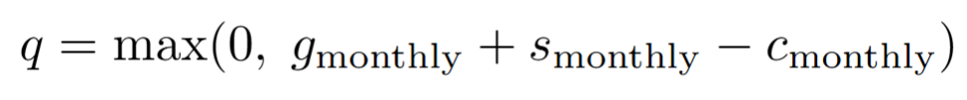
Model structure
Calvin
Step 1: compute the harmful shortfall

Slide 147
Model structure
Calvin
Step 1: compute the harmful shortfall
Step 2: convert annual rates to monthly rates

Slide 148
Model structure
Calvin
Step 1: compute the harmful shortfall
Step 2: convert annual rates to monthly rates
Step 3: solve the 3-gap ODE system with MATLAB ode45

Slide 149
Model structure
Calvin
Step 1: compute the harmful shortfall
Step 2: convert annual rates to monthly rates
Step 3: solve the 3-gap ODE system with MATLAB ode45
Step 4: extract final gaps and convert them into RBM

Slide 150
Execution
Diart

Slide 151
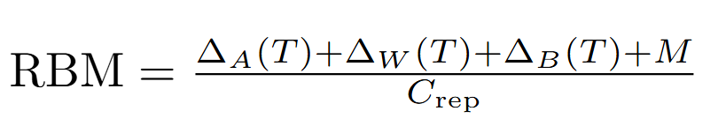
Execution
Diart
Notes:
“At the top, RBM is calculated as total repair deficit divided by monthly saving capacity.”
“So the numerator is the total financial damage that needs to be repaired.”
“The denominator is how much the person can realistically save each month.”
“That is why the same loss can produce different RBMs for different people.”

Slide 152
Execution
Diart
Total repair deficit

Slide 153
Execution
Diart
Total repair deficit
Monthly saving capacity

Slide 154
Execution
Diart
Total repair deficit
Monthly saving capacity
Notes:
“Before calculating the damage, we first define the harmful shortfall.”
“This is the gambling loss that exceeds the person’s safe monthly cushion.”
“If gambling stays within the safe cushion, the harmful shortfall is zero.”
“But once losses exceed that cushion, the model treats the excess as financially damaging.”

Slide 155
Execution
Diart
Total repair deficit
Monthly saving capacity
Harmful shortfall beyond safe cushion

Slide 156
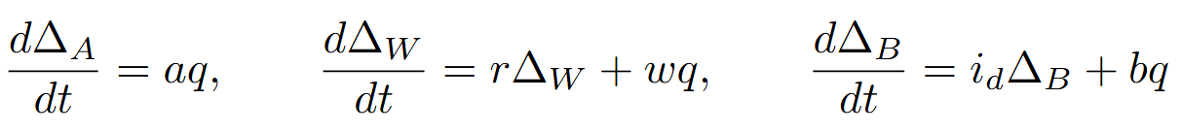
Execution
Diart
Total repair deficit
Monthly saving capacity
Harmful shortfall beyond safe cushion
Notes:
“The harmful shortfall is then split into three compartments.”
“The first is depleted savings.”
“This increases directly with the harmful shortfall.”
“The second is missed investment growth.”
“This grows because money that could have been invested is no longer available.”
“So the damage compounds over time through lost returns.”
“The third is debt accumulation.”
“This grows both from the gambling shortfall and from interest on existing debt.”
“That makes debt-funded gambling especially dangerous.”

Slide 157
Execution
Diart
Total repair deficit
Monthly saving capacity
Harmful shortfall beyond safe cushion
Depleted savings

Slide 158
Execution
Diart
Total repair deficit
Monthly saving capacity
Harmful shortfall beyond safe cushion
Depleted savings
Missed investment growth

Slide 159
Execution
Diart
Total repair deficit
Monthly saving capacity
Harmful shortfall beyond safe cushion
Depleted savings
Missed investment growth
Debt accumulation

Slide 160
Execution
Diart
Total repair deficit
Monthly saving capacity
Harmful shortfall beyond safe cushion
Depleted savings
Missed investment growth
Debt accumulation

Slide 161
Execution
Diart
Total repair deficit
Monthly saving capacity
Harmful shortfall beyond safe cushion
Depleted savings
Missed investment growth
Debt accumulation
Monthly rates + initial conditions
Notes:
Point to monthly rates and initial conditions
“At the bottom, we convert annual rates into monthly rates.”
“We also start the damage compartments at zero.”
“This means we are measuring the additional damage caused by the gambling event.”
“So the model does not just ask, ‘how much did they lose?’”
“It asks, ‘how much future financial recovery has that loss created?’”

Slide 162
ode45 solver
Gyula

Slide 163
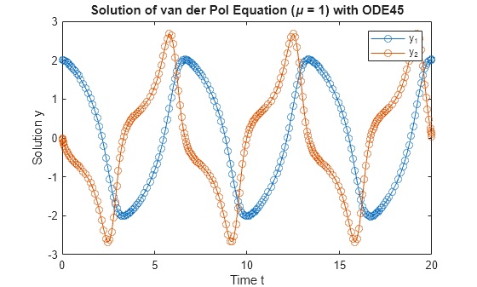
ode45 solver
Gyula

Slide 164
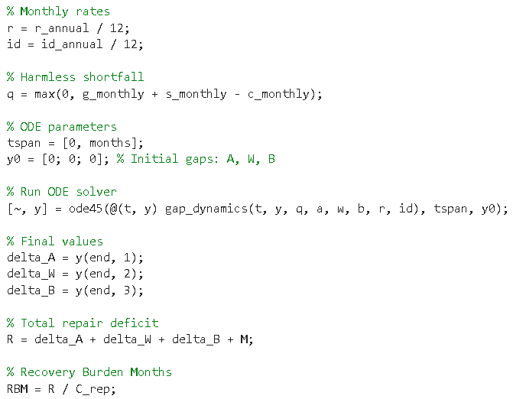
ode45 solver
Gyula

Slide 165
ode45 solver
Gyula
ode45 computes the time path of the three financial gaps and returns their final values for RBM

Slide 166
Gambling Impact & Recovery Analysis
Calvin

Slide 167

Gambling Impact & Recovery Analysis
Calvin

Slide 168
Gambling Impact & Recovery Analysis
Calvin
The Exponential Trap of Debt: Funding gambling with high-interest debt creates an exponential recovery timeline.

Slide 169

Gambling Impact & Recovery Analysis
Calvin
The Exponential Trap of Debt: Funding gambling with high-interest debt creates an exponential recovery timeline.

Slide 170
Gambling Impact & Recovery Analysis
Calvin
The "Safe Cushion" Illusion: Budgeting a financial buffer offers a false sense of security if limits are breached.
The Exponential Trap of Debt: Funding gambling with high-interest debt creates an exponential recovery timeline.

Slide 171
Sensitivity Analysis
Calvin
Notes:
NEW VERSION
Insensitive to Rate Errors: Despite modeling compound debt and missed investments, a 20% swing in interest or investment rates alters the recovery time by less than a month over a 5-year horizon. Perfect APR or macroeconomic estimates aren't necessary for reliable Recovery Burden Month (RBM) predictions.
"Cash Flow is King": Recovery is overwhelmingly dictated by four direct monthly cash flows: Gambling Loss, Saving Capacity, Safe Cushion, and Leakage. Ultimately, behavioral changes—like plugging cash drains and boosting savings—impact recovery vastly more than securing better interest rates.
OLD VERSION
The Model is Highly Robust to Financial Rates Although the differential equations in gap_dynamics.m explicitly model the compounding effects of debt (id_annual) and missed investments (r_annual), the model is impressively robust (insensitive) to forecasting errors in these rates over a 5-year period. A 20% swing in investment returns or debt interest rates changes the recovery time by less than 1 month. Takeaway: You do not need perfect estimates of macroeconomic factors or the exact APR of a user's credit card to get a reliable RBM prediction.
"Cash Flow is King". The top 7 parameters which impact recovery burden are shown in the figure. Even within this top 7, the model's output is overwhelmingly dictated by the top four parameters, which are all direct monthly cash flows: Gambling Loss, Monthly Saving Capacity, Safe Cushion, and Stress/Leakage. Takeaway: The model highlights that behavioral changes (plugging the cash drain and boosting monthly savings) matter vastly more than finding a better interest rate to pay off the debt.

Slide 172

Sensitivity Analysis
Calvin
Notes:
Insensitive to Rate Errors:
Perfect APR or macroeconomic estimates not necessary for reliable Recovery Burden Month (RBM) predictions.
"Cash Flow is King":
Recovery is dictated by four direct monthly cash flows: Gambling Loss, Saving Capacity, Safe Cushion, and Leakage.
NEW VERSION
Insensitive to Rate Errors: Despite modeling compound debt and missed investments, a 20% swing in interest or investment rates alters the recovery time by less than a month over a 5-year horizon. Perfect APR or macroeconomic estimates aren't necessary for reliable Recovery Burden Month (RBM) predictions.
"Cash Flow is King": Recovery is overwhelmingly dictated by four direct monthly cash flows: Gambling Loss, Saving Capacity, Safe Cushion, and Leakage. Ultimately, behavioral changes—like plugging cash drains and boosting savings—impact recovery vastly more than securing better interest rates.
OLD VERSION
The Model is Highly Robust to Financial Rates Although the differential equations in gap_dynamics.m explicitly model the compounding effects of debt (id_annual) and missed investments (r_annual), the model is impressively robust (insensitive) to forecasting errors in these rates over a 5-year period. A 20% swing in investment returns or debt interest rates changes the recovery time by less than 1 month. Takeaway: You do not need perfect estimates of macroeconomic factors or the exact APR of a user's credit card to get a reliable RBM prediction.
"Cash Flow is King". The top 7 parameters which impact recovery burden are shown in the figure. Even within this top 7, the model's output is overwhelmingly dictated by the top four parameters, which are all direct monthly cash flows: Gambling Loss, Monthly Saving Capacity, Safe Cushion, and Stress/Leakage. Takeaway: The model highlights that behavioral changes (plugging the cash drain and boosting monthly savings) matter vastly more than finding a better interest rate to pay off the debt.
Removed:
Ultimately, behavioral changes—like plugging cash drains and boosting savings—impact recovery vastly more than securing better interest rates.

Slide 173
Sensitivity Analysis
Calvin
Insensitive to Rate Errors:
Notes:
Insensitive to Rate Errors:
Perfect APR or macroeconomic estimates not necessary for reliable Recovery Burden Month (RBM) predictions.
"Cash Flow is King":
Recovery is dictated by four direct monthly cash flows: Gambling Loss, Saving Capacity, Safe Cushion, and Leakage.
NEW VERSION
Insensitive to Rate Errors: Despite modeling compound debt and missed investments, a 20% swing in interest or investment rates alters the recovery time by less than a month over a 5-year horizon. Perfect APR or macroeconomic estimates aren't necessary for reliable Recovery Burden Month (RBM) predictions.
"Cash Flow is King": Recovery is overwhelmingly dictated by four direct monthly cash flows: Gambling Loss, Saving Capacity, Safe Cushion, and Leakage. Ultimately, behavioral changes—like plugging cash drains and boosting savings—impact recovery vastly more than securing better interest rates.
OLD VERSION
The Model is Highly Robust to Financial Rates Although the differential equations in gap_dynamics.m explicitly model the compounding effects of debt (id_annual) and missed investments (r_annual), the model is impressively robust (insensitive) to forecasting errors in these rates over a 5-year period. A 20% swing in investment returns or debt interest rates changes the recovery time by less than 1 month. Takeaway: You do not need perfect estimates of macroeconomic factors or the exact APR of a user's credit card to get a reliable RBM prediction.
"Cash Flow is King". The top 7 parameters which impact recovery burden are shown in the figure. Even within this top 7, the model's output is overwhelmingly dictated by the top four parameters, which are all direct monthly cash flows: Gambling Loss, Monthly Saving Capacity, Safe Cushion, and Stress/Leakage. Takeaway: The model highlights that behavioral changes (plugging the cash drain and boosting monthly savings) matter vastly more than finding a better interest rate to pay off the debt.
Removed:
Ultimately, behavioral changes—like plugging cash drains and boosting savings—impact recovery vastly more than securing better interest rates.

Slide 174
Sensitivity Analysis
Calvin
Insensitive to Rate Errors:
  Perfect APR or macroeconomic estimates not necessary for the RBM predictions
Notes:
Insensitive to Rate Errors:
Perfect APR or macroeconomic estimates not necessary for reliable Recovery Burden Month (RBM) predictions.
"Cash Flow is King":
Recovery is dictated by four direct monthly cash flows: Gambling Loss, Saving Capacity, Safe Cushion, and Leakage.
NEW VERSION
Insensitive to Rate Errors: Despite modeling compound debt and missed investments, a 20% swing in interest or investment rates alters the recovery time by less than a month over a 5-year horizon. Perfect APR or macroeconomic estimates aren't necessary for reliable Recovery Burden Month (RBM) predictions.
"Cash Flow is King": Recovery is overwhelmingly dictated by four direct monthly cash flows: Gambling Loss, Saving Capacity, Safe Cushion, and Leakage. Ultimately, behavioral changes—like plugging cash drains and boosting savings—impact recovery vastly more than securing better interest rates.
OLD VERSION
The Model is Highly Robust to Financial Rates Although the differential equations in gap_dynamics.m explicitly model the compounding effects of debt (id_annual) and missed investments (r_annual), the model is impressively robust (insensitive) to forecasting errors in these rates over a 5-year period. A 20% swing in investment returns or debt interest rates changes the recovery time by less than 1 month. Takeaway: You do not need perfect estimates of macroeconomic factors or the exact APR of a user's credit card to get a reliable RBM prediction.
"Cash Flow is King". The top 7 parameters which impact recovery burden are shown in the figure. Even within this top 7, the model's output is overwhelmingly dictated by the top four parameters, which are all direct monthly cash flows: Gambling Loss, Monthly Saving Capacity, Safe Cushion, and Stress/Leakage. Takeaway: The model highlights that behavioral changes (plugging the cash drain and boosting monthly savings) matter vastly more than finding a better interest rate to pay off the debt.
Removed:
Ultimately, behavioral changes—like plugging cash drains and boosting savings—impact recovery vastly more than securing better interest rates.

Slide 175
Sensitivity Analysis
Calvin
Insensitive to Rate Errors:
  Perfect APR or macroeconomic estimates not necessary for the RBM predictions
"Cash Flow is King":
Notes:
Insensitive to Rate Errors:
Perfect APR or macroeconomic estimates not necessary for reliable Recovery Burden Month (RBM) predictions.
"Cash Flow is King":
Recovery is dictated by four direct monthly cash flows: Gambling Loss, Saving Capacity, Safe Cushion, and Leakage.
NEW VERSION
Insensitive to Rate Errors: Despite modeling compound debt and missed investments, a 20% swing in interest or investment rates alters the recovery time by less than a month over a 5-year horizon. Perfect APR or macroeconomic estimates aren't necessary for reliable Recovery Burden Month (RBM) predictions.
"Cash Flow is King": Recovery is overwhelmingly dictated by four direct monthly cash flows: Gambling Loss, Saving Capacity, Safe Cushion, and Leakage. Ultimately, behavioral changes—like plugging cash drains and boosting savings—impact recovery vastly more than securing better interest rates.
OLD VERSION
The Model is Highly Robust to Financial Rates Although the differential equations in gap_dynamics.m explicitly model the compounding effects of debt (id_annual) and missed investments (r_annual), the model is impressively robust (insensitive) to forecasting errors in these rates over a 5-year period. A 20% swing in investment returns or debt interest rates changes the recovery time by less than 1 month. Takeaway: You do not need perfect estimates of macroeconomic factors or the exact APR of a user's credit card to get a reliable RBM prediction.
"Cash Flow is King". The top 7 parameters which impact recovery burden are shown in the figure. Even within this top 7, the model's output is overwhelmingly dictated by the top four parameters, which are all direct monthly cash flows: Gambling Loss, Monthly Saving Capacity, Safe Cushion, and Stress/Leakage. Takeaway: The model highlights that behavioral changes (plugging the cash drain and boosting monthly savings) matter vastly more than finding a better interest rate to pay off the debt.
Removed:
Ultimately, behavioral changes—like plugging cash drains and boosting savings—impact recovery vastly more than securing better interest rates.

Slide 176
Sensitivity Analysis
Calvin
Insensitive to Rate Errors:
  Perfect APR or macroeconomic estimates not necessary for the RBM predictions
"Cash Flow is King":
Recovery is dictated by four direct monthly cash flows:
Notes:
Insensitive to Rate Errors:
Perfect APR or macroeconomic estimates not necessary for reliable Recovery Burden Month (RBM) predictions.
"Cash Flow is King":
Recovery is dictated by four direct monthly cash flows: Gambling Loss, Saving Capacity, Safe Cushion, and Leakage.
NEW VERSION
Insensitive to Rate Errors: Despite modeling compound debt and missed investments, a 20% swing in interest or investment rates alters the recovery time by less than a month over a 5-year horizon. Perfect APR or macroeconomic estimates aren't necessary for reliable Recovery Burden Month (RBM) predictions.
"Cash Flow is King": Recovery is overwhelmingly dictated by four direct monthly cash flows: Gambling Loss, Saving Capacity, Safe Cushion, and Leakage. Ultimately, behavioral changes—like plugging cash drains and boosting savings—impact recovery vastly more than securing better interest rates.
OLD VERSION
The Model is Highly Robust to Financial Rates Although the differential equations in gap_dynamics.m explicitly model the compounding effects of debt (id_annual) and missed investments (r_annual), the model is impressively robust (insensitive) to forecasting errors in these rates over a 5-year period. A 20% swing in investment returns or debt interest rates changes the recovery time by less than 1 month. Takeaway: You do not need perfect estimates of macroeconomic factors or the exact APR of a user's credit card to get a reliable RBM prediction.
"Cash Flow is King". The top 7 parameters which impact recovery burden are shown in the figure. Even within this top 7, the model's output is overwhelmingly dictated by the top four parameters, which are all direct monthly cash flows: Gambling Loss, Monthly Saving Capacity, Safe Cushion, and Stress/Leakage. Takeaway: The model highlights that behavioral changes (plugging the cash drain and boosting monthly savings) matter vastly more than finding a better interest rate to pay off the debt.
Removed:
Ultimately, behavioral changes—like plugging cash drains and boosting savings—impact recovery vastly more than securing better interest rates.

Slide 177
Sensitivity Analysis
Calvin
Insensitive to Rate Errors:
  Perfect APR or macroeconomic estimates not necessary for the RBM predictions
"Cash Flow is King":
Recovery is dictated by four direct monthly cash flows:
  Gambling Loss
Notes:
Insensitive to Rate Errors:
Perfect APR or macroeconomic estimates not necessary for reliable Recovery Burden Month (RBM) predictions.
"Cash Flow is King":
Recovery is dictated by four direct monthly cash flows: Gambling Loss, Saving Capacity, Safe Cushion, and Leakage.
NEW VERSION
Insensitive to Rate Errors: Despite modeling compound debt and missed investments, a 20% swing in interest or investment rates alters the recovery time by less than a month over a 5-year horizon. Perfect APR or macroeconomic estimates aren't necessary for reliable Recovery Burden Month (RBM) predictions.
"Cash Flow is King": Recovery is overwhelmingly dictated by four direct monthly cash flows: Gambling Loss, Saving Capacity, Safe Cushion, and Leakage. Ultimately, behavioral changes—like plugging cash drains and boosting savings—impact recovery vastly more than securing better interest rates.
OLD VERSION
The Model is Highly Robust to Financial Rates Although the differential equations in gap_dynamics.m explicitly model the compounding effects of debt (id_annual) and missed investments (r_annual), the model is impressively robust (insensitive) to forecasting errors in these rates over a 5-year period. A 20% swing in investment returns or debt interest rates changes the recovery time by less than 1 month. Takeaway: You do not need perfect estimates of macroeconomic factors or the exact APR of a user's credit card to get a reliable RBM prediction.
"Cash Flow is King". The top 7 parameters which impact recovery burden are shown in the figure. Even within this top 7, the model's output is overwhelmingly dictated by the top four parameters, which are all direct monthly cash flows: Gambling Loss, Monthly Saving Capacity, Safe Cushion, and Stress/Leakage. Takeaway: The model highlights that behavioral changes (plugging the cash drain and boosting monthly savings) matter vastly more than finding a better interest rate to pay off the debt.
Removed:
Ultimately, behavioral changes—like plugging cash drains and boosting savings—impact recovery vastly more than securing better interest rates.

Slide 178
Sensitivity Analysis
Calvin
Insensitive to Rate Errors:
  Perfect APR or macroeconomic estimates not necessary for the RBM predictions
"Cash Flow is King":
Recovery is dictated by four direct monthly cash flows:
  Gambling Loss
  Saving Capacity
Notes:
Insensitive to Rate Errors:
Perfect APR or macroeconomic estimates not necessary for reliable Recovery Burden Month (RBM) predictions.
"Cash Flow is King":
Recovery is dictated by four direct monthly cash flows: Gambling Loss, Saving Capacity, Safe Cushion, and Leakage.
NEW VERSION
Insensitive to Rate Errors: Despite modeling compound debt and missed investments, a 20% swing in interest or investment rates alters the recovery time by less than a month over a 5-year horizon. Perfect APR or macroeconomic estimates aren't necessary for reliable Recovery Burden Month (RBM) predictions.
"Cash Flow is King": Recovery is overwhelmingly dictated by four direct monthly cash flows: Gambling Loss, Saving Capacity, Safe Cushion, and Leakage. Ultimately, behavioral changes—like plugging cash drains and boosting savings—impact recovery vastly more than securing better interest rates.
OLD VERSION
The Model is Highly Robust to Financial Rates Although the differential equations in gap_dynamics.m explicitly model the compounding effects of debt (id_annual) and missed investments (r_annual), the model is impressively robust (insensitive) to forecasting errors in these rates over a 5-year period. A 20% swing in investment returns or debt interest rates changes the recovery time by less than 1 month. Takeaway: You do not need perfect estimates of macroeconomic factors or the exact APR of a user's credit card to get a reliable RBM prediction.
"Cash Flow is King". The top 7 parameters which impact recovery burden are shown in the figure. Even within this top 7, the model's output is overwhelmingly dictated by the top four parameters, which are all direct monthly cash flows: Gambling Loss, Monthly Saving Capacity, Safe Cushion, and Stress/Leakage. Takeaway: The model highlights that behavioral changes (plugging the cash drain and boosting monthly savings) matter vastly more than finding a better interest rate to pay off the debt.
Removed:
Ultimately, behavioral changes—like plugging cash drains and boosting savings—impact recovery vastly more than securing better interest rates.

Slide 179
Sensitivity Analysis
Calvin
Insensitive to Rate Errors:
  Perfect APR or macroeconomic estimates not necessary for the RBM predictions
"Cash Flow is King":
Recovery is dictated by four direct monthly cash flows:
  Gambling Loss
  Saving Capacity
  Safe Cushion
Notes:
Insensitive to Rate Errors:
Perfect APR or macroeconomic estimates not necessary for reliable Recovery Burden Month (RBM) predictions.
"Cash Flow is King":
Recovery is dictated by four direct monthly cash flows: Gambling Loss, Saving Capacity, Safe Cushion, and Leakage.
NEW VERSION
Insensitive to Rate Errors: Despite modeling compound debt and missed investments, a 20% swing in interest or investment rates alters the recovery time by less than a month over a 5-year horizon. Perfect APR or macroeconomic estimates aren't necessary for reliable Recovery Burden Month (RBM) predictions.
"Cash Flow is King": Recovery is overwhelmingly dictated by four direct monthly cash flows: Gambling Loss, Saving Capacity, Safe Cushion, and Leakage. Ultimately, behavioral changes—like plugging cash drains and boosting savings—impact recovery vastly more than securing better interest rates.
OLD VERSION
The Model is Highly Robust to Financial Rates Although the differential equations in gap_dynamics.m explicitly model the compounding effects of debt (id_annual) and missed investments (r_annual), the model is impressively robust (insensitive) to forecasting errors in these rates over a 5-year period. A 20% swing in investment returns or debt interest rates changes the recovery time by less than 1 month. Takeaway: You do not need perfect estimates of macroeconomic factors or the exact APR of a user's credit card to get a reliable RBM prediction.
"Cash Flow is King". The top 7 parameters which impact recovery burden are shown in the figure. Even within this top 7, the model's output is overwhelmingly dictated by the top four parameters, which are all direct monthly cash flows: Gambling Loss, Monthly Saving Capacity, Safe Cushion, and Stress/Leakage. Takeaway: The model highlights that behavioral changes (plugging the cash drain and boosting monthly savings) matter vastly more than finding a better interest rate to pay off the debt.
Removed:
Ultimately, behavioral changes—like plugging cash drains and boosting savings—impact recovery vastly more than securing better interest rates.

Slide 180
Sensitivity Analysis
Calvin
Insensitive to Rate Errors:
  Perfect APR or macroeconomic estimates not necessary for the RBM predictions
"Cash Flow is King":
Recovery is dictated by four direct monthly cash flows:
  Gambling Loss
  Saving Capacity
  Safe Cushion
  Leakage
Notes:
Insensitive to Rate Errors:
Perfect APR or macroeconomic estimates not necessary for reliable Recovery Burden Month (RBM) predictions.
"Cash Flow is King":
Recovery is dictated by four direct monthly cash flows: Gambling Loss, Saving Capacity, Safe Cushion, and Leakage.
NEW VERSION
Insensitive to Rate Errors: Despite modeling compound debt and missed investments, a 20% swing in interest or investment rates alters the recovery time by less than a month over a 5-year horizon. Perfect APR or macroeconomic estimates aren't necessary for reliable Recovery Burden Month (RBM) predictions.
"Cash Flow is King": Recovery is overwhelmingly dictated by four direct monthly cash flows: Gambling Loss, Saving Capacity, Safe Cushion, and Leakage. Ultimately, behavioral changes—like plugging cash drains and boosting savings—impact recovery vastly more than securing better interest rates.
OLD VERSION
The Model is Highly Robust to Financial Rates Although the differential equations in gap_dynamics.m explicitly model the compounding effects of debt (id_annual) and missed investments (r_annual), the model is impressively robust (insensitive) to forecasting errors in these rates over a 5-year period. A 20% swing in investment returns or debt interest rates changes the recovery time by less than 1 month. Takeaway: You do not need perfect estimates of macroeconomic factors or the exact APR of a user's credit card to get a reliable RBM prediction.
"Cash Flow is King". The top 7 parameters which impact recovery burden are shown in the figure. Even within this top 7, the model's output is overwhelmingly dictated by the top four parameters, which are all direct monthly cash flows: Gambling Loss, Monthly Saving Capacity, Safe Cushion, and Stress/Leakage. Takeaway: The model highlights that behavioral changes (plugging the cash drain and boosting monthly savings) matter vastly more than finding a better interest rate to pay off the debt.
Removed:
Ultimately, behavioral changes—like plugging cash drains and boosting savings—impact recovery vastly more than securing better interest rates.

Slide 181
Findings (backed by figures shown in the model)
Calvin
Notes:
Q1: Vulnerability exists before gambling begins. Financially fragile households are already closer to deficit, and salary plus housing costs are the biggest drivers of exposure.
Q2: Gambling harm is amplified by behavioural feedback. Loss-chasing, dynamic bet sizing, and continuation rules can push bettors into riskier states over time.
Q3: The long-run damage depends on how losses are financed. Debt-funded losses create much worse recovery paths than reduced savings alone.
Overall: Online gambling harm is a chain:
financial fragility → behavioural escalation → recovery burden.

Slide 182
Findings (backed by figures shown in the model)
Calvin
Vulnerability exists before gambling begins
Notes:
Q1: Vulnerability exists before gambling begins. Financially fragile households are already closer to deficit, and salary plus housing costs are the biggest drivers of exposure.
Q2: Gambling harm is amplified by behavioural feedback. Loss-chasing, dynamic bet sizing, and continuation rules can push bettors into riskier states over time.
Q3: The long-run damage depends on how losses are financed. Debt-funded losses create much worse recovery paths than reduced savings alone.
Overall: Online gambling harm is a chain:
financial fragility → behavioural escalation → recovery burden.

Slide 183
Findings (backed by figures shown in the model)
Calvin
Vulnerability exists before gambling begins
Loss-chasing and risky betting behaviour amplify harm
Notes:
Q1: Vulnerability exists before gambling begins. Financially fragile households are already closer to deficit, and salary plus housing costs are the biggest drivers of exposure.
Q2: Gambling harm is amplified by behavioural feedback. Loss-chasing, dynamic bet sizing, and continuation rules can push bettors into riskier states over time.
Q3: The long-run damage depends on how losses are financed. Debt-funded losses create much worse recovery paths than reduced savings alone.
Overall: Online gambling harm is a chain:
financial fragility → behavioural escalation → recovery burden.

Slide 184
Findings (backed by figures shown in the model)
Calvin
Vulnerability exists before gambling begins
Loss-chasing and risky betting behaviour amplify harm
Debt-funded losses create the worst long-run outcomes
Notes:
Q1: Vulnerability exists before gambling begins. Financially fragile households are already closer to deficit, and salary plus housing costs are the biggest drivers of exposure.
Q2: Gambling harm is amplified by behavioural feedback. Loss-chasing, dynamic bet sizing, and continuation rules can push bettors into riskier states over time.
Q3: The long-run damage depends on how losses are financed. Debt-funded losses create much worse recovery paths than reduced savings alone.
Overall: Online gambling harm is a chain:
financial fragility → behavioural escalation → recovery burden.

Slide 185
Findings (backed by figures shown in the model)
Calvin
Vulnerability exists before gambling begins
Loss-chasing and risky betting behaviour amplify harm
Debt-funded losses create the worst long-run outcomes
Overall: Gambling harm is uneven, self-reinforcing and long-lasting
Notes:
Q1: Vulnerability exists before gambling begins. Financially fragile households are already closer to deficit, and salary plus housing costs are the biggest drivers of exposure.
Q2: Gambling harm is amplified by behavioural feedback. Loss-chasing, dynamic bet sizing, and continuation rules can push bettors into riskier states over time.
Q3: The long-run damage depends on how losses are financed. Debt-funded losses create much worse recovery paths than reduced savings alone.
Overall: Online gambling harm is a chain:
financial fragility → behavioural escalation → recovery burden.

Slide 186
Technical computing!
Diart
Notes:
Modular code — connected three models into one workflow
Stochastic simulation — captured real-world randomness
Dynamic state updates — tracked behaviour over time
Numerical ODE solving — modelled long-run recovery
Sensitivity analysis — identified the key drivers

Slide 187
Technical computing!
Stochastic simulation Randomness
Diart
Notes:
Modular code — connected three models into one workflow
Stochastic simulation — captured real-world randomness
Dynamic state updates — tracked behaviour over time
Numerical ODE solving — modelled long-run recovery
Sensitivity analysis — identified the key drivers

Slide 188
Technical computing!
Stochastic simulation Randomness
Dynamic state updates Behaviour changes
Diart
Notes:
Modular code — connected three models into one workflow
Stochastic simulation — captured real-world randomness
Dynamic state updates — tracked behaviour over time
Numerical ODE solving — modelled long-run recovery
Sensitivity analysis — identified the key drivers

Slide 189
Technical computing!
Stochastic simulation Randomness
Dynamic state updates Behaviour changes
Numerical ODE solving Long-run account
Diart
Notes:
Modular code — connected three models into one workflow
Stochastic simulation — captured real-world randomness
Dynamic state updates — tracked behaviour over time
Numerical ODE solving — modelled long-run recovery
Sensitivity analysis — identified the key drivers

Slide 190
Technical computing!
Stochastic simulation Randomness
Dynamic state updates Behaviour changes
Numerical ODE solving Long-run account
Sensitivity analysis Identifying the key drivers
Diart
Notes:
“This final slide summarises what technical computing allowed us to do.”
“First, stochastic simulation allowed us to model randomness.”
“This was essential for gambling outcomes and emergency financial shocks, because these are uncertain events.”
“Second, dynamic state updates allowed us to model behaviour changes.”
“The gambler’s risk level changes after wins and losses, especially through loss-chasing.”
“Third, numerical ODE solving allowed us to model the long-run account.”
“This was needed for recovery, because debt and missed investment growth evolve continuously over time.”
“Finally, sensitivity analysis helped us identify the key drivers.”
“Instead of only producing results, we could test which inputs mattered most.”
“So technical computing helped us connect the mathematics to the real-world process: randomness, behaviour change, long-run financial damage, and policy-relevant drivers.”

Slide 191


Thank you!
Diart

